Slide 1
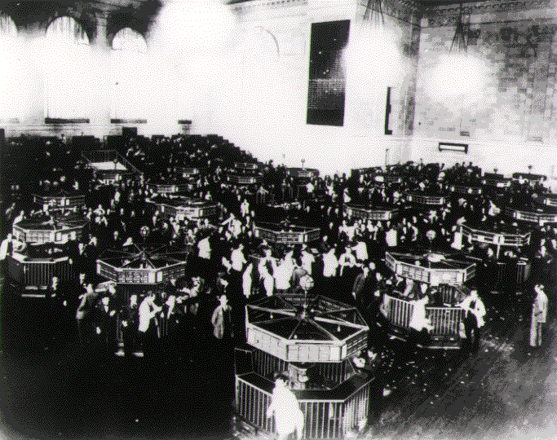
The Great Depression – Pre-Test
1. What event is generally regarded as leading to the start of the Great Depression in 1929?

Slide 2
The Great Depression – Pre-Test
2. In the early 1920s many people bought stock by only putting down as little as 10% of the stock’s purchase price, and then borrowing the rest from a brokerage firm. What was this risky practice known as?
A. installment-plan buying
B. cash-buying
C. margin-buying
D. consumer-credit

Slide 3
The Great Depression – Pre-Test
3. Because of his inability to solve the problems caused by the Depression, on whom did many Americans blame it?
A. Calvin Coolidge
B. Warren Harding
C. Herbert Hoover
D. Franklin Delano Roosevelt

Slide 4
The Great Depression – Pre-Test
4. Elected in 1932, which President was most responsible for trying to improve the American economy during the Great Depression?
A. Harry Truman
B. Franklin Delano Roosevelt
C. Herbert Hoover
D. Calvin Coolidge

Slide 5
The Great Depression
5. In 1933, at the height of the Great Depression, what percentage of the workforce in the US was unemployed?
A. 5%
B. 10%
C. 15%
D. 25%

Slide 6
The Great Depression – Pre-Test
6. What name was given to the programs of relief and recovery that were put into place to improve the US economy during the Great Depression?
A. The Square Deal
B. The New Deal
C. The New Freedom
D. The Five-Year Plan

Slide 7
The Great Depression – Pre-Test
7. Created in the 1930s, the Civilian Conservation Corps (CCC) and the Works Progress Administration (WPA) were designed to –
A. give tax breaks to big businesses
B. give land grants to farmers
C. raise the federal minimum wage
D. give people jobs

Slide 8
The Great Depression – Pre-Test
8. In the 1930s, what gov’t program was created to provide a minimum retirement income and income for people with disabilities?
A. Medicare
B. Social Security
C. Medicaid
D. TANF (Temporary Assistance for Needy Families)

Slide 9
The Great Depression – Pre-Test
9. Which of the following is characteristic of an economic depression?
A. large business investments and low taxes
B. consumer confidence and high stock prices
C. high employment and more investing
D. high unemployment and overproduction

Slide 10
The Great Depression – Pre-Test
10. In the 1930s what agency was created to try and regulate the stock market?
A. the Securities and Exchange Commission (SEC)
B. the Civil Works Administration (CWA)
C. the Works Progress Administration (WPA)
D. the Federal Trade Commission (FTC)

Slide 11
Intro Activity – The Great Depression
1. On the top half of your post-it note, write down as much as you know about the Great Depression.
2. On the bottom half, take a guess as to what percentage of the US labor force was unemployed at the height of the Great Depression.
3. Post your responses on the poster paper at the front of the room.

Slide 12
Intro Writing Prompt – The Great Depression
1. In one paragraph write a response to the following scenario. Imagine you’ve lost your job and you’re a single parent. Now imagine…
you can’t pay your bills…
you have no savings on which to fall back…
there are no gov’t programs that can provide assistance for you….
you have no family in the area to help…
you have two children (ages 3 and 6) that are depending on you…
What would you do? How would you survive? Describe what you would do.

Slide 13
The Great Depression
Causes and Solutions

Slide 14
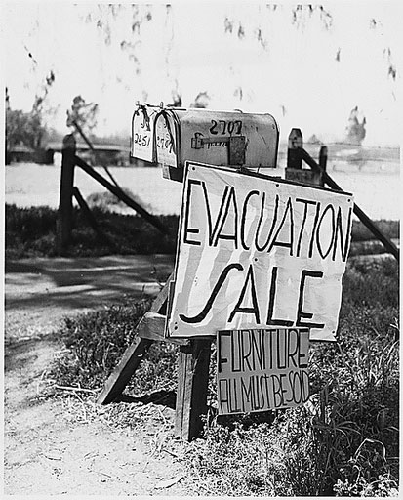
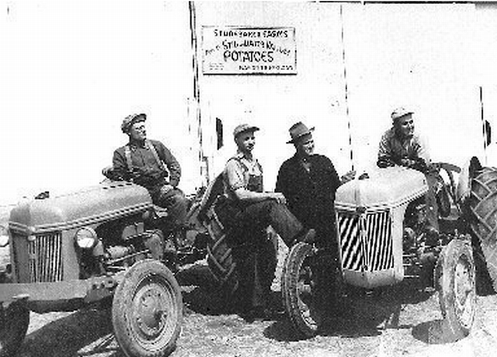
Causes of the Great Depression – Problems Plague the Agricultural Sector
Demand for crops fell after WWI – harder for farmers to sell crops
Rural depression – farmers were living on credit, had trouble paying debts and loans, lose farms

Slide 15
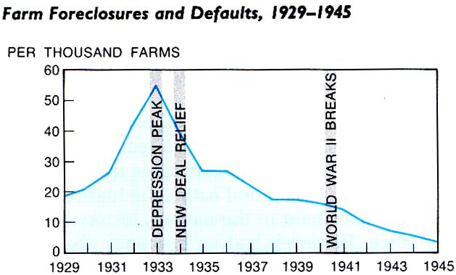

Slide 16
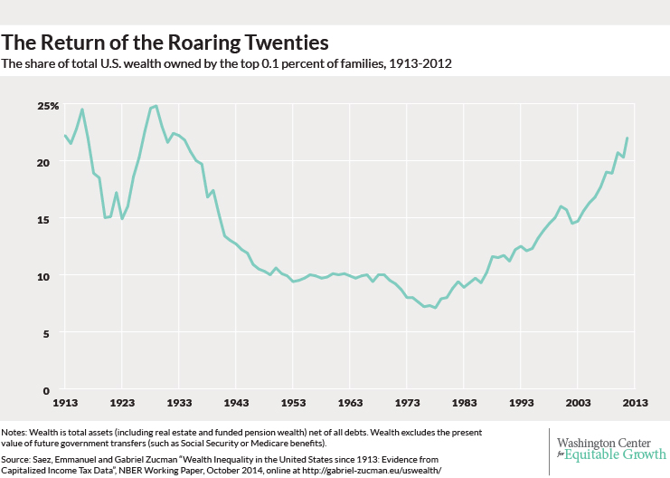

Slide 17
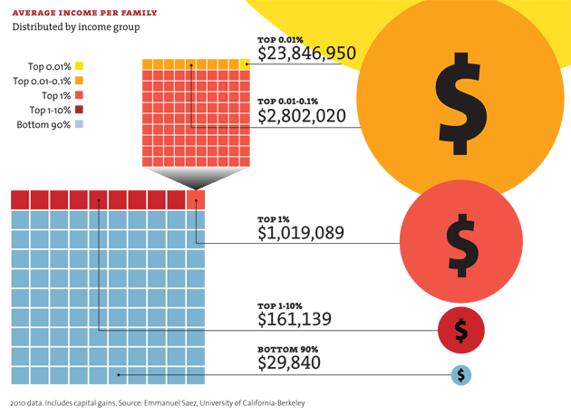

Slide 18
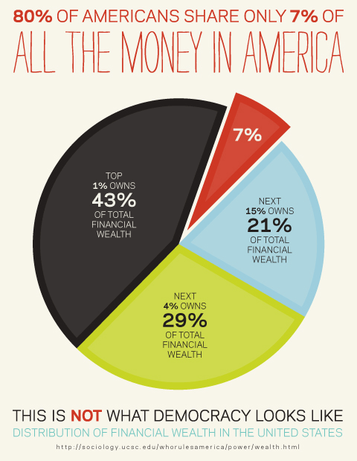

Slide 19
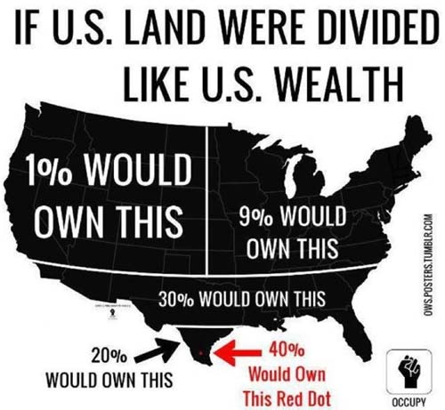

Slide 20
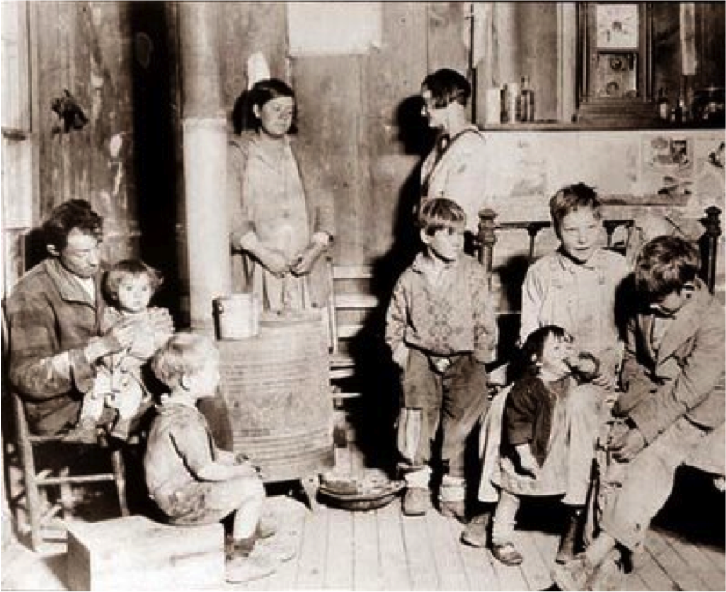
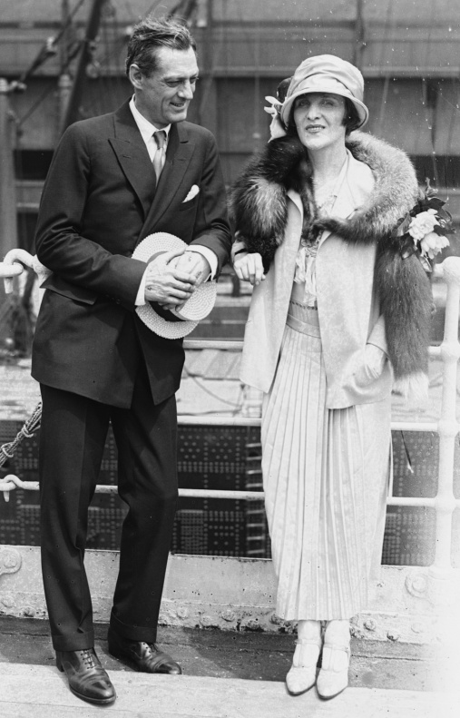
Causes of the Great Depression – Uneven Wealth Distribution
Huge wealth gap between rich and poor
Wealthy spent, but not enough to keep a healthy economy booming

Slide 21
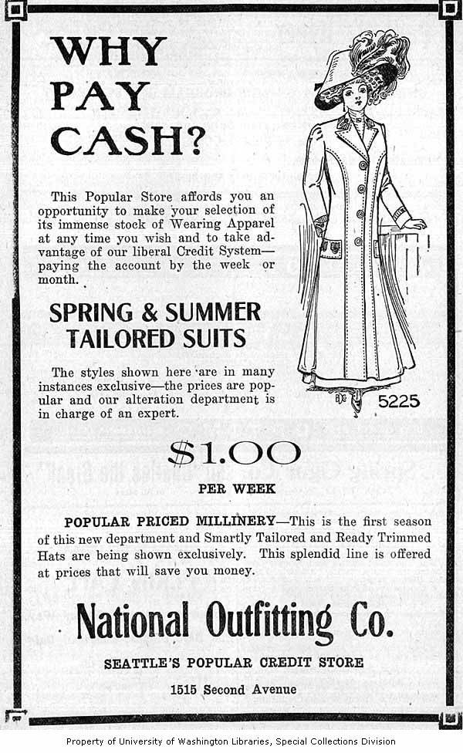
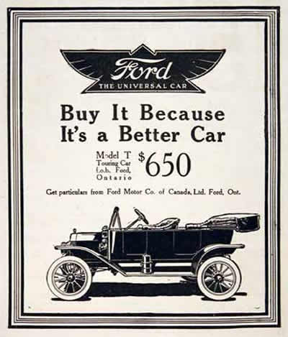
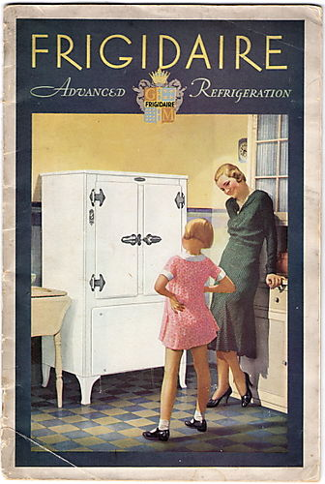
Causes of the Great Depression – Easy Credit Hides Problems
Expansion of credit and installment buying – people live well beyond their means – buying goods using installment buying and using credit – consumer debt rises!!
Companies produced more than they could sell (overproduction) – surplus of goods leads to fall in prices and slowed activity – people start losing jobs

Slide 22
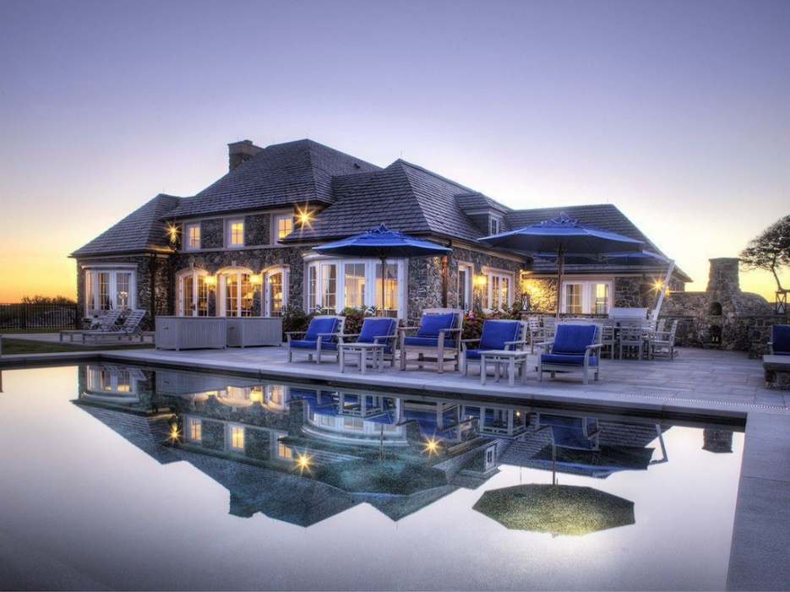
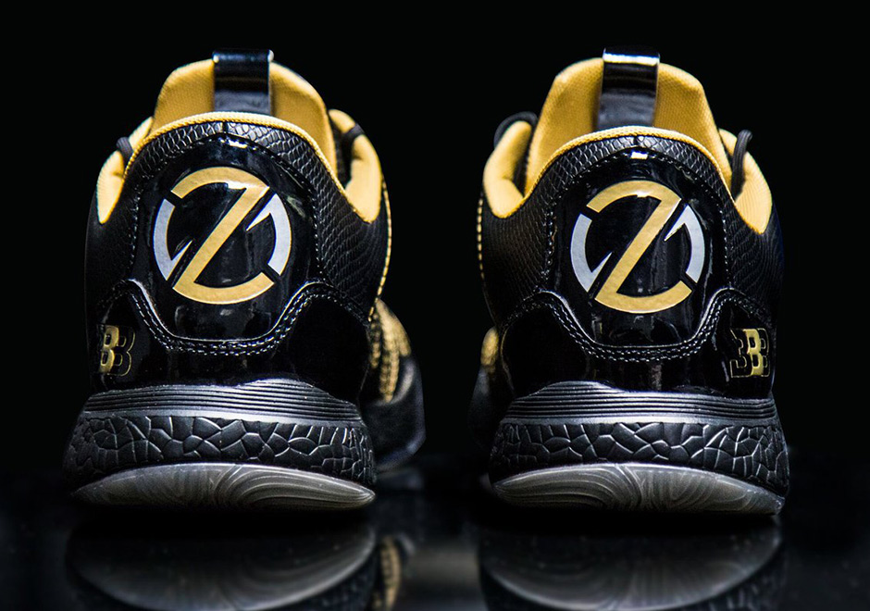

Slide 25
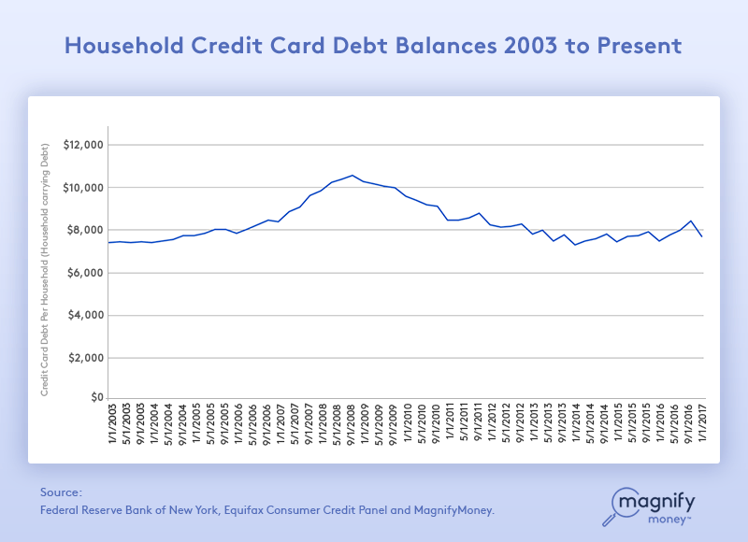

Slide 26
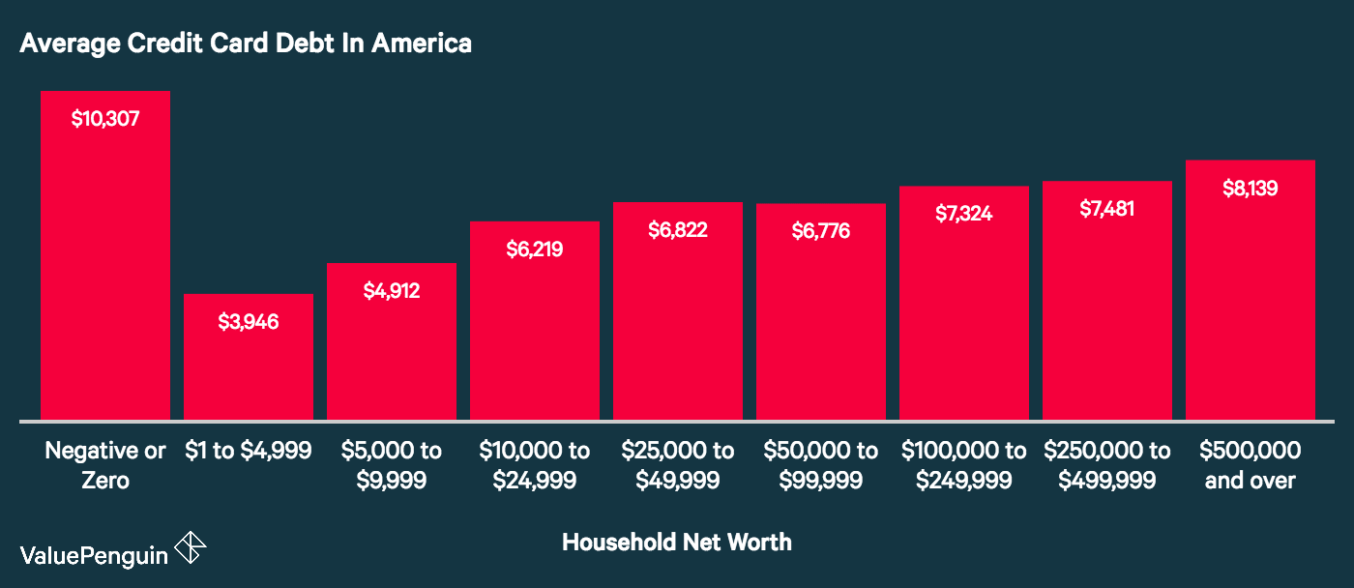

Slide 27
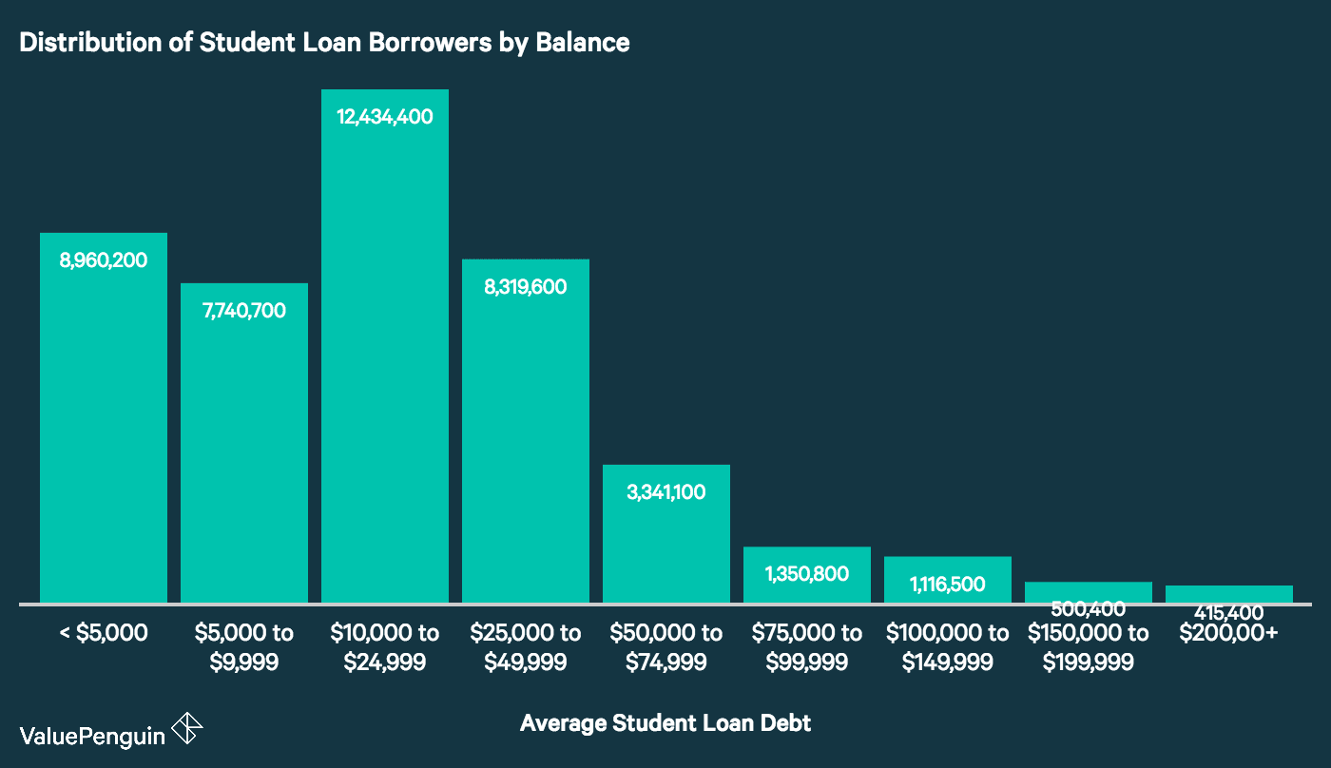

Slide 28
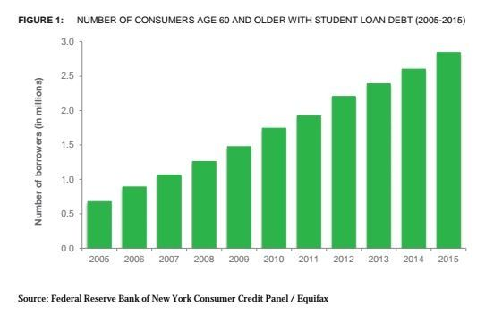

Slide 29
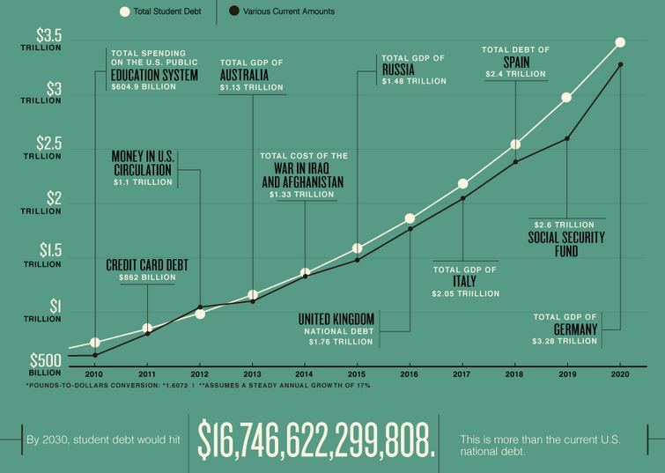

Slide 30
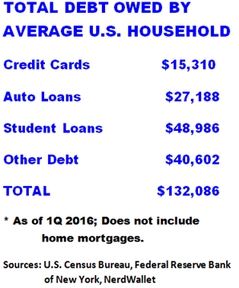

Slide 31
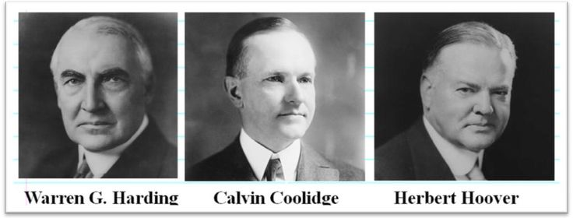
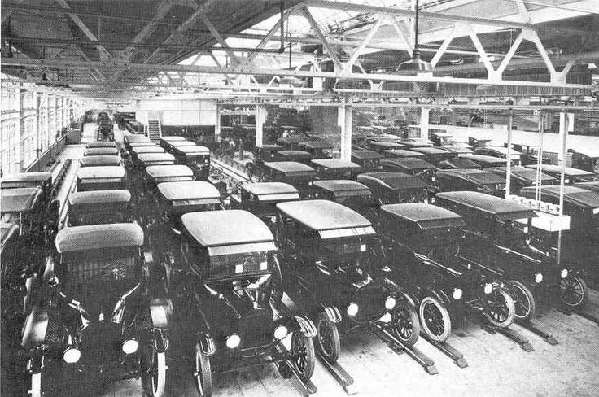
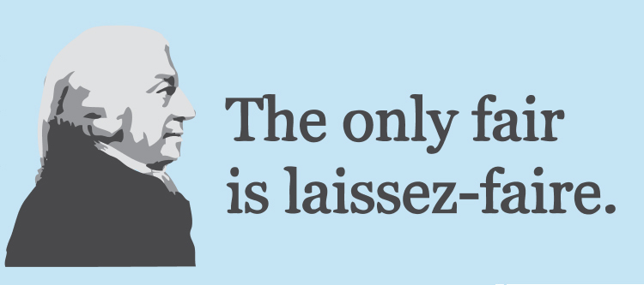
Causes of the Great Depression
Also….
Presidents supported laissez-faire – intervene in economy as little as possible – gov’t not prepared!

Slide 32
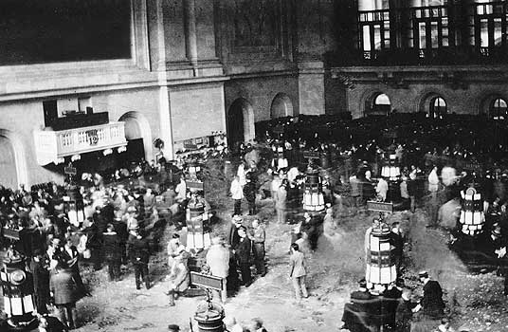

Slide 33
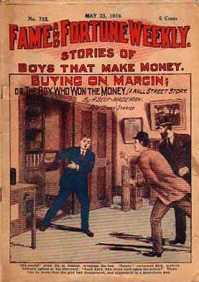
Causes of the Great Depression – Problems in the Stock Market
Speculation: unsafe investing – companies lied about their success
Investors bought unsafe stocks – bought stocks on margin – put 10% down, took loans to buy stocks based on projected success

Slide 34
How does the stock market work?
You buy 100 shares of stock of
How much money have you invested?
x $5.00 per share
$500.00
Scenario #1
stock increases to $20 per share
How much are your 100 shares of stock now worth?
How much profit have you made?
100 shares of stock
$2,000.00 stock value
x $20.00 per share
- $500.00 initial investment
$2,000.00
$1,500.00 net profit

Slide 35
How does the stock market work?
You buy 100 shares of stock of
How much money have you invested?
x $5.00 per share
$500.00
Scenario #2
stock decreases to $1 per share
How much are your 100 shares of stock now worth?
How much money have you lost?
100 shares of stock
$100.00 stock value
x $1 per share
- $500.00 initial investment
$100.00
$400.00 net loss

Slide 36
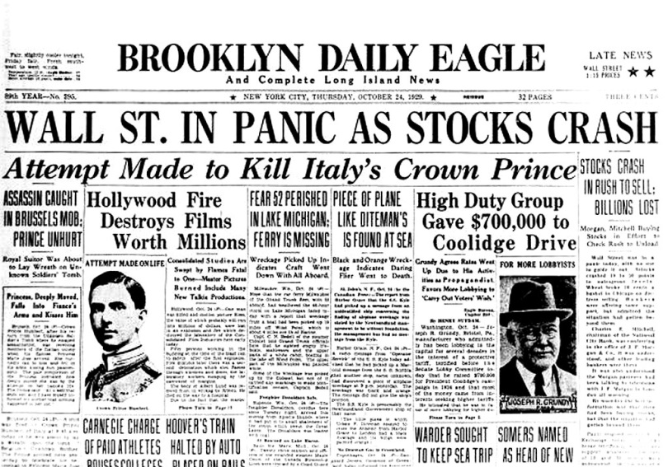
Causes of Great Depression – The Crash Begins
Stock Market Crash
Prices began to fall
Investors began to panic and sell their stock
Black Tuesday October 29, 1929
The market crashed – 16 million shares of stock sold on one day!

Slide 37
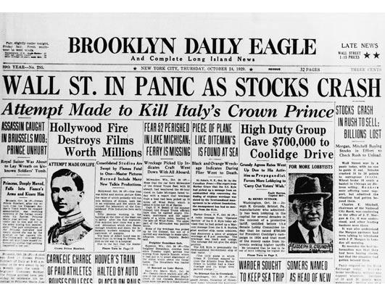
Black Tuesday – October 29, 1919: The Results
1. A record 16.4 million shares are traded (the previous record had been 12.9 million shares on Black Thursday)
2. The stock market loses an estimated $14 billion in one day, which was:
A. More than the United States had spent during World War I

Slide 38
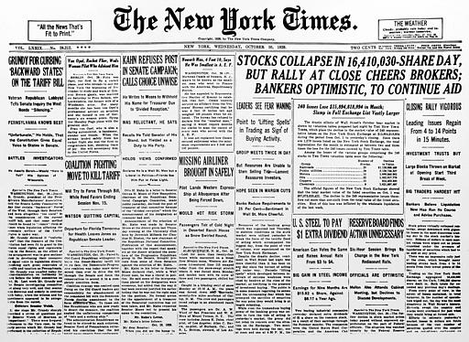

Slide 40
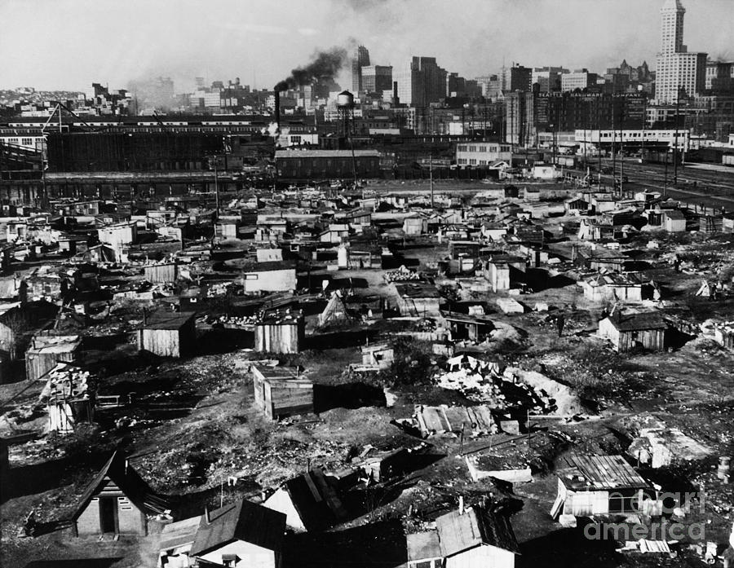
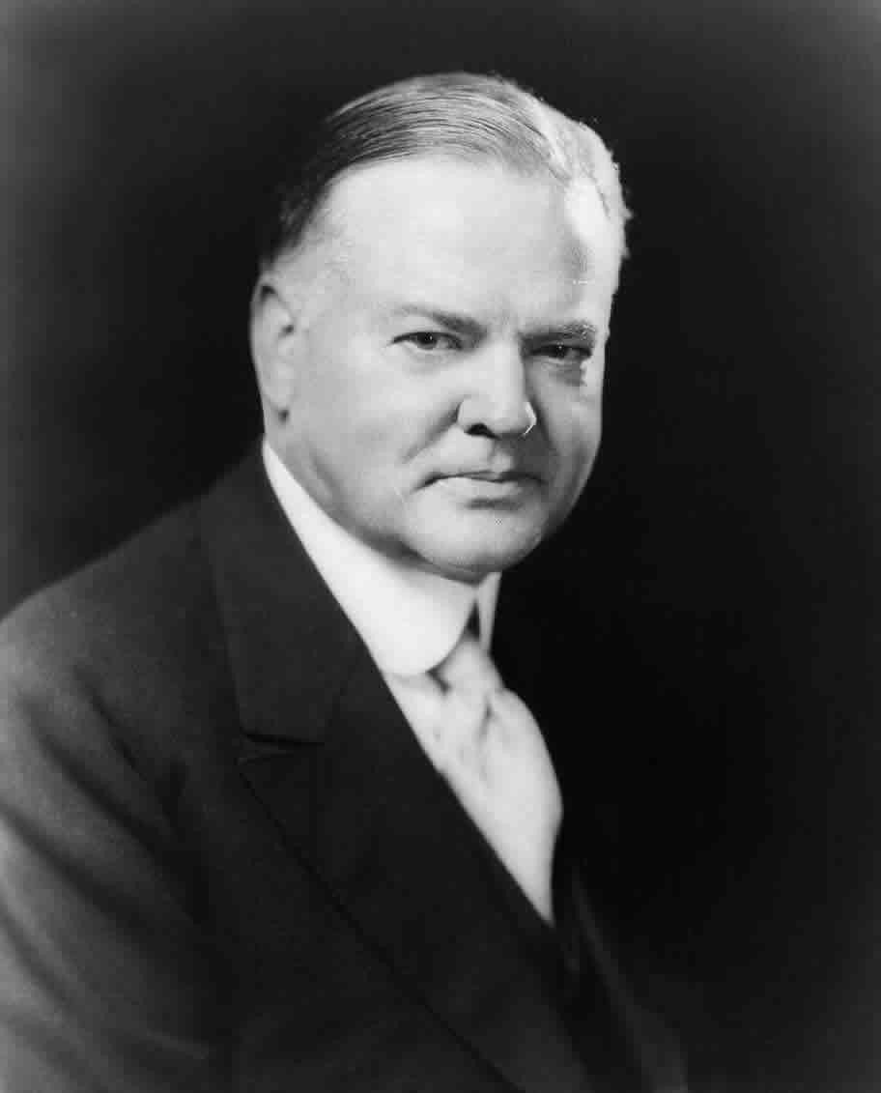
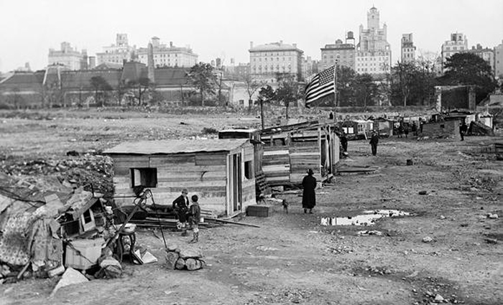
“Hoovervilles”

Slide 41
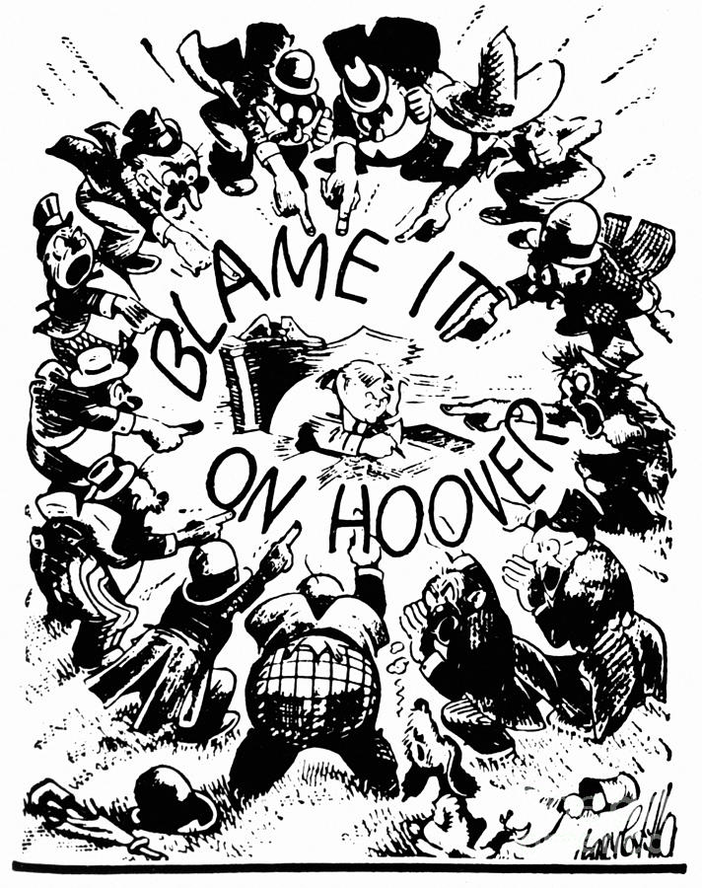

Slide 42
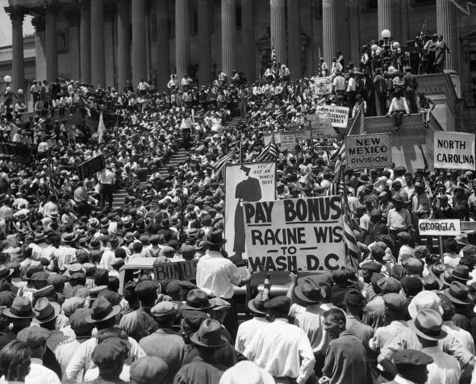
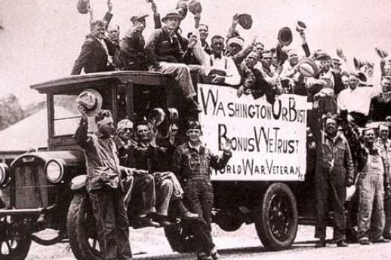
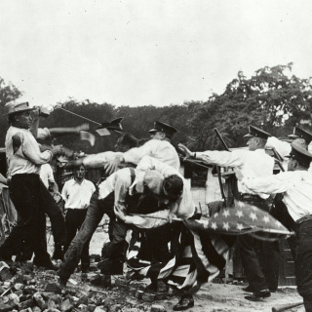
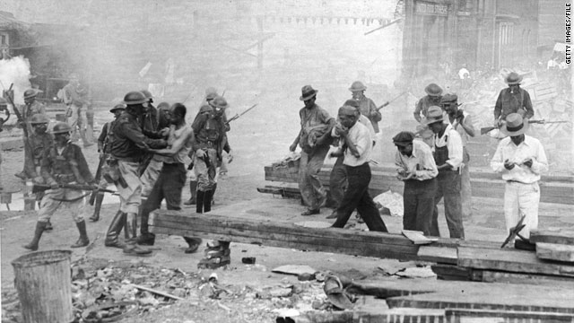

Slide 43
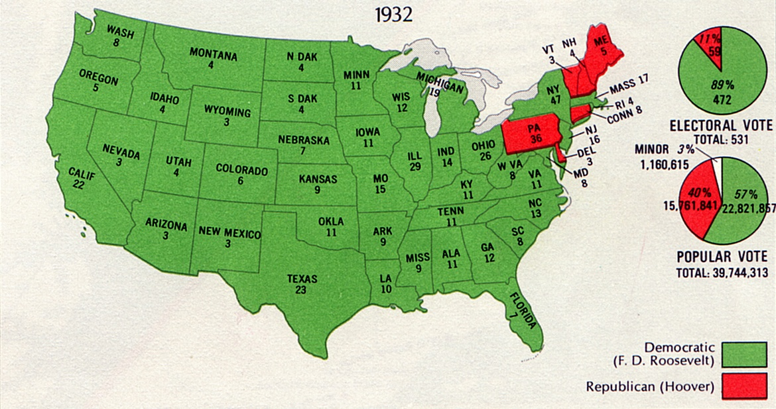

Slide 44
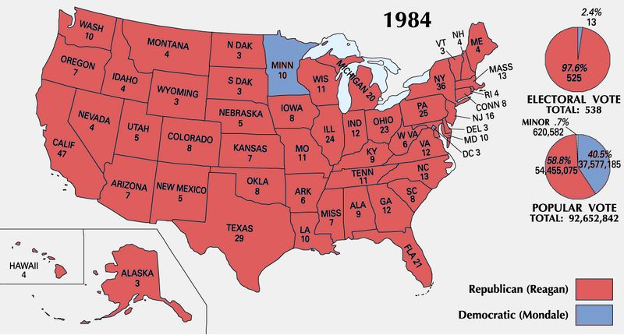

Slide 45
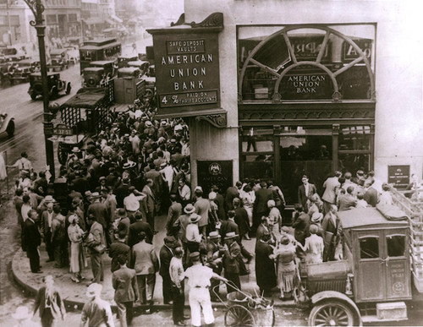
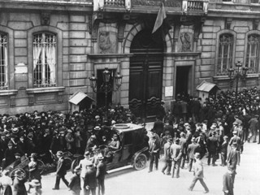
Banks Collapse
1. Banks closed due to mass withdrawals of deposits (“bank runs”) – banks speculated in the stock market with people’s money – when market crashed, banks lost money
2. Throughout the 1930s an estimated 6,000 banks failed across the US

Slide 46
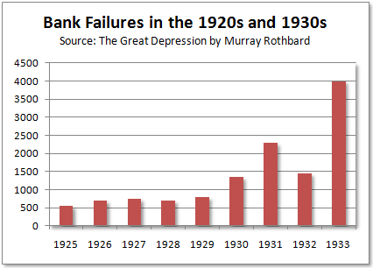

Slide 47
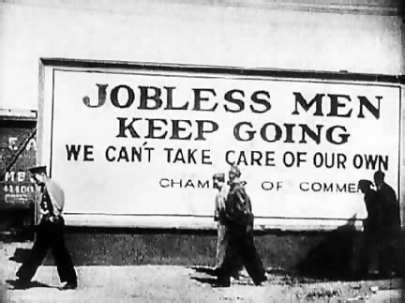
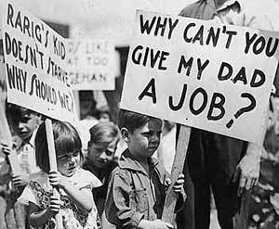
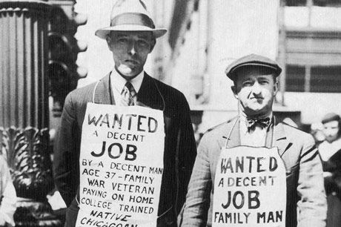
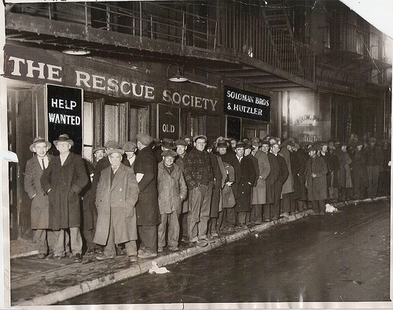

Slide 48
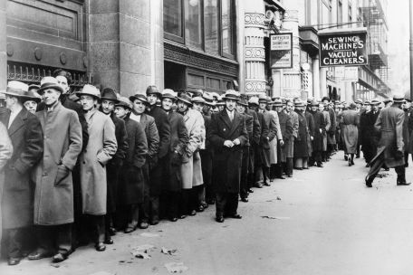
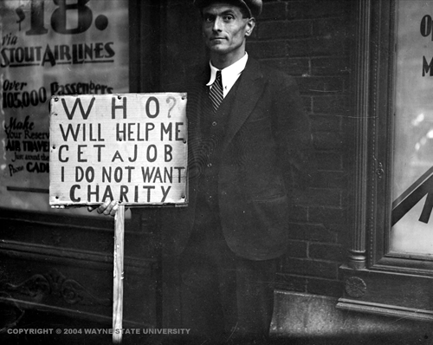
Effects of the Great Depression – Businesses Close and Unemployment Grows
Thousands of businesses close – due mainly to overproduction of goods and drop in consumer spending
High unemployment – workers lose jobs, incomes/wages reduced
25% of Americans were unemployed by 1933

Slide 49
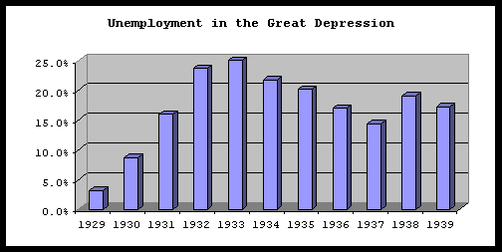

Slide 50
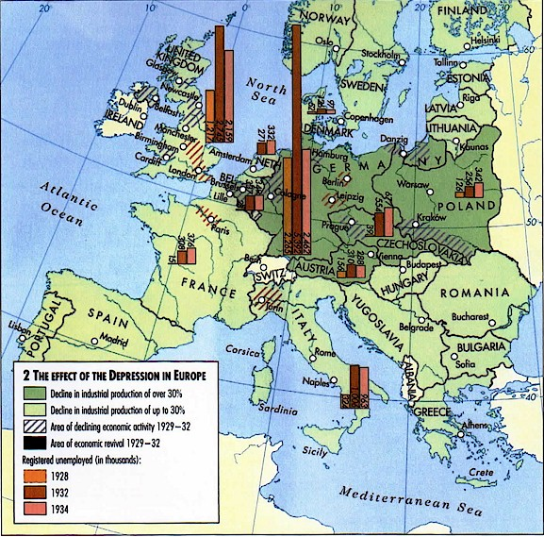

Slide 55
Effects of the Great Depression – Businesses Close and Unemployment Grows
Widespread poverty, appearance of breadlines/soup kitchens, homelessness, hunger, despair
The “Dust Bowl” (due to over farming and drought) ravages the Great Plains – people lose farms, millions migrate westward (known as “Okies”) or to cities looking for opportunities

Slide 56
Effects of Great Depression – Tariffs Add to the Woes
June 1930 – US Congress passes Hawley-Smoot Tariff – raises prices on foreign goods – other countries do the same against US exports
Almost stops world trade – countries can’t sell goods – sink deeper into depression

Slide 57
Effects of the Great Depression – Worldwide Depression
Many European economies had been funded by US loans
American loans drastically reduced during depression – Europeans unable to pay off war debts

