Slide 1
Unit V Influencers of Democracy
POLITICAL PARTIES

Slide 2
Essential Question
How does various unelected groups influence the political process, the political landscape and the United States governing institutions?

Slide 3
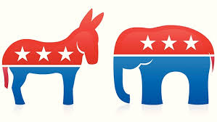
PMI-5: Political parties, interest groups, and social movements provide opportunities for participation and influence how people relate to government and policymakers
PMI 5.A: Describe linkage institutions
PMI 5.B: Explain the functions and impact of political parties on the electorate and government
Essential Questions: How does various unelected groups influence the political process, the political landscape and the United States governing institutions?
Students Can:
Evaluate the functions and impacts political parties have on the democratic process of our government
AGENDA
Factionalism in America
The Role of the Party
Political Party Effect
HOMEWORK
This Election has Gone Critical

Slide 4
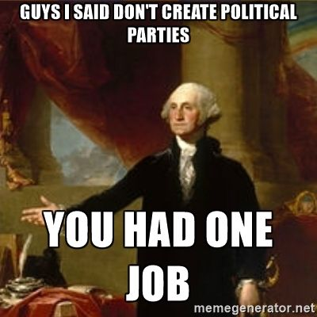
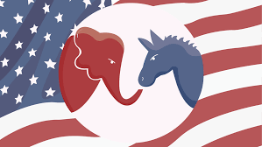
Debating the Two Party System
Soon after the establishment of the U.S. Constitution the founders adapted their idea of representative democracy to include political parties. For most of the history of the United States our democracy has been governed by two political parties. But does the two party system effectively support out democracy.
Two Party System – Let’s ditch this party, it’s LAME!
Two Party System – It’s a RAGER!

Slide 5
Factionalism
“Liberty is to faction, what air is to fire, an ailment without which it instantly expires. But it could not be a less folly to abolish liberty, which is essential to political life, because it nourishes faction, than it would be to wish the annihilation of air, which is essential to animal life, because it imparts to fire its destructive agency.”
- James Madison, Federalist 10
Explain how political parties supports Madison’s argument in Federalist 10.
Explain whether political parties support pluralism or hyper-pluralism in American democracy.

Slide 6
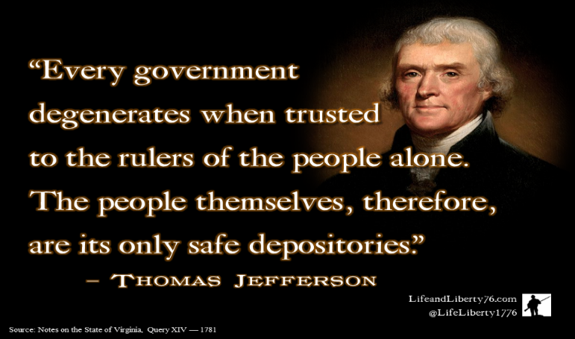
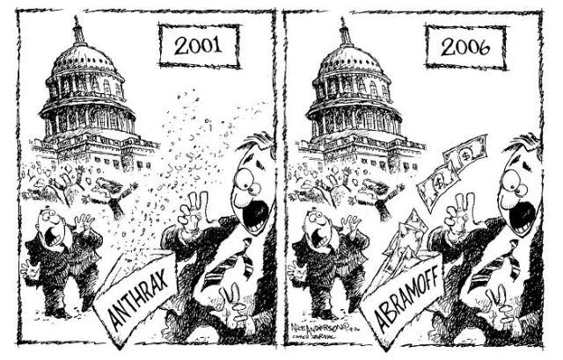
The Unelected Connector
The United States political system is influenced by a variety of unelected groups that focused on checking government’s power
Linkage Institutions: unelected groups that connect the people to government (promoted by the 1st Amendment)
Political Parties
Elections
Mass Media
Interest Groups
Trusted advocate of the people
Dangerous interloper of the unelected
or

Slide 7
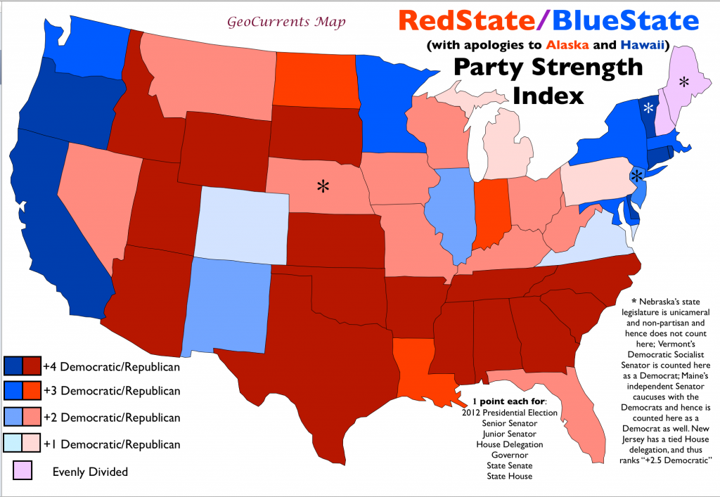
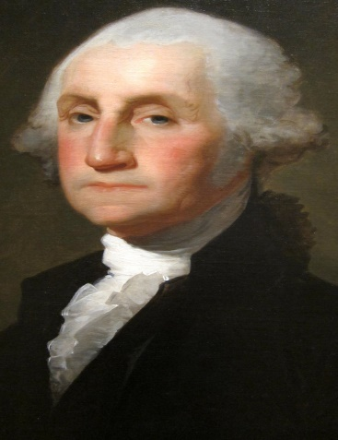
Political Parties
Political Party: Advocates of multiple public policies that work to get their ideas in government through elections.
Two Party System - Founding Fathers were against their use, yet today they are main stay (traditional change to the Constitution)
Convenient way to promote
public policy
However, [political parties] may now and then answer popular ends, they may likely in the course of time and things, to become potent engines, by which cunning, ambitious, and unprincipled men will be able to subvert the power of the people and to usurp for themselves the reins of government, destroying afterwards the very engines which have lifted them to an unjust dominion.”
- George Washington, Farewell Address, 1796
Preach!!!!!
How correct was Washington’s warning about the institution of political parties into our constitutional democracy?

Slide 8
Decentralized Structure
National Committee head by a Chairperson: fundraising, national convention, party platform, and recruit candidates
Issues:
Federalism: election laws on campaigning and finance
Inter party competition: primary elections (who goes first)
Ideological splits (factionalism)
State Committees: (1 per state):
Select national committee rep.
Support state and national candidates
Local Committee: Precinct Captain
Canvass voters
Get out to vote to promote candidates

Slide 9
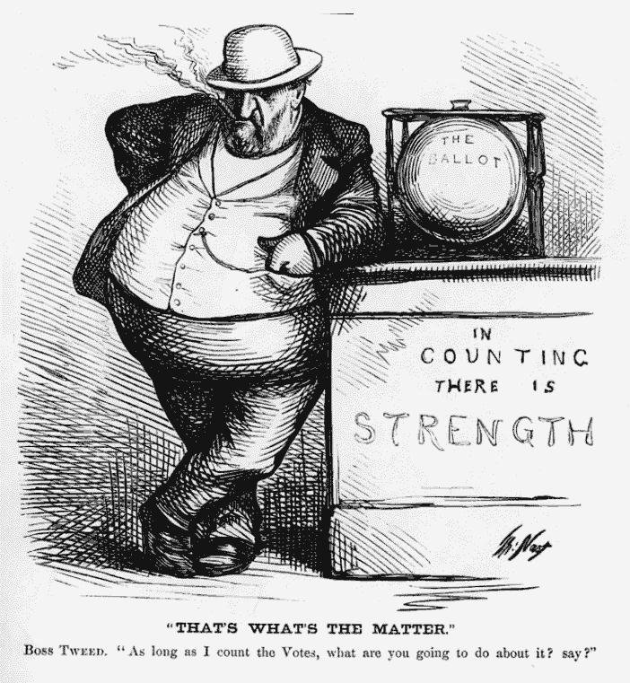
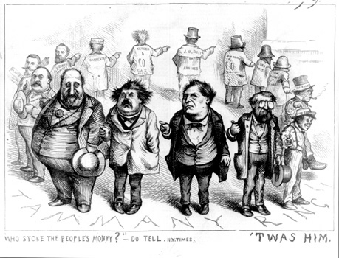
All Politics is Local
Local level motivates the grassroots (the people) – canvasing, voting, campaigning, & public policy issues
Leadership: precinct captains
Issue: Political Machine – controls voting
and take advantage of patronage
Protections (Progressive Reforms)
Voter registration
Australian Ballot
Poll watchers
Primary system

Slide 10
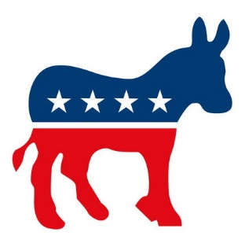
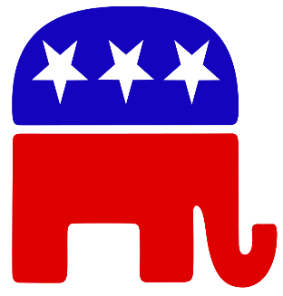
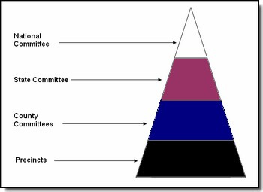
Political Party Structure
The American political party structure is designed to carry out multiple task at the same time. Use the following task and explain how the different levels help carry out the task.
Recruit candidates
Carry the people’s message (The Grassroots Movement)
Cue Voters
Campaigning
Nominate candidates
Unify the electorate
Watchdog role (opposition)
Help organize government

Slide 11
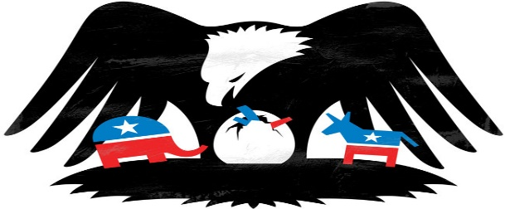
This Election has gone Critical
Critical Elections Assignment
Evaluate whether the following elections are critical elections
Federalists: Election of 1790
Democrat-Republicans: Election of 1800
Jackson Democrats: Election of 1824
Whig Party: Election of 1840
Republican Party: Election of 1860
Populist Party: Election of 1896
Democrat Party: Election of 1932
Democrat Party: Election of 1964
Conservative Coalition: Election of 1980

Slide 12
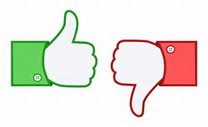
Promotion of Republicanism
How effective are political parties at acting as a linkage institution and helping promoting republicanism?
Select candidates
Run campaigns
Cue the electorate (party identification)
Articulate policy (Rep. = Conservative
& Dem. = Liberal)
Coordinate policy makers
Construct an argument summary as to whether we should to continue to use political parties in our modern democracy

Slide 13
PMI-5: Political parties, interest groups, and social movements provide opportunities for participation and influence how people relate to government and policymakers
PMI 5.A: Describe linkage institutions
PMI 5.B: Explain the functions and impact of political parties on the electorate and government
Essential Questions: How does various unelected groups influence the political process, the political landscape and the United States governing institutions?
Students Can:
Evaluate the functions and impacts political parties have on the democratic process of our government
AGENDA
An Effective TWO Party System?
The Role of the Party
Political Party Effect
HOMEWORK
This Election has Gone Critical

Slide 14
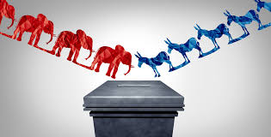
Effectiveness??????
Evaluate whether the two-party system works for American democracy (Choose 2)
Carrying the people’s message:
Promoting pluralism in American democracy
Unifying the electorate

Slide 15
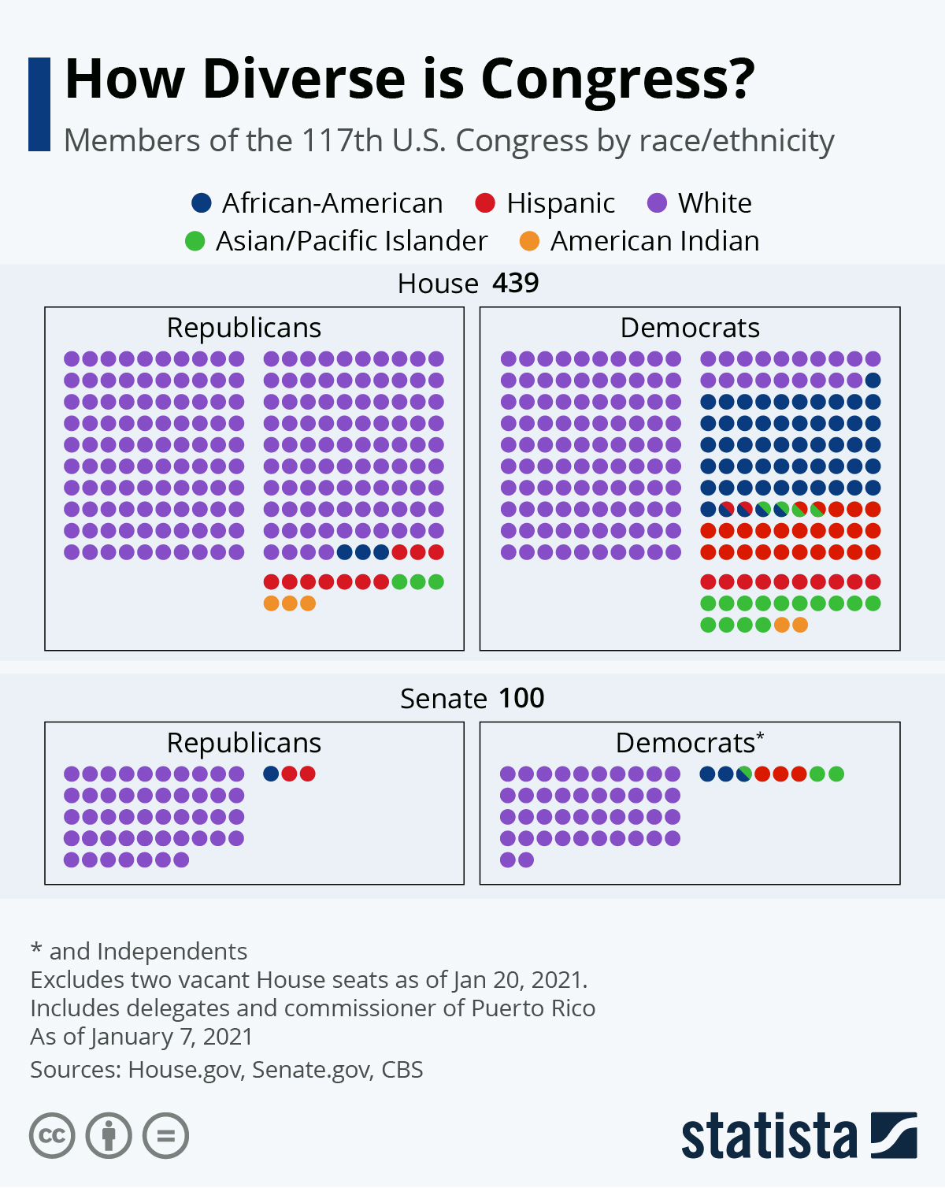
Wielding Political Power
Party politics in government
Majority v. Minority party in State legislatures = Gerrymandering (control of the HOR)
Majority v. Minority party in Congress
Can pass legislation
Control of committees (chairs & majority members)
Key leadership roles (Speaker of the House)
Senate - Power over appointment (especially fed. Court judges)
Pork barreling

Slide 16
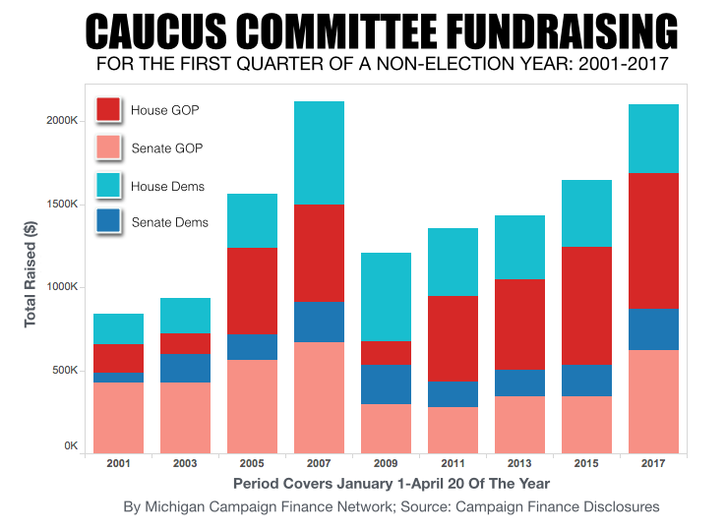
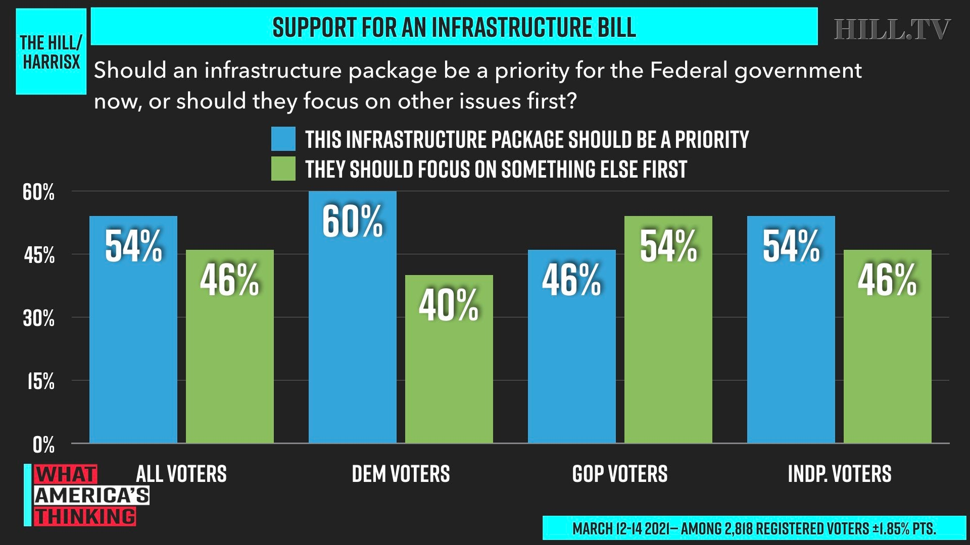
The reach of the Hill
Hill Committees: Special non-legislative committees (Ex. Democratic Congress Campaign Committee & National Republican Congressional Committee)
Recruit candidates for open seats
Conduct public opinion polls
Fundraising
Create political ads

Slide 17
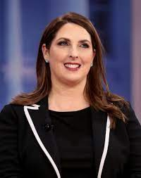
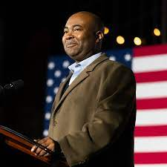
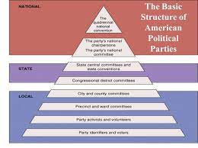
Building the Party Machine
Structure of the Political Party - Decentralized organization
RNC v. DNC
Ronna McDaniel (R)
Jamie Harrison (D)
National Chairperson:
Guide the party’s day-to-day operations
Fundraising
Convey party messaging
Recruit members
Plan nation convention

Slide 18
Trend in Politics
Democrat
Republican
Independent
Party De-alignment
Describe the trend the graph depicts.
Explain why the trends selected in part one exist in today’s political landscape?

Slide 19
A Candidate Appeal
Micro-targeting – using various means of communication to reach voters to build support
How does the campaign ad utilize micro-targeting to support the candidacy of Donald Trump?
How does Donald Trump’s campaign strategy demonstrate the idea of candidate centered politics?

Slide 20
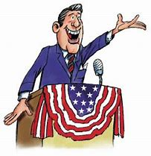
Delegate vs. Trustee
Ideal representation?
Delegate role
Trustee role
Government elected officials are elected to carry out the ideas & views of the people who they represent
The people trust their elected officials to do what is in their best interest based on his/her experiences

Slide 21
PMI-5: Political parties, interest groups, and social movements provide opportunities for participation and influence how people relate to government and policymakers
PMI 5.A: Describe linkage institutions
PMI 5.B: Explain the functions and impact of political parties on the electorate and government
Essential Questions: How does various unelected groups influence the political process, the political landscape and the United States governing institutions?
Students Can:
Evaluate the functions and impacts political parties have on the democratic process of our government
Explain why and how political parties change and adapt
AGENDA
The 2016 Trend
Critical Elections in America
Identifying Election Cycles
HOMEWORK
The Third Wheel of Politics

Slide 22
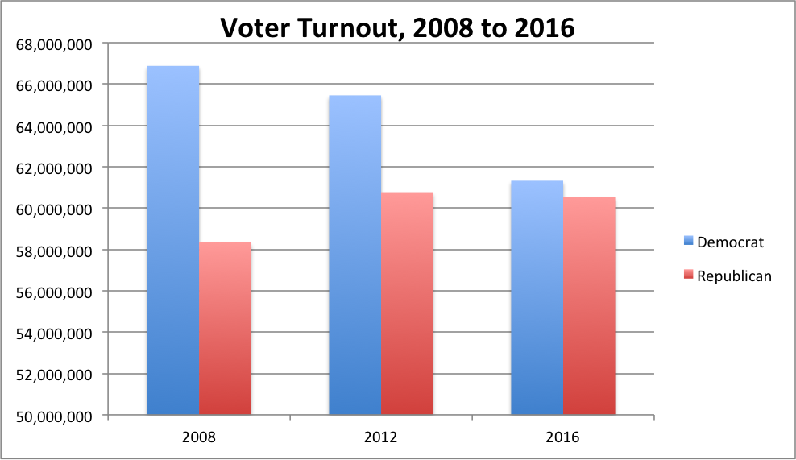
2016 Going Critical
Evaluate whether the election of 2016 was a critical election. Use at least two guidelines of realigning elections to demonstrate your conclusion.

Slide 23
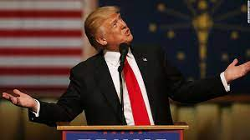
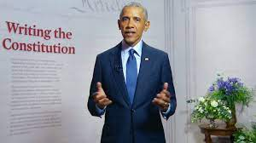
Leaning to the Candidate
Candidate centered politics – focus on the candidate instead of the party
Factors:
Rise of social media
Mass media – agenda setting, horse race journalism & sensationalism (crafting media presence)
Interest groups electioneering: PACS & Super PACs – issue advocacy ads
Being the face of the party
Being the face of the party
Impact:
Growth of incumbency
Growth of name recognition
Growth of party polarization

Slide 24
De-aligning political movement
Party Dealignment – rise of voters declaring themselves independents (only 60% of voters identify as a member of Dems. or Reps.)
Growth of split ticket voting
Truly independent (about of 1/3 of independents – most still lean towards one of the political parties)

Slide 25
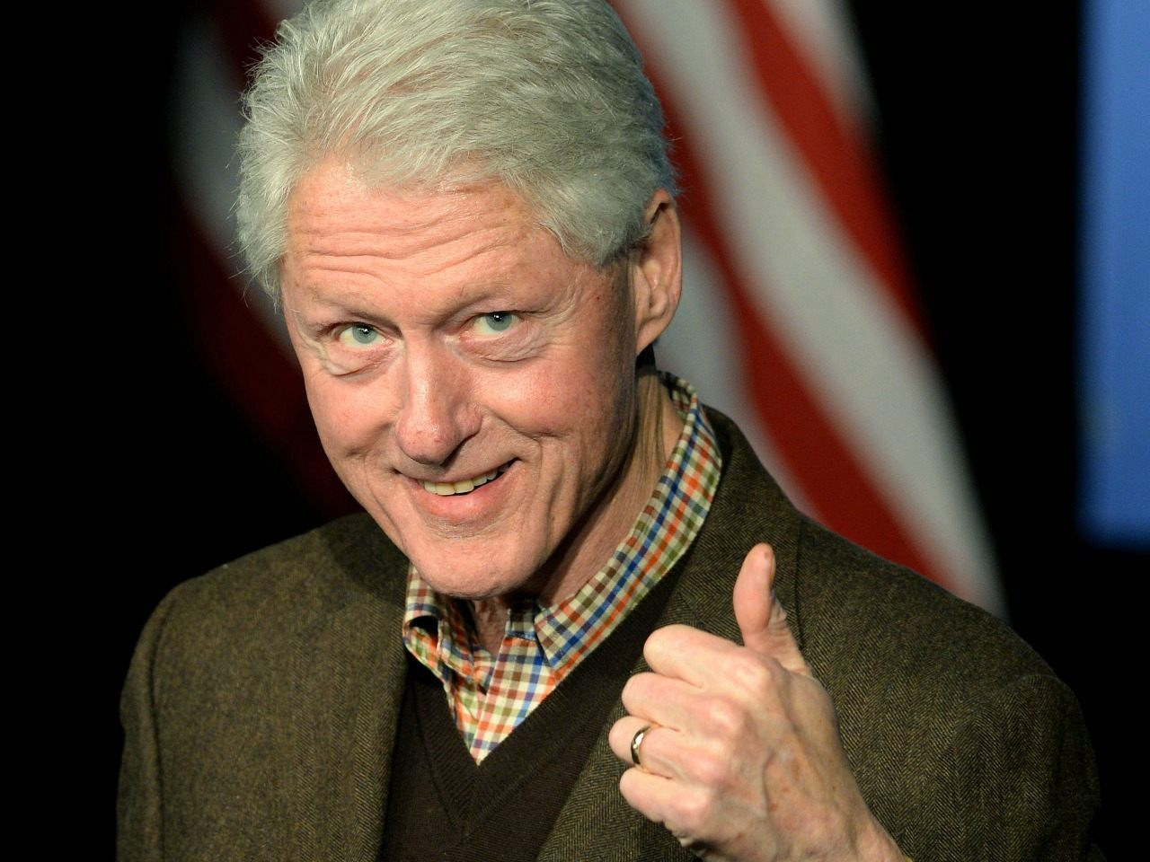
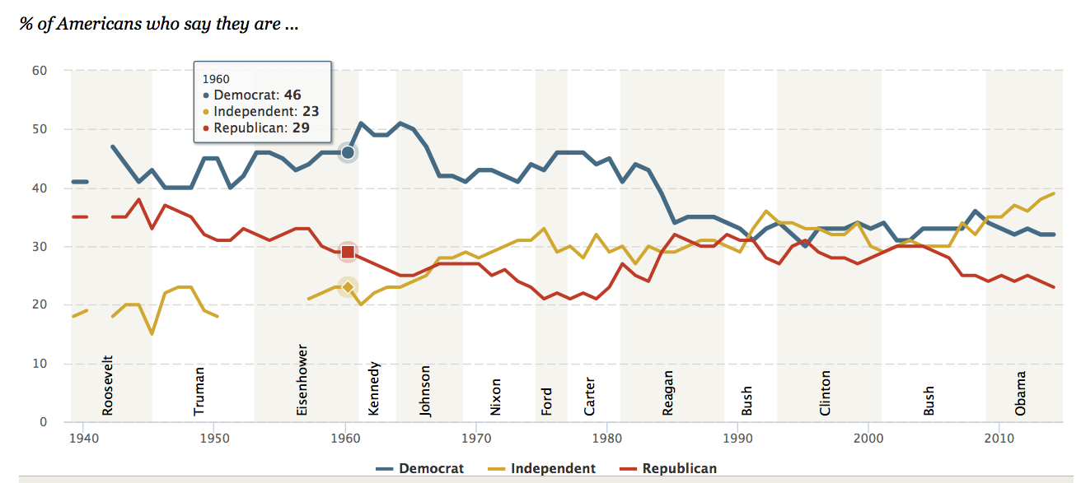
Party Transformation
United States – TWO Party System
You cannot resist me America!!!
Transformation: Political Parties are weakening
Change from party-centered to candidate centered politics
De-alignment – Rise of the Independence
Primary system for nominating elections
Rise of Interest Groups use of electioneering

Slide 26
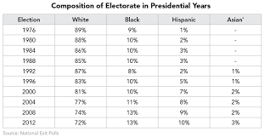
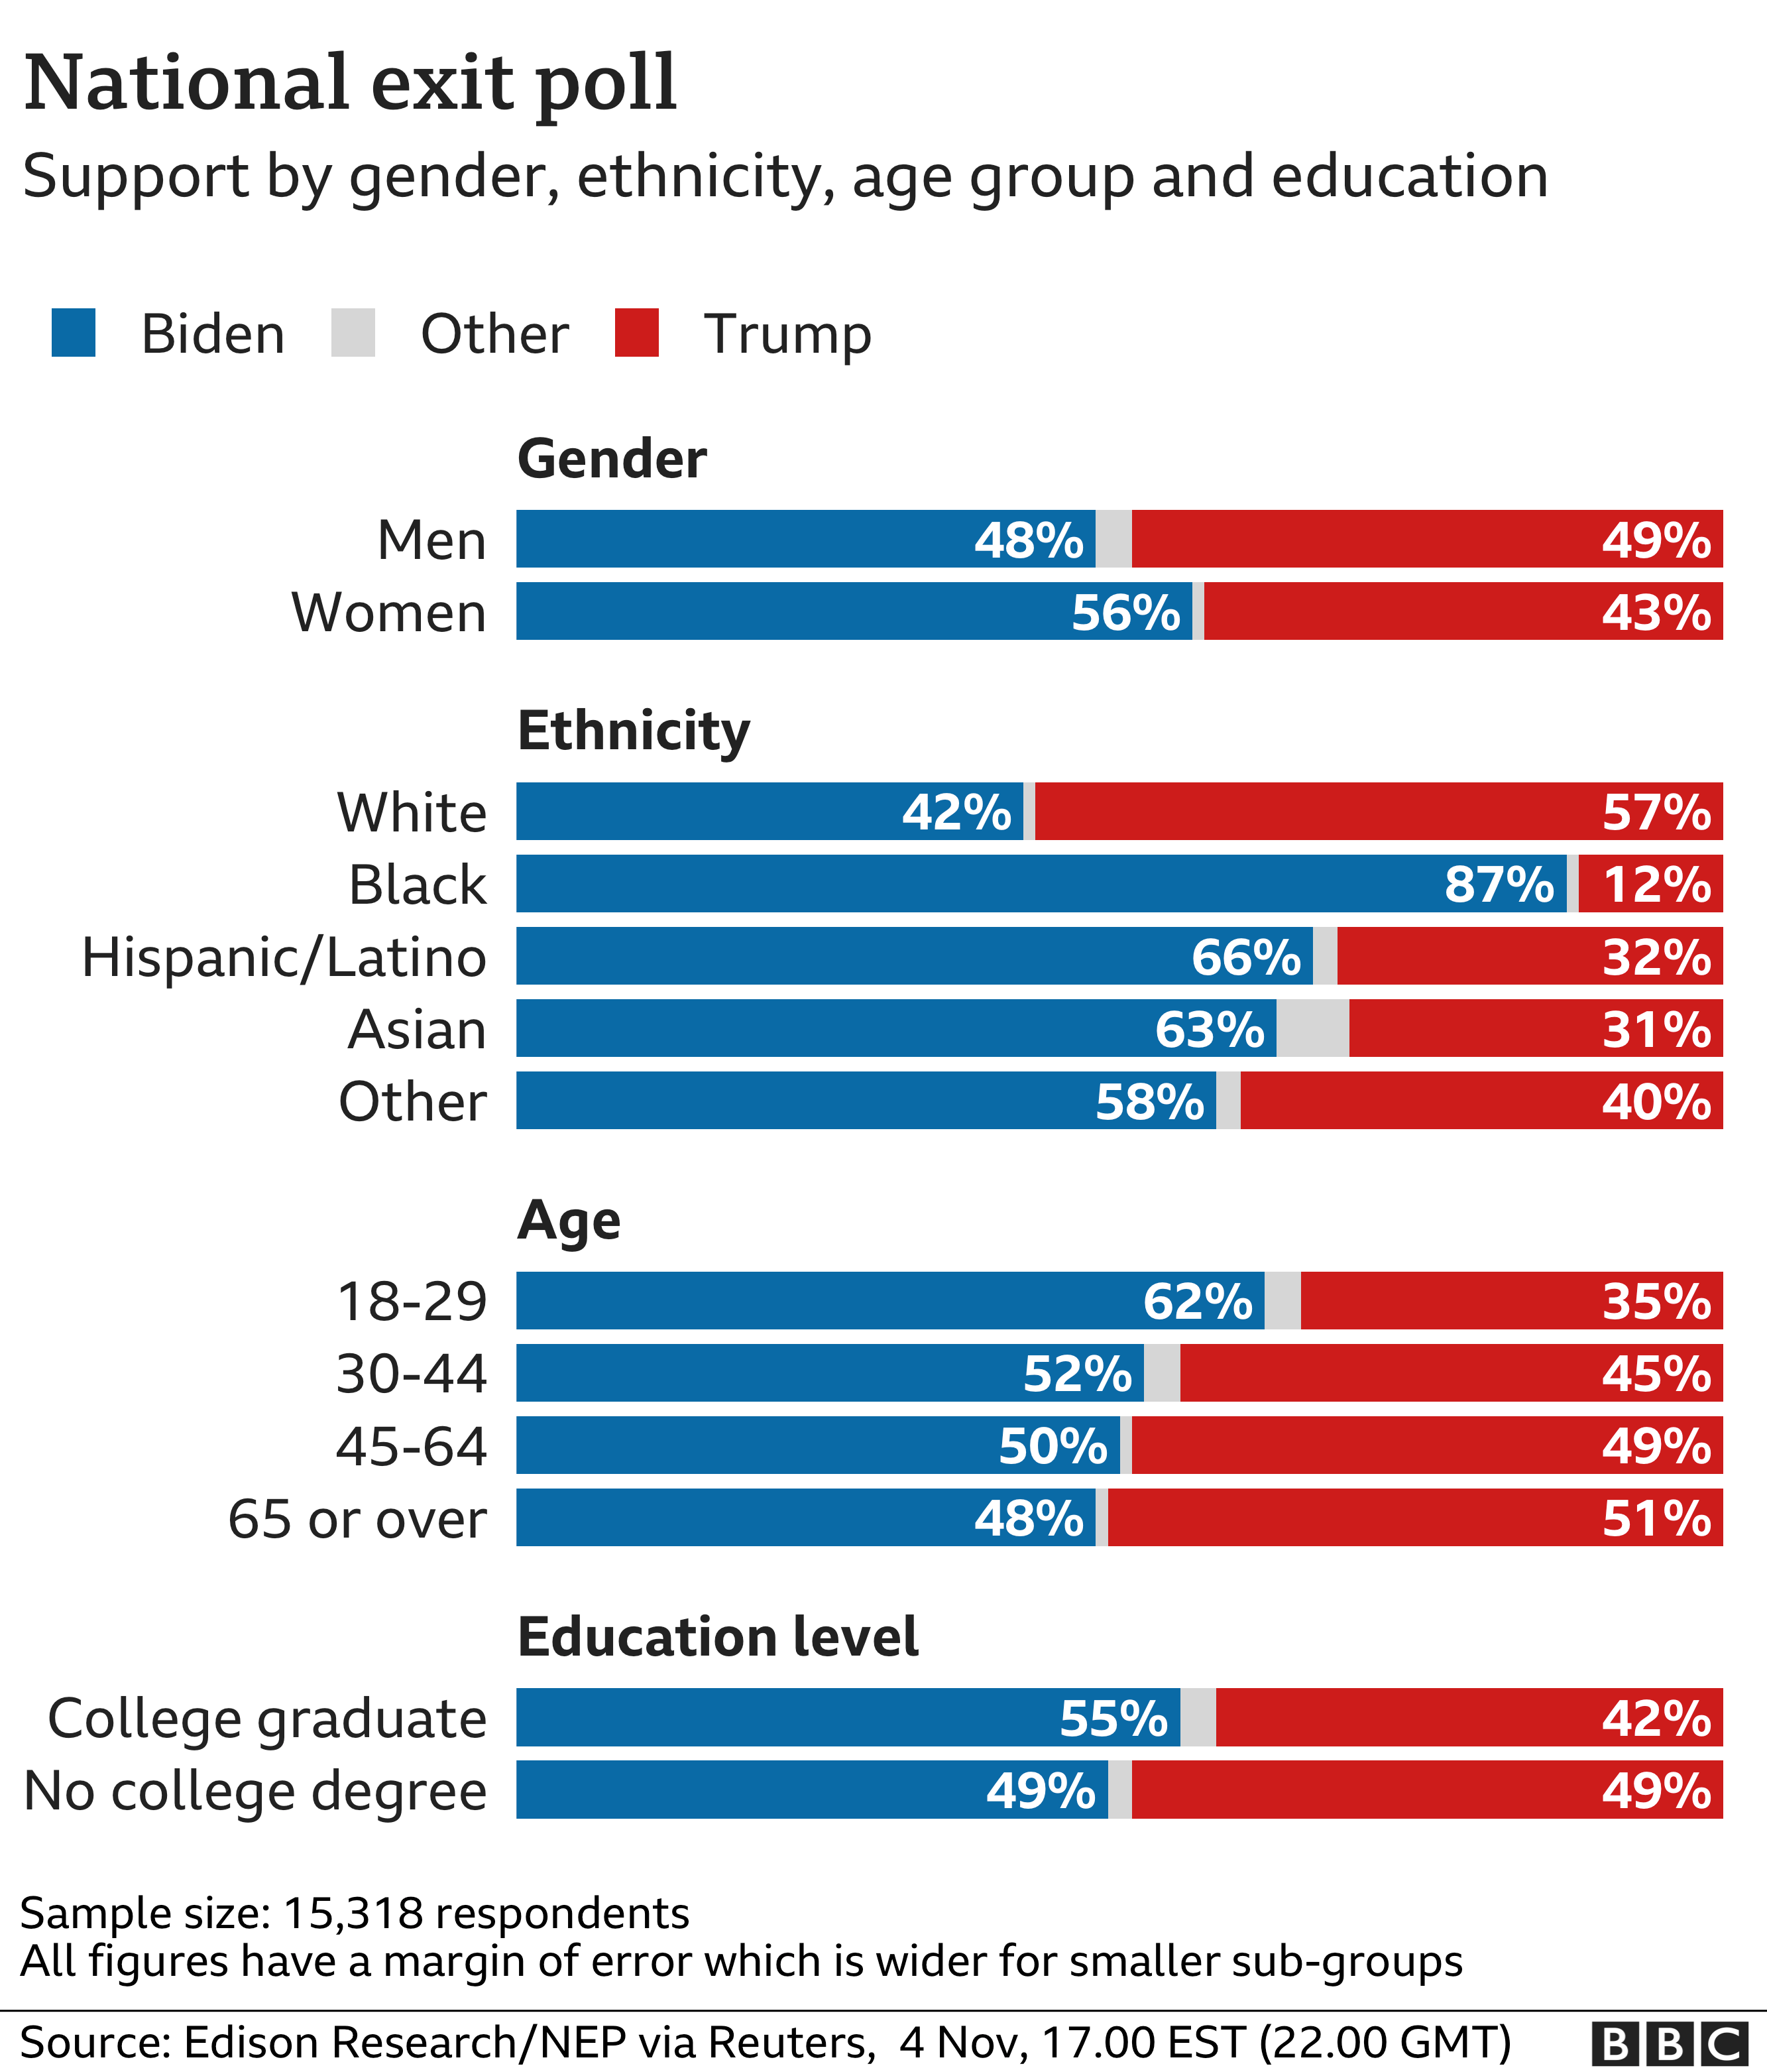
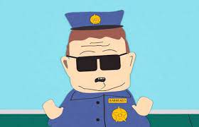
The Status Quo
Maintaining Elections: No major political upheavals and maintains the current status of the two party system (most common type)
There is nothing to see here!

Slide 27
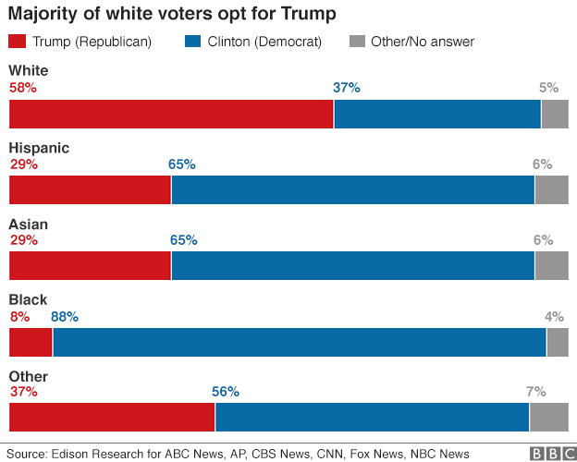
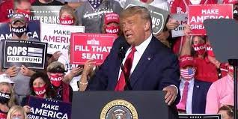
Temporary Shift
Deviating Election: a temporary shift within the electorate due to a popular candidate, but basic party loyalty remains the same
2016 Election

Slide 28
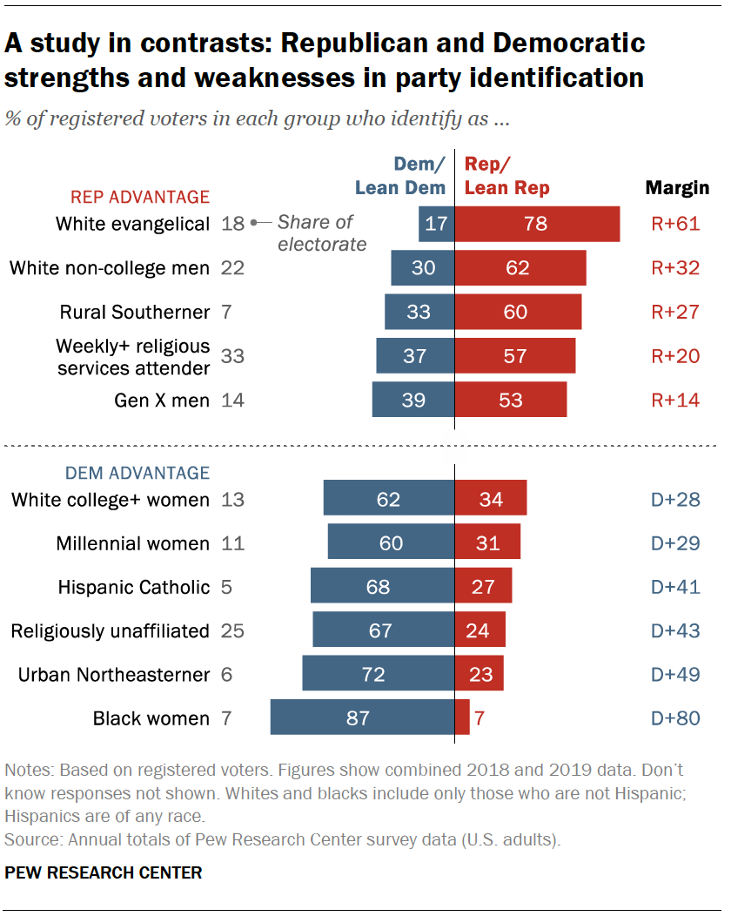
Back to Status quo
Reinstating Election: return to normal voting patterns
2020 Election

Slide 29
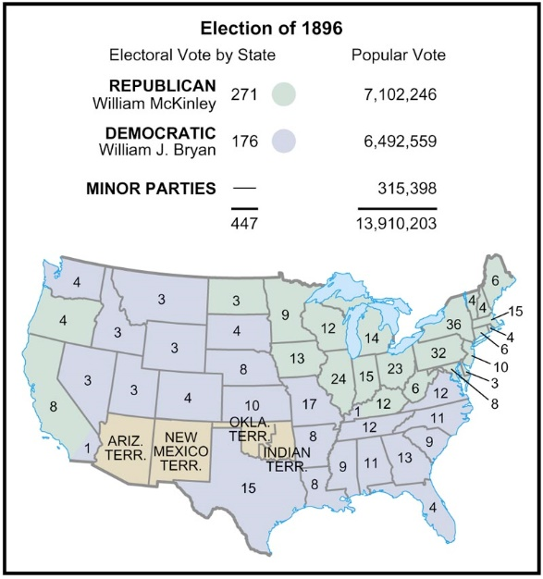
Realigning or Critical Elections
Critical Elections: the breaking down of political parties or political coalitions and the formation of a new ones.
Factors:
Usually centers around a crisis
Either a political party dies and is replaced or new political coalition is formed
Higher voter turnout (can be connected to suffrage expansion)
Leads to a long maintaining of political party

Slide 30
Election Diagnostic
Evaluate the following elections to determine what type of election they represent
Realigning
Maintaining
Deviating
Re-instating
1932 Election - 2000 Election - 2008 Election
1968 Election - 1976 Election - 1980 Election
1984 Election - 1992 Election - 1952 Election

Slide 31
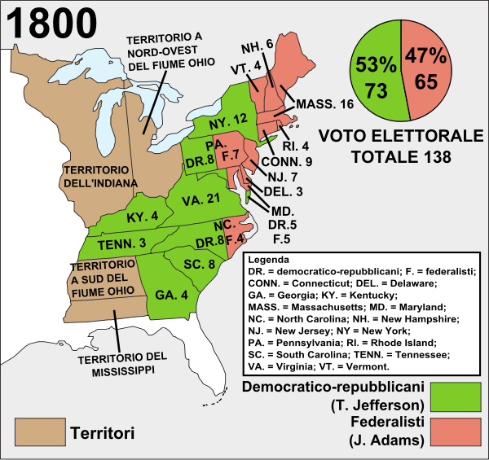
1800 Elections
Crisis: Quasi War with France and Alien & Sedition Act
Rise of the Democrat/Republicans and the fall of the Federalist Party (First peaceful transitions of power)
Ideological Transition:
Federalist – Stronger national government and supported national infrastructure
Democrat-Republicans – state rights & limited government

Slide 32
Election 1824
Crisis: the corrupt bargain of 1824 which caused Andrew Jackson to lose the Presidency in a runoff election in the House of Representatives
Democrat-Republicans Democrats
Expansion of Suffrage: Removed the property requirement for voting
Innovations
State & Local party organizations
Four year campaign
National convention

Slide 33
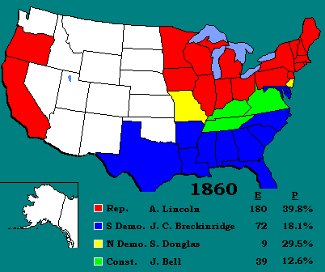
1860 Election (Critical)
Crisis: sectionalism and the country on the verge of war
Republican party replace the Whig party
Will expand suffrage through the 15th Amendment in 1866

Slide 34
1896 Election
Crisis: Industrial Revolution vs. Agrarian and Gold bugs v. Silverites
Reinforces Republican majority as they align themselves with industrialist and the Gold Standard
Party Dies: Populists
Policy Shift: Progressive Reforms (regulation, great voice of the common man)

Slide 35
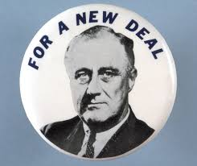
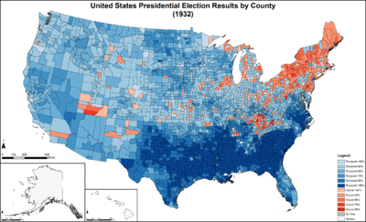
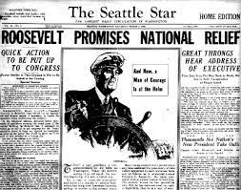
1932 Election
Crisis: Great Depression
Coalition Shift: African Americans and unions vote Democrat
Expansion of Suffrage: 19th Amendment (1920)
Policy Change:
Shift from laissez faire economics to
Keynesian economic theory
Beginning of the Social Welfare State

Slide 36
To Realign or Not
1968 and 1972 failed realignment
Southerners switch to the Republicans party (regional shift)

Slide 37
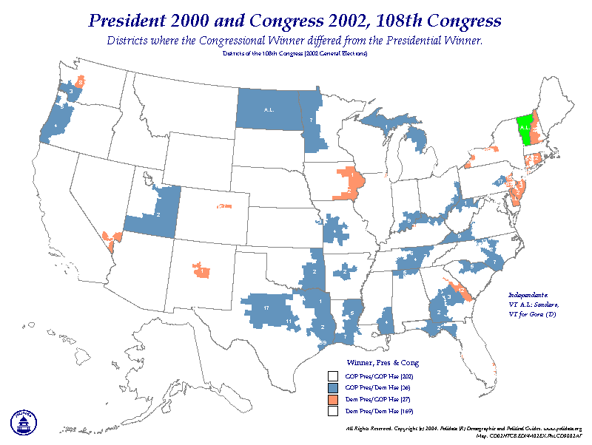
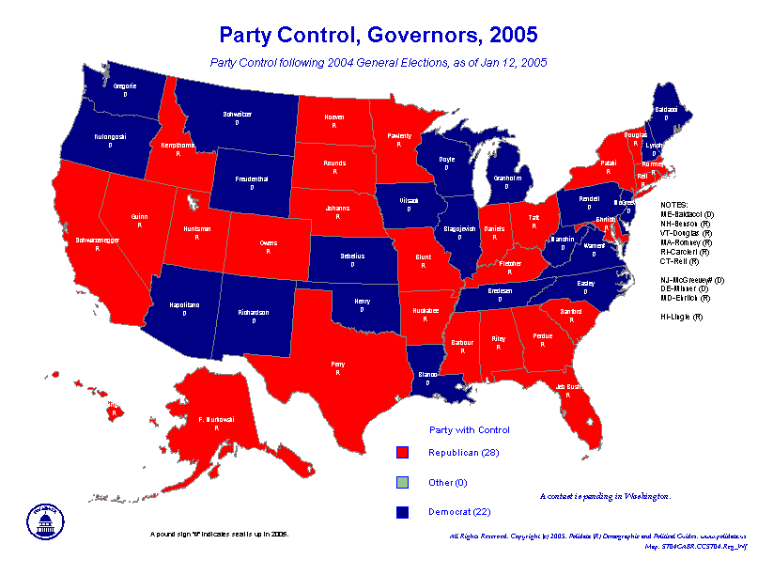
A Critical Election in 2000?
Evaluate were the election of 2000 was a realigning election

Slide 38
PMI-5: Political parties, interest groups, and social movements provide opportunities for participation and influence how people relate to government and policymakers
PMI 5.A: Describe linkage institutions
PMI 5.B: Explain the functions and impact of political parties on the electorate and government
Essential Questions: How does various unelected groups influence the political process, the political landscape and the United States governing institutions?
Students Can:
Evaluate the functions and impacts political parties have on the democratic process of our government
Explain why and how political parties change and adapt
AGENDA
Debating the Two Party System
Factors of the Third Wheel
The Value of the Third Party
HOMEWORK
Review for AP Exam

Slide 39
To be or Not to be a 2-Party
Keeping the two party system
Analyze the public opinion poll about the need of the for a third party
What factors support the argument that a legitimate third party should be added to American politics?

Slide 40
Party Systems
Multiparty System
Two Party System
Lots of political choices
Proportional representation (plurality)
Highly unstable (coalition break down)
Party membership required
Two choices (minority not heard in government)
Winner-take-all system (majority)
Highly stable (peaceful transition of power)
Political party membership not required

Slide 41
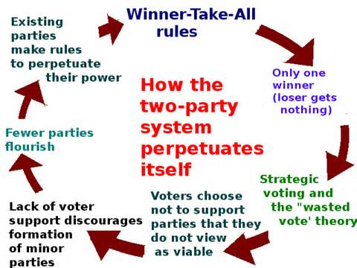
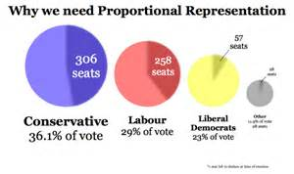
Duverger’s Law
Duverger’s Law is a principle which states that if a country uses a winner-take-all system, the candidate that has the most votes wins, it will use a two party system. But if a country uses proportional representation, assigning seats to parties based on the number of votes received, it will use a multi-party system.
How does this principle negatively effect the United States political process?
US Two-Party System: single member district – whoever wins the majority or plurality of votes wins

Slide 42
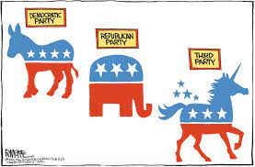
The Power of Third Parties
Evaluate whether third parties play a legitimate role in American democracy in the United States.
Legitimate Factor
Illegitimate Factor

Slide 43
The Power of Third Parties
Since the founding of the United States our government institution has promoted a two-party system in order to carry the voice of the people.
Develop an argument analyzing whether the United States needs to legitimatize third parties as option to expand the voice of the people.
Articulate a defensible claim or thesis that responds to the prompt and establishes a line of reasoning.
Support your claim with at least TWO pieces of accurate and relevant information.
At least ONE piece of evidence must be from the list below
Federalist 10
Constitution- Bill of Rights
Federalist 51

Slide 44
Types of third parties
Single issues: parties that focus on one issue (prohibitionist)
Ideological party: push extreme views (socialist or libertarian)
Splinter or Spoiler party: pulls votes away from one of the two major parties (Bull-moose party or Dixiecrats)
Single candidates: party surrounds a particular candidate (Ross Perot – fiscal financial responsibility)

Slide 45
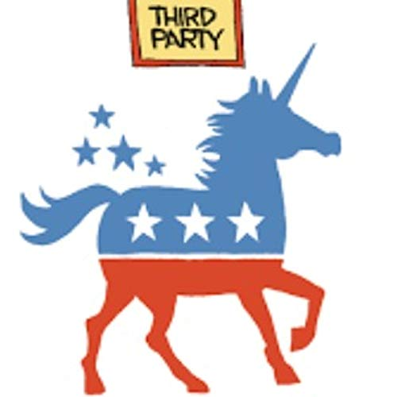
A Third wheel in politics
The influence of the third party
Safety Valve of the Two-Party System | Influences on the Two-Party System
Legal Barriers Against Third Parties | Societal Barriers Against Third Parties

Slide 46
Alternative Choice
Third Party (Minor Parties)
Safety valve for discontents
Voice of the fringe element
Impact - Ideas adopted by the two major parties (environmentalism, income taxes, 17th Amendment)
Spoiler party (Splinter Party)
Represents - Minority voice
1912 Election Outcome

Slide 47
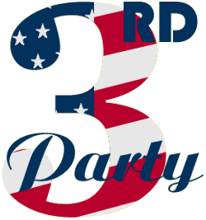
The Third Wheel Losers:
Factors that LIMIT participation
Too EXTREME for moderate America
Electoral Laws
petition to get on the ballot
Matching funds – must have 5% of popular vote in a prior election
Winner-take-all system (pluralism)
Not newsworthy
Throw away vote

Slide 48
Promoting the Two Party System
Many have argued that the United States should become a multi-party system.
Explain two electoral rules that inhibit the United States in becoming a multi-party system.
Explain ONE reasons that Americans don’t support third parties in the United States elections

Slide 49
PMI-5: Political parties, interest groups, and social movements provide opportunities for participation and influence how people relate to government and policymakers
PMI 5.A: Describe linkage institutions
PMI 5.B: Explain the functions and impact of political parties on the electorate and government
Essential Questions: How does various unelected groups influence the political process, the political landscape and the United States governing institutions?
Students Can:
Evaluate the functions and impacts political parties have on the democratic process of our government
Explain why and how political parties change and adapt
AGENDA
Recall Challenge
The Presidential Marathon
This system be RIGGED
HOMEWORK
Presidential Marathon
Friday, 4/23 – Argumentative Response Essay

Slide 50
Recall challenge
Conceptual FRQ:
1. The framers of the United States Constitution created a legislative system that is bicameral. However, it is not just bicameral; the framers also established two houses of distinctly different character and authority.
Discuss two reasons why the framers created a bicameral legislature.
Identify one power unique to the House of Representatives and explain why the framers gave the House that power.
Identify one power unique to the Senate and explain why the framers gave the Senate that power.

Slide 51
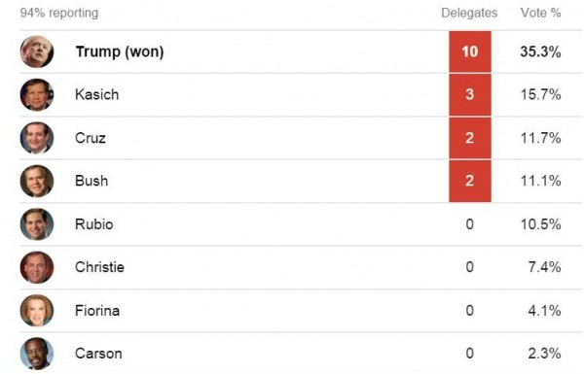
The Power of the “Big Mo”
How do early victories in the first two nomination elections shape the selection of the president of the United States?

Slide 52
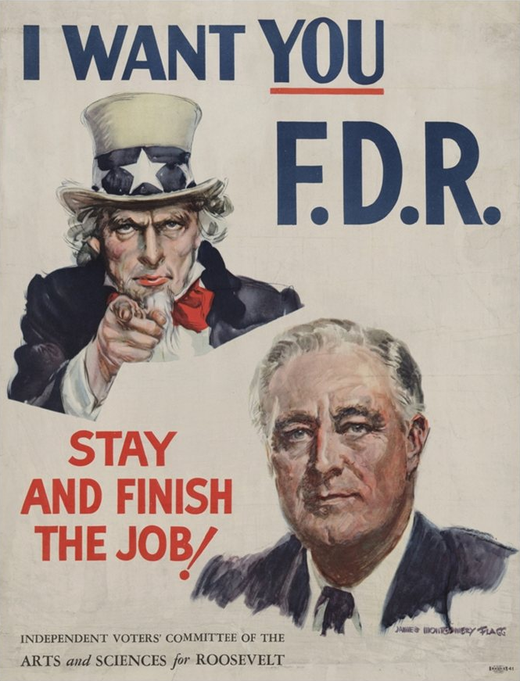
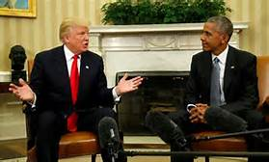
I want to be POTUS
Step 1: Form an exploratory committee & build public interest
Step 2: Formally announce your candidacy
Step 3: Nominating elections (all 50 states)
Step 4: General Election

Slide 53
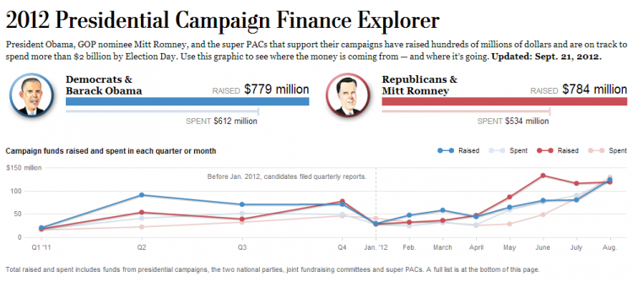
Winning a Presidential Victory
Promoting Candidate Centered Politics INCREASED CAMPAIGN COST
Mass Media (Need for Media Advisors)
Photo-ops
Debates
Horse Race Journalism
Sound bites
Political Consultants
Campaign chair
Lawyers
Pollster (Public Opinion Polls)
Media Advisors
Campaign Finance
PACs
Super PACs
Internet fundraising

Slide 54
Nomination Elections
Progressive reforms empowered the people to select the presidential candidate (primary system, Australian ballot)
Goal collect delegates to the convention (1144 winner-take-all system for Republicans & 2118 proportional system for the Democrats)
Nominating elections (states choose process)
Open primaries
Closed primaries
Blanket primaries
Caucuses

Slide 55
A Truly Democratic Process?
Building the Big Mo
Iowa Caucus & New Hampshire Primaries – winners have the best shot on winning on Super Tuesday
Super Tuesday – Up to 52% of the delegates are up for grab
Frontloading: states attempt to move up their nominating elections to have greater say in selecting the party nominee

Slide 56
The Big Reveal
Political Party National Convention
Delegates select the ticket (Delegates chosen by nomination elections)
The TICKET announced (President and Vice President Candidate)
The PLATFORM finalized (stances on issues)
Build Big Mo for the general election

Slide 57
A General Shift
Campaign Strategy – Goal win the Electoral
College vote (Why do you ignore New York,
California, and Texas, the largest electoral
value states?)
Candidates shift their views from party ideas to more moderate views (win independent votes)
Electioneering in SWING STATES
Mudslinging (Attack ads)

Slide 58
Evaluating the Primary System
The NOMINATION process is RIGGED!
The NOMINATION process is RIGGED!
Explain TWO reasons why both Republican and Democratic candidates have argued the nomination process to win the presidency is rigged
Winning the Big Mo
Horse Race Journalism
Party Rules for assigning delegates
Nomination elections
National Convention is meaningless

Slide 59
The Voice of the Party
Democrat Party being representative of their constituency (more diverse supporters)
1968 National Convention – Chicago Seven Riots
Fraser-McGovern Commission:
Goal: make the nomination process more representative of supporters of the Democratic Party
Impact: fractionalized the party
Super-delegates: 15% of the delegate slots were set aside for public officeholders and party officials (peer review of the nomination elections)

Slide 60
General vs. Nominating
Nominating Election
General Election
Focus on those who identify with the party and its values
Media has heavy influence in outcome (horse race journalism)
Winning the Big Mo.
Requires campaigning in every state
Deals with a lower voter turnout
Winning delegates to the National Convention
Focuses on moderate America
Has a higher voter turnout
Campaign efforts focus on swing states
Attacks ads (mudslinging)
Winner-take-all system

Slide 61
PMI-5: Political parties, interest groups, and social movements provide opportunities for participation and influence how people relate to government and policymakers
PMI 5.A: Describe linkage institutions
PMI 5.B: Explain the functions and impact of political parties on the electorate and government
Essential Questions: How does various unelected groups influence the political process, the political landscape and the United States governing institutions?
Students Can:
Evaluate the functions and impacts political parties have on the democratic process of our government
Explain why and how political parties change and adapt
AGENDA
The Power of a Midterm
Congressional Campaign Strategy
Contrasting Styles
HOMEWORK
Presidential Marathon
Friday, 4/23 – Argumentative Response Essay

Slide 62
Turnout the Vote
Presidential Elections v. Midterm Elections Turnout
Identify TWO major trends in voter turnout illustrated by the graph.
How the following impact midterm elections for Congress
Incumbency
Committee Assignments
C. Explain ONE major difference between a presidential campaign and a congressional campaign for elected office

Slide 63
Incumbency
Congressional Incumbency = High Re-election
Name Recognition
War chest (PACs & Super PACs back the incumbent)
Staffers
Pork barreling and casework = CREDIT CLAIMING

Slide 64
Presidential coattails
Presidential approval rating and presidential elections impact on congressional elections
Presidential Coattail Effect – voters support president’s party in congressional elections (debatable)
Lame Duck – A President who does not win a second term or cannot run for re-elections

Slide 65
Gerry Man Again
One party rule of state legislatures
Gerrymandering safe districts in the House of Representatives
General Elections are not competitive
Primary Elections are competitive for an open seat

Slide 66
The Bling, Bling of Campaigning
Increasing cost of campaigning
Political Consultants
Campaign Ads (mudslinging)
Social Media
Public Opinion Polls
Mass Media
Winning Independents’ Votes

Slide 67
To Debate or Not to Debate
Debating an opponents – Presidential candidate yes vs. Congressional candidates NO
Incumbents & Frontrunners have the advantage (name recognition)
Gaffes could legitimize an opponent

Slide 68
Contrasting Campaigns
Presidential Campaigns v. Congressional Campaigns
Congressional Elections
Presidential Elections

Slide 69
Elected Position Campaigns
Congressional Elections
Presidential Elections
Very on sided (incumbency advantage)
Fewer people vote in midterm elections
Taking Credit (pork-barreling)
Can blame the politics of Washington (duck responsibility)
Presidential Coattail effect
More competitive (winner rarely gets more than 55% of the vote)
More voters
Greater media coverage

Slide 70
Nomination Process
How democratic is the process of selecting the nominees for president by today’s standards
Highlight reforms that have been made to the nomination process
Evaluate its strengths and weaknesses

Slide 71
PMI-5: Political parties, interest groups, and social movements provide opportunities for participation and influence how people relate to government and policymakers
PMI 5.A: Describe linkage institutions
PMI 5.B: Explain the functions and impact of political parties on the electorate and government
Essential Questions: How does various unelected groups influence the political process, the political landscape and the United States governing institutions?
Students Can:
Evaluate the functions and impacts political parties have on the democratic process of our government
Explain why and how political parties change and adapt
AGENDA
Argumentative Essay
HOMEWORK
Dollar, Dollar Nation

Slide 72
Prompt
In the early days of the country, presidential campaigns were conducted within a significantly shorter period of time. Today, it is common for potential presidential candidates to start campaigning shortly after the congressional midterms end, making the presidential campaign season a regular fixture in American political life.
Develop an argument that explores whether longer presidential campaign seasons are helpful or harmful to American democracy.
Use at least one piece of evidence from one of the following foundational documents:
The Federalist 70
Brutus 1
Article II of the United States Constitution
In your essay, you must:
✓ Respond to the prompt with a defensible claim or thesis that establishes a line of reasoning.
✓ Support your claim with at least TWO pieces of specific and relevant evidence.
One piece of evidence must come from one of the foundational documents listed above.
A second piece of evidence can come from any other foundational document not used as your first piece of evidence, or it may be from your knowledge of course concepts.
✓ Use reasoning to explain why your evidence supports your claim/thesis.
✓ Respond to an opposing or alternative perspective using refutation, concession, or rebuttal.

Slide 73
PMI-5: Political parties, interest groups, and social movements provide opportunities for participation and influence how people relate to government and policymakers
PMI 5.A: Describe linkage institutions
PMI 5.B: Explain the functions and impact of political parties on the electorate and government
Essential Questions: How does various unelected groups influence the political process, the political landscape and the United States governing institutions?
Students Can:
Evaluate the functions and impacts political parties have on the democratic process of our government
Explain why and how political parties change and adapt
AGENDA
Campaign Dough-nation
Bring the Bling of Campaigning
Contrasting Styles
HOMEWORK
Dollar, Dollar Nation

Slide 74
Money Changes Everything
Explain the difference between Hard Money and Soft Money in political campaign finance.
Explain ONE factor that has promoted the growth of campaign finance in American elections
Explain why it is hard to limit money’s influence on election campaigns

Slide 75
Do-Nation Democracy
Money is the life’s blood of any campaign (new way for political participation)
Issue: promoting free speech vs. protecting the integrity of elections
Who is behind the money and what do they want in return?

Slide 76
Election Reform Act of 1974
Created the Federal Elections Commission to over see elections
Buckley v. Valeo: establish that campaign contributions are protected by the 1st Amendment free speech, but they can be limited, EXCEPT if it your own $$$
Magical Word Test: limits issue advocacy ads by interest groups (ex. vote for)
- Full disclosure of campaign contributions
- Establish limits on campaign contributions given to the candidate (Hard Money) Prevents contributions from foreign interests and limits the amount that can be donated to a candidate per election cycle ($2000 per candidate)
- Established federal elections matching funds

Slide 77
Money Adapts
PACS: (Political Action Committees)
Interest groups, Corporations, & labor unions electioneering (campaign influencing)
Bundling – lump sum donations

Slide 78
Bipartisan Campaign Act of 2002
McCain-Feingold Law
Banned soft money donations to national party
Limits campaign ads by interest groups
Upheld by McConnell v. FEC – protection of the integrity of elections

Slide 79
Issue Advocacy Ads
Issue Advocacy Ads: created by SUPER PACS (independent expenditures)
Only regulation (magic word test)

Slide 80
Citizens United v. FEC
Question before the Court: The issues on appeal were whether, as applied to Hillary, (1) § 441b's prohibition on corporate independent election expenditures was constitutional and (2) BCRA's disclaimer, disclosure, and reporting requirements were constitutional.
Citizens United vs. FEC - The First Amendment prevents the government from putting limits on independent expenditures giving by SUPER PACS

Slide 81
Super PACS since Citizens United
Which democratic group think theory does the rise of dark money re-enforce?
Citizens United vs. FEC effect – RISE OF SUPER PACS (unlimited contributions “DARK MONEY)

