Slide 1
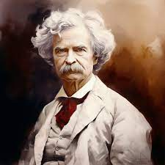
Industrialization - (The Gilded Age)
Unit VI 1866 – 1899
All that is GOLD does NOT Glitter!
“It is a time where one’s spirit is subdued and sad, one knows not why; when the past seems a storm-swept desolation, life a vanity and a burden, and a future but a way to death. It is a time when one is filled with vague longings; when one dreams of flight to peaceful islands in the remote solitudes of the sea, or folds his hands and says, What is the use of struggling, and toiling and worrying any more? let us give it all up.”
- Mark Twain, The Gilded Age: A Tale of Today, 1873

Slide 2
Period 6: (1866 – 1898) The transformation of the United States from an agricultural to an increasingly industrialized and urbanized society brought about significant economic, political, diplomatic, social, environmental, and cultural changes.
Essential Question: Evaluate how the development of industrial capitalism cause transformation in the United States bring about a modern age.
Students Can:
Explain how various factors contributed to the continuity and change of the “New South” from 1877-1899
Discern how innovation was a major contributing factor in the rise of industrialization
Evaluate how industrialism caused socioeconomic continuity and change
Agenda:
Unit V Review
Welcome to the New South (or the Old South)
New South or Old South
Homework:
Study for Unit V Test
Progress Check on AP Central

Slide 3
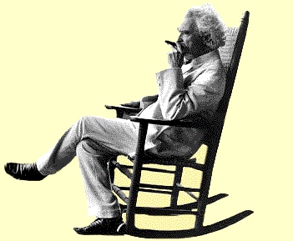
POV of Industrialization
Evaluate Mark Twain’s Perspective of Industrialization
“It is a time where one’s spirit is subdued and sad, one knows not why; when the past seems a storm-swept desolation, life a vanity and a burden, and a future but a way to death. It is a time when one is filled with vague longings; when one dreams of flight to peaceful islands in the remote solitudes of the sea, or folds his hands and says, What is the use of struggling, and toiling and worrying any more? let us give it all up.”
- Mark Twain, The Gilded Age: A Tale of Today, 1873
Why would I say that about industrialization?

Slide 4
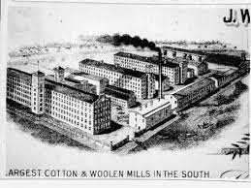
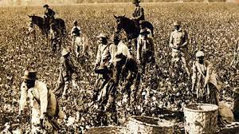
Reflection on Reconstruction
Analyze images – evaluate how each image gives a different perspective of the South from 1866 - 1899

Slide 5
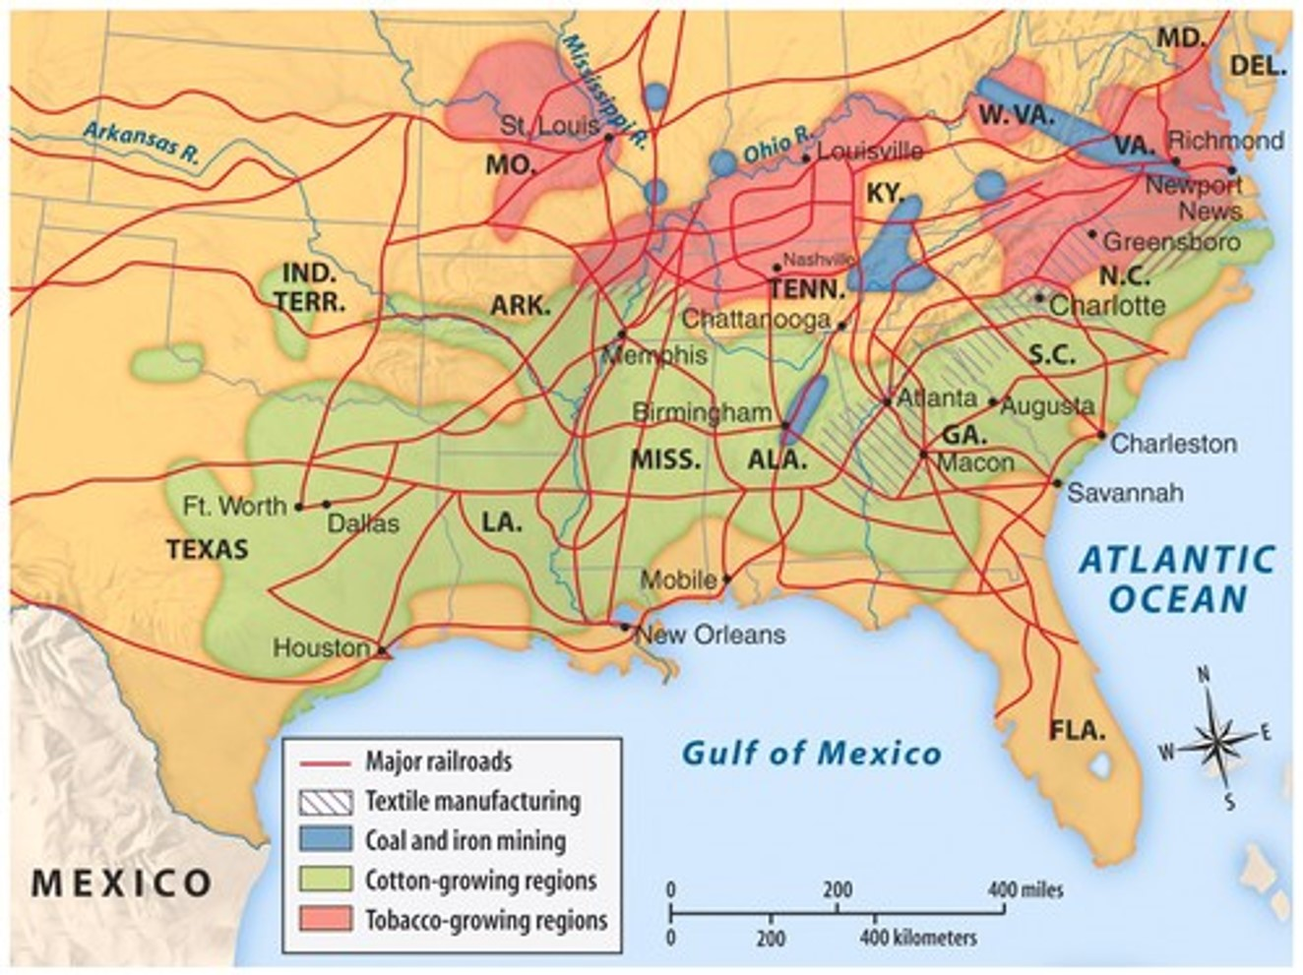
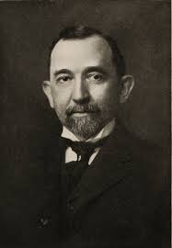
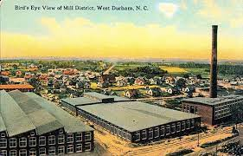
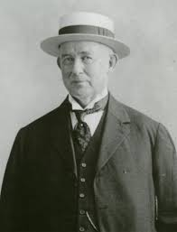
New South – remade and improved????
New South (goal) – self sufficient economy, built on industrial capitalist values, modernize transportation and improved race relations
N.C., G.A, & S.C. – Top producers of textiles
Birmingham, AL – Steel production
Erwin Textile Mill (Benjamin Newton Duke)
Memphis, TN – Lumber industry
Richmond, VA – Tobacco industry
James B. Duke – American Tobacco Co. - Cigarette Industry
Southern Power Co. 1905

Slide 6
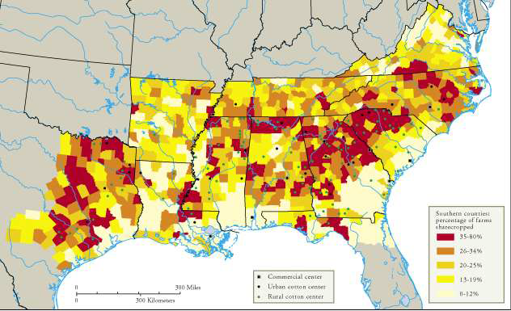
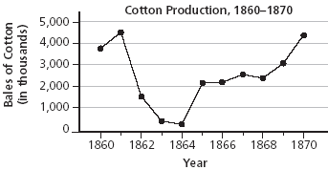
Slow Southern Growth
Lack of rapid industrialization
Weakening Industrialization in the South
Financing for industrialization controlled by the North
Lack of government support of public education (No skilled laborers)
Cash Crop Agriculture – dominates the South

Slide 7
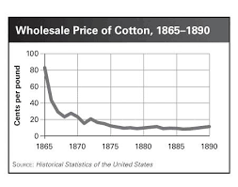
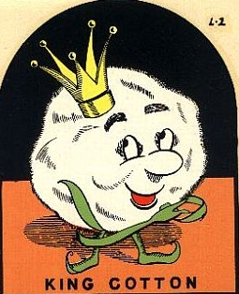
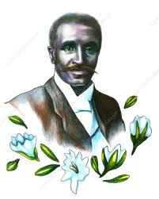
Innovation for the Southern Man
Southern agriculture – Still dominated by COTTON
King Cotton = #1 commodity of the South
Over production = 50% decline in price
George Washington Carver
Crop diversification: peanuts, sweet potatoes, & soybeans

Slide 8
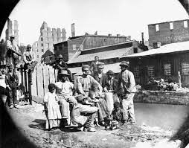
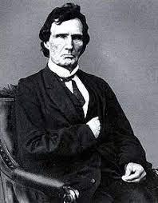
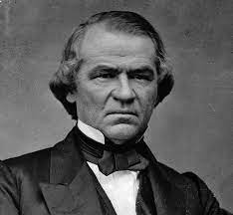
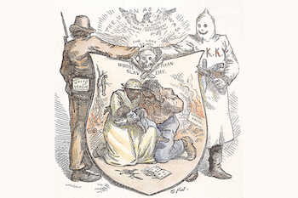
Reconstruction Perspective
Prompt: Evaluate to what extent the Reconstruction period from 1865 to 1877 should be considered a failed revolution.
Thesis: Claim = A reason + B reason however X
Four pieces of evidence to defend your thesis
Sample Thesis: Western Expansion caused U.S. relations with Native Americans to decline (Claim) because of conflicts of land ownership (Reason A) and destruction of Natives’ culture (Reason B). However settlers did benefit from trade with American Indians (However).
Freedmen
Radical Republicans
Reconstruction Presidents
Redeemers

Slide 9
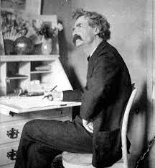
Same old song or new and improved
Evaluate to what extent the New South reflects Mark Twain’s satirical depiction of the period 1866 -1899 as the “Gilded Age”.
New South (GOLD ON TOP)
Solid South (darkness underneath)
Why did I call it the Gilded Age

Slide 10
Period 6: (1866 – 1898) The transformation of the United States from an agricultural to an increasingly industrialized and urbanized society brought about significant economic, political, diplomatic, social, environmental, and cultural changes.
Essential Question: Evaluate how the development of industrial capitalism cause transformation in the United States bring about a modern age.
Students Can:
Explain how various factors contributed to the continuity and change of the “New South” from 1877-1899
Discern how innovation was a major contributing factor in the rise of industrialization
Evaluate how industrialism caused socioeconomic continuity and change
Agenda:
Unit V Review
Unit V Test
Homework:
Rise of Industrial Capitalism – Reading 375 – 380 in AMSCO & Discussion Question

Slide 11
Period 6: (1866 – 1898) The transformation of the United States from an agricultural to an increasingly industrialized and urbanized society brought about significant economic, political, diplomatic, social, environmental, and cultural changes.
Essential Question: Evaluate how the development of industrial capitalism cause transformation in the United States bring about a modern age.
Students Can:
Explain how various factors contributed to the continuity and change of the “New South” from 1877-1899
Discern how innovation was a major contributing factor in the rise of industrialization
Evaluate how industrialism caused socioeconomic continuity and change
Agenda:
In Context with the New South
Feeding Industrialization
The Contextualization of Industrialization
Homework:
Rise of Industrial Capitalism – Reading 375 – 380 in AMSCO & Discussion Question

Slide 12
Same old song or new and improved
Evaluate to what extent the New South reflects Mark Twain’s satirical depiction of the period 1866 -1899 as the “Gilded Age”.
New South (GOLD ON TOP)
Solid South (darkness underneath)
Why did I call it the Gilded Age

Slide 13
The 2nd Industrial Revolution
Industrial Revolution 1866 – 1899: development of mechanization and modernization to make the U.S. #1 economy in the world
Percentage of World Industrial Output
Identify and explain factors that made the U.S. an industrial power by the beginning of the 20th century

Slide 14
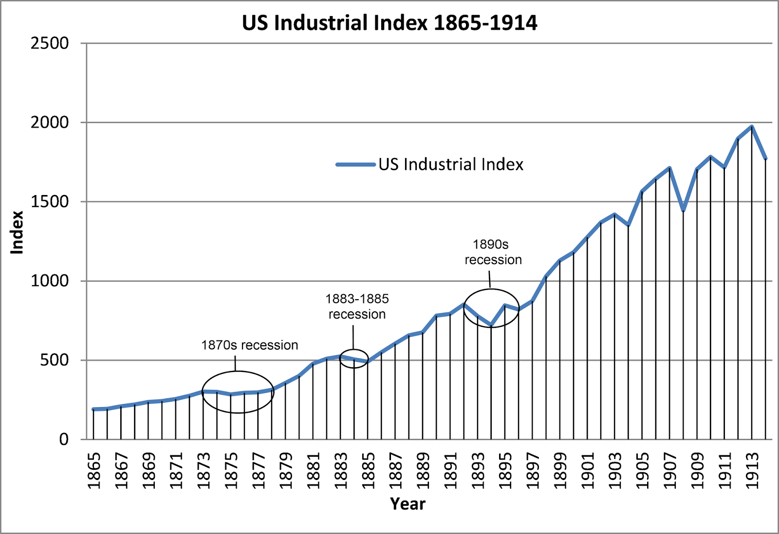
Building the Industrial Mite
Factors for U.S. Transformation 1866-1899
Abundance of raw materials (THE WEST)
Growth of the labor force (IMMIGRATION)
New Innovations
Capital $$$ (War profiteering)
Talent businessmen (Captains of Industry)
New business organizations
Growing markets to sell mas produced items
Laissez faire beliefs of government
The Market Revolution of 1830-1850
Growth U.S. Industry

Slide 15
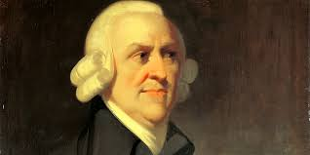
Hands-OFF! U.S. Government
Pro-growth attitude of the government
Laissez Faire: Government should have little to NO intervention into the market economy & allow the invisible hand regulate it. (Adam Smith, Wealth of Nations)
Government – NO TOUCH!!
Regulators of the U.S. Economy
SUPPLY
PRICE
DEMAND
COMPETITION
Evaluate whether the U.S. government has followed the idea of laissez faire in it’s interactions of the U.S. economy.

Slide 16
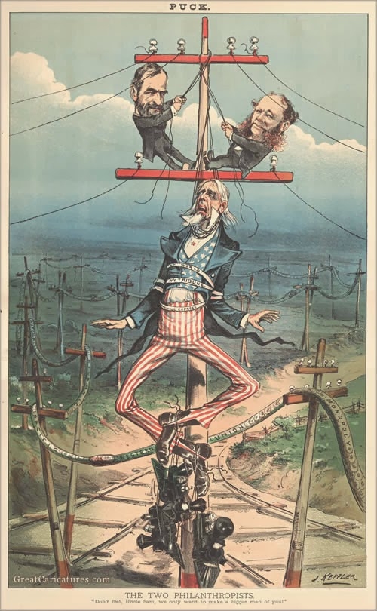
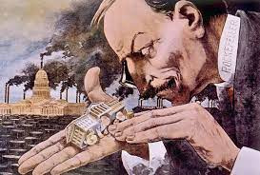
Plutocracy or Democracy?????
Plutocracy: government run by the wealthy
Trust Giants Point of View - What a Funny Little Government
Evaluate to what extent the U.S. government represented a plutocracy from 1866 - 1899
Two Philanthropists
Don’t fret, Uncle Sam, we only want to make a bigger man of you”

Slide 17
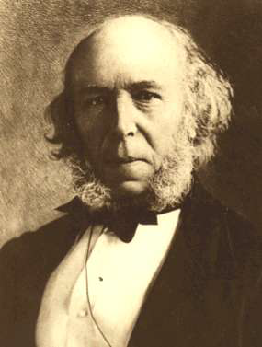
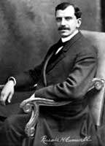
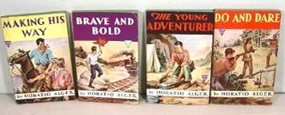
Defense of Industrial Capitalism
Cultural arguments for Capitalism
Social Darwinism
Herbert Spencer
“survival of the fittest”
Andrew Carnegie
The Gospel of Wealth (philanthropy)
Russell Conwell
“Acres of Diamonds” (religion)
Horatio Alger (rags to riches stories)
Protestant work ethic
Herbert Spencer
Russell Conwell
Horatio Alger’s Books

Slide 18
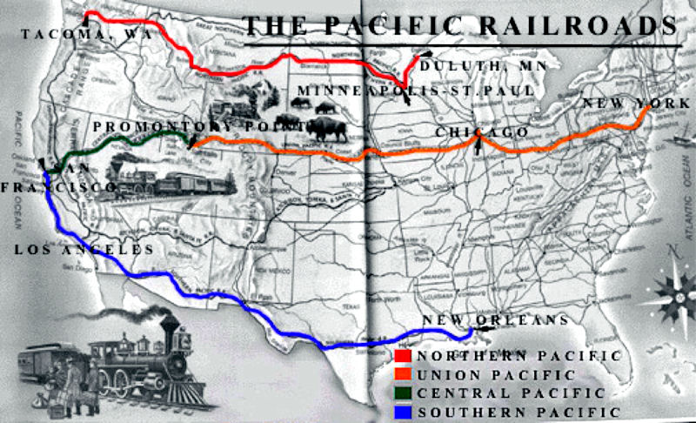
Traversing the Continental U.S.
Development of the transcontinental railroad
Completed 1869 at Promontory Point, Utah
U.S. Government funded (Pacific Railways Act, 1862)
Lead to political corruption (Credit Mobilier Scandal)
Transcontinental R.R.
Impact on the U.S.
Links the country
Promotes westward migration
Supports trade with Asia & industrialization
Creation of time zones 1883

Slide 19
Period 6: (1866 – 1898) The transformation of the United States from an agricultural to an increasingly industrialized and urbanized society brought about significant economic, political, diplomatic, social, environmental, and cultural changes.
Essential Question: Evaluate how the development of industrial capitalism cause transformation in the United States bring about a modern age.
Students Can:
Explain how various factors contributed to the continuity and change of the “New South” from 1877-1899
Discern how innovation was a major contributing factor in the rise of industrialization
Evaluate how industrialism caused socioeconomic continuity and change
Agenda:
POV in Industrial Revolution
Meet the Men that Built America
Historical Contexts of the Industrial Revolution
Homework:
Technological Innovation of the Industrial Revolution due 1/23 by class

Slide 20
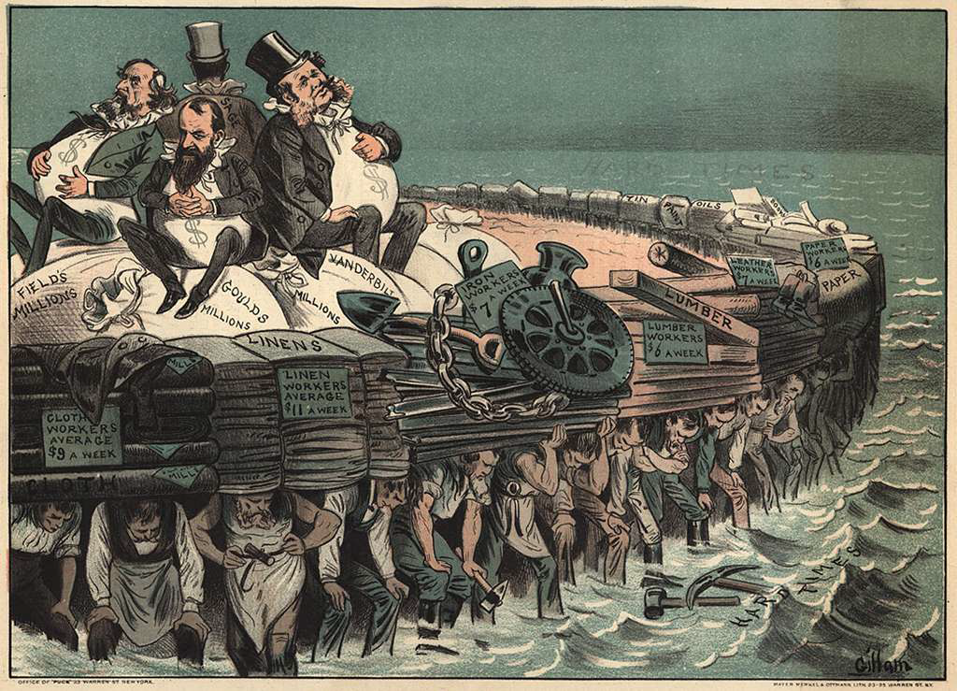
“The Protectors of our Industries”
HIPP the Political Cartoon – “The Protectors of our Industries”, PUCK, 1883

Slide 21
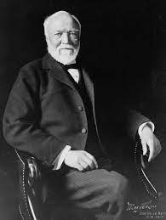
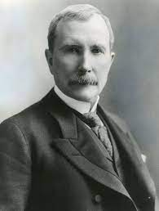
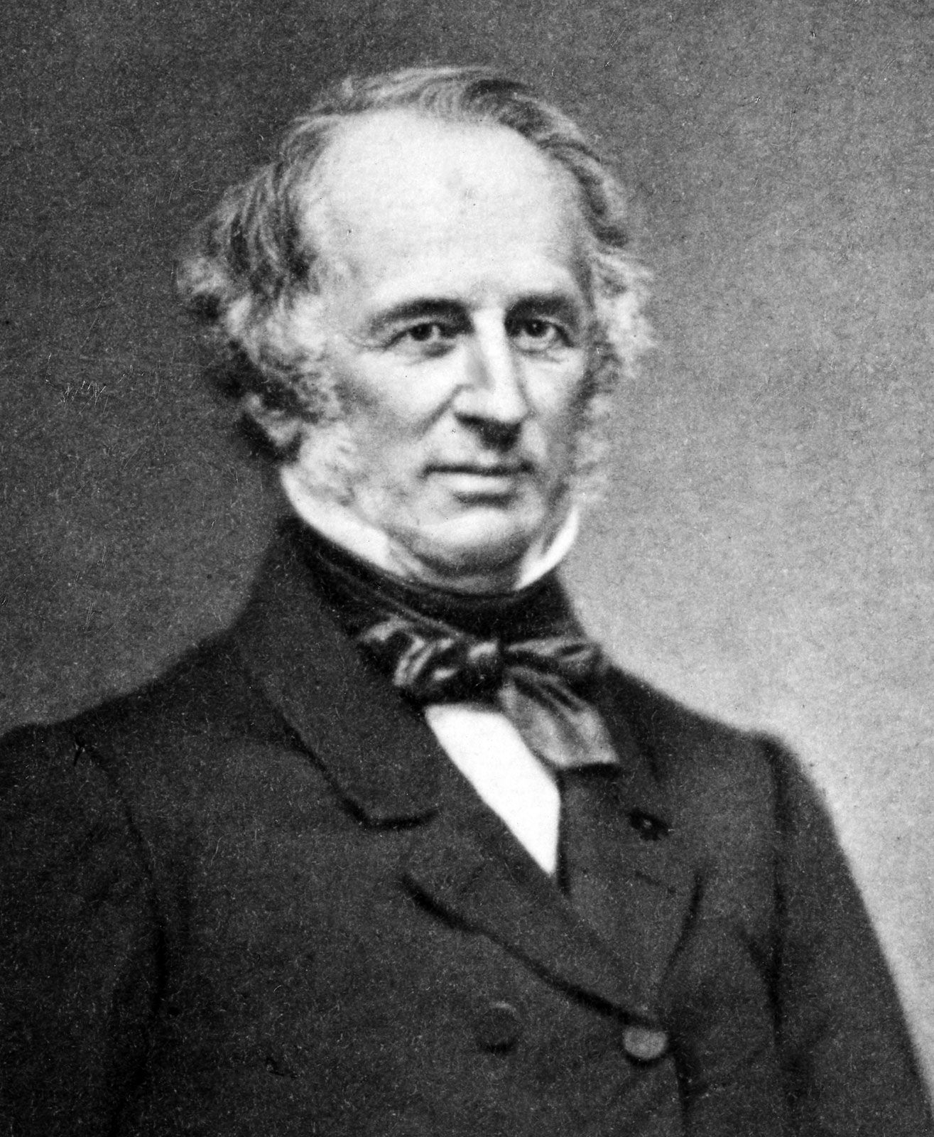
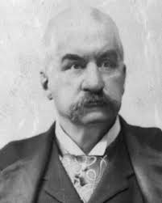
Captains of Industry or Robber Barons
Industrial Empires of the Gilded Age
Andrew Carnegie
Titan of Steel
John D. Rockefeller
Titan of Oil
Cornelius Vanderbilt
Titan of RRs
JP Morgan
Titan of Finance

Slide 22
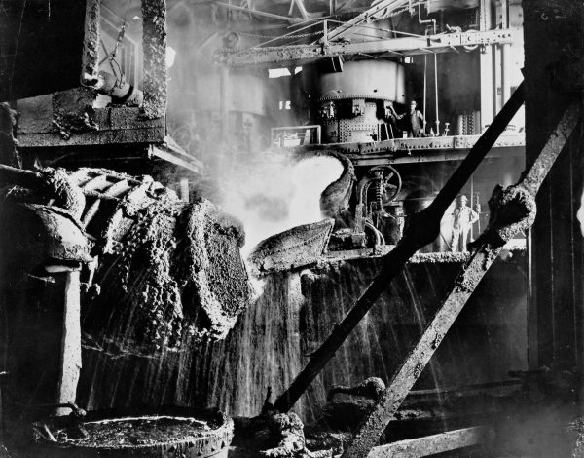
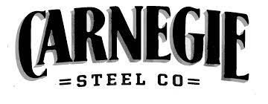
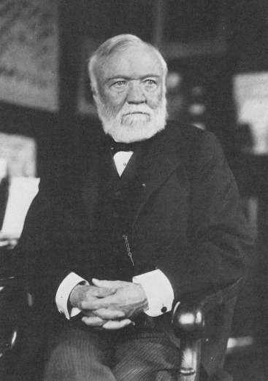
Carnegie Steel
The King of Steel – Andrew Carnegie
Bessemer Process
Factors for a Steel Empire
Mass production (Bessemer Process)
Economies of scale
Vertical Integration
Vertical Integration

Slide 23
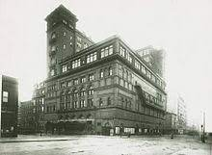
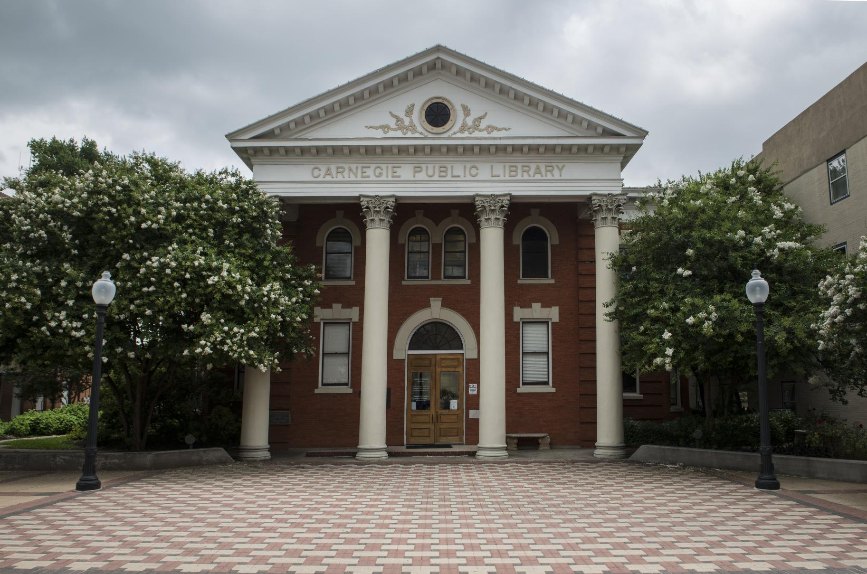
The Carnegie Effect
Carnegie Hall, NYC
Andrew Carnegie Mansion
Carnegie Public Libraries (1 of 2,509)

Slide 24
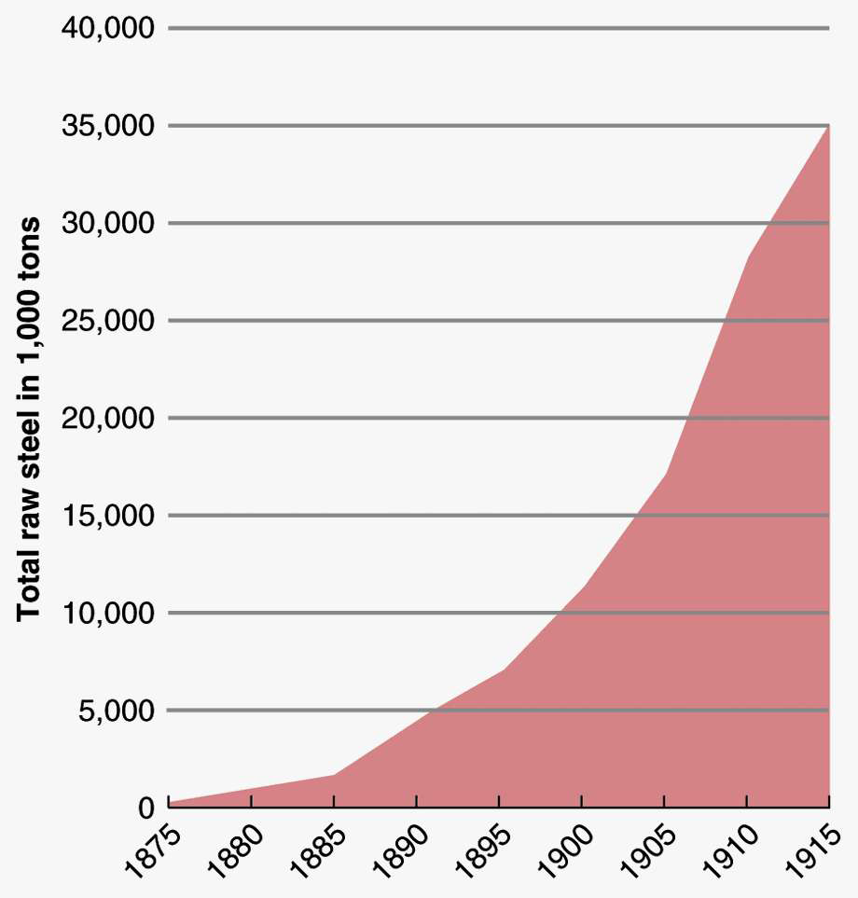
International Steel Production,1880 & 1914
U.S. Steel Production,1875 -1915

Slide 25
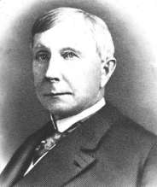
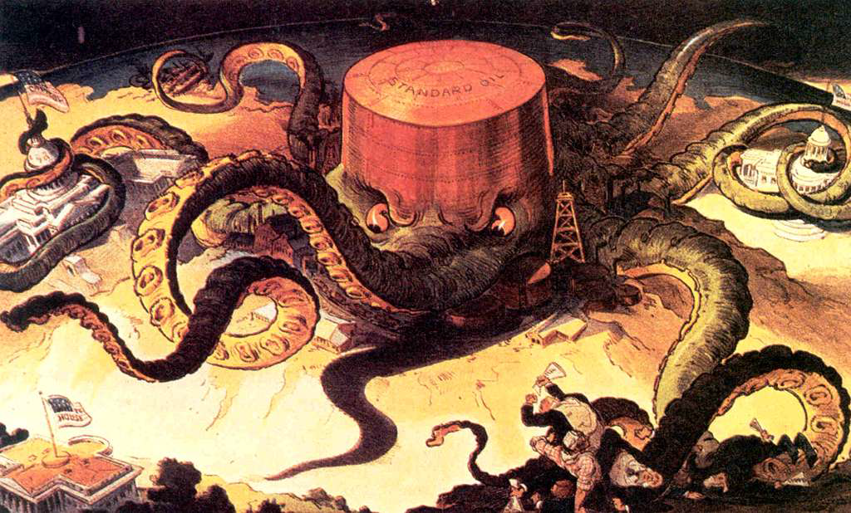
The Sultan of Oil
Standard Oil Co. – John D. Rockefeller
Building an Oil Empire
Horizontal integration – buying out competitors
Monopoly – one company controls the market for oil
Trust – one board of trustees manages a combination of companies
“Next!”

Slide 26
Period 6: (1866 – 1898) The transformation of the United States from an agricultural to an increasingly industrialized and urbanized society brought about significant economic, political, diplomatic, social, environmental, and cultural changes.
Essential Question: Evaluate how the development of industrial capitalism cause transformation in the United States bring about a modern age.
Students Can:
Explain how various factors contributed to the continuity and change of the “New South” from 1877-1899
Discern how innovation was a major contributing factor in the rise of industrialization
Evaluate how industrialism caused socioeconomic continuity and change
Agenda:
Context of a Revolution
Meet the Men that Built America
Captain of Industry or Robber Baron
Homework:
Technological Innovation of the Industrial Revolution due 1/23 by class

Slide 27
Change & Continuity Context
Evaluate what has changed and what has continued (stayed the same) because of the rise of Industrialization
Change
Continuity – History repeats itself
Have I seen this before or is something new?

Slide 28
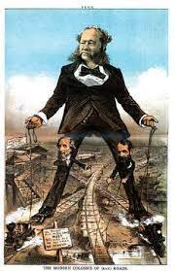
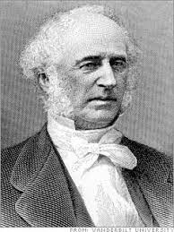
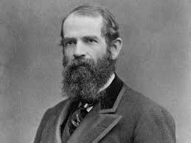
Railroad Titans
Railroad tycoons: Cornelius Vanderbilt & Jay Gould
Rise of the RR Empire
NY Central Line - Railroad Monopoly
Modern advancements: Pullman sleeper cars, steel gauge track, airbrakes
Rebating – trade discounts for favors
Pooling – fixed rates with competitors to bankrupt others
Cornelius Vanderbilt
Profiting off others
Stock watering – inflating assets prior to selling them and pocketing profits
Jay Gould

Slide 29
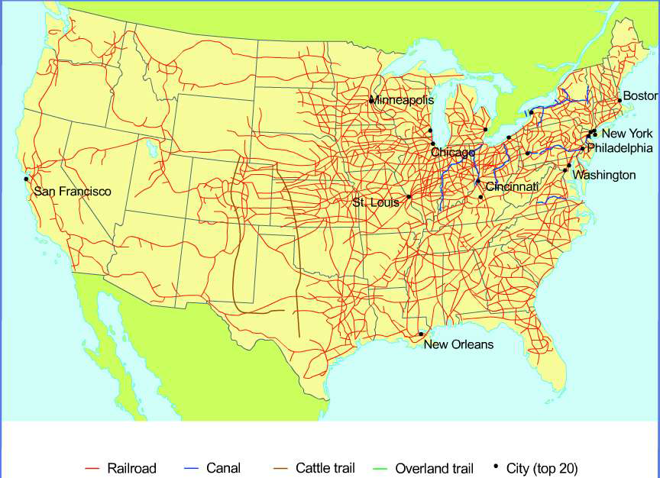
Expansion of the RRs
1871 – 1900: 170,000 miles of railroads built
Promoting development of railroads (4 New Transcontinental R.R. built)
U.S. government: tax credits & land grants
Innovations:
Railroads built by corporations (stockholders)
Consolidations of railroads (connecting different lines into one)
Standardization – gauge of track

Slide 30
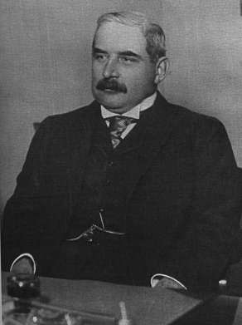
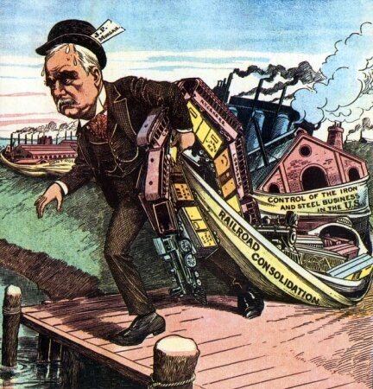
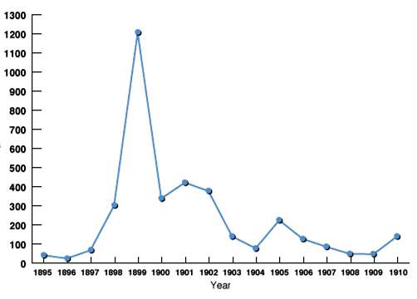
Controlling the Strings of Capitalism
The Finance King – JP Morgan
Consolidation: buying various industries
Holding company – One company managing various companies
Corporate Mergers 1865 - 1910

Slide 31
Captain of Industry or Robber Baron?
Evaluate whether U.S. industrialist should be viewed as Captains of Industry or Robber Barons

Slide 32
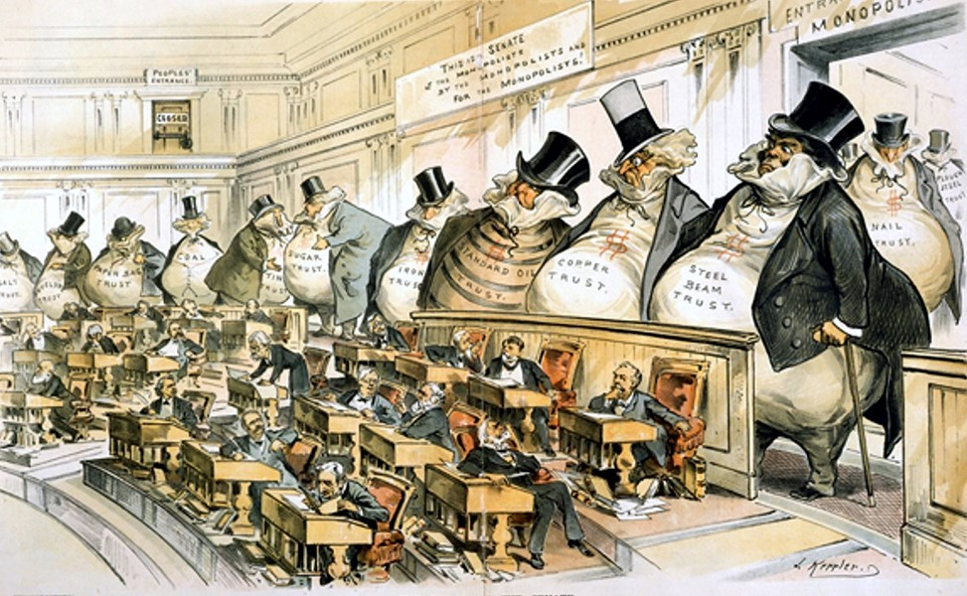
The Boss of Senate by Joseph Kepler
HIPP the document

Slide 33
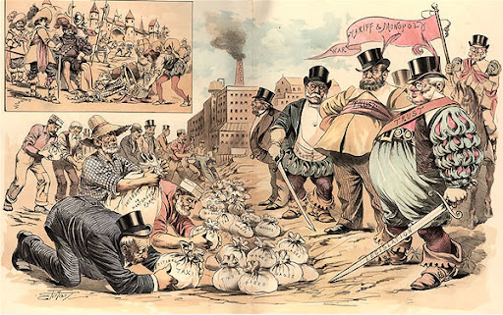
Historical Perspective
Evaluate the Point of View
History Repeats Itself – The Robber Barons of the Middle Ages and the Robber Barons of Today, Sam Ehrhardt

Slide 34
Period 6: (1866 – 1898) The transformation of the United States from an agricultural to an increasingly industrialized and urbanized society brought about significant economic, political, diplomatic, social, environmental, and cultural changes.
Essential Question: Evaluate how the development of industrial capitalism cause transformation in the United States bring about a modern age.
Students Can:
Explain how various factors contributed to the continuity and change of the “New South” from 1877-1899
Discern how innovation was a major contributing factor in the rise of industrialization
Evaluate how industrialism caused socioeconomic continuity and change
Agenda:
Context of a Revolution
Meet the Men that Built America
Captain of Industry or Robber Baron
Homework:
Technological Innovation of the Industrial Revolution due 1/23 by class

Slide 35
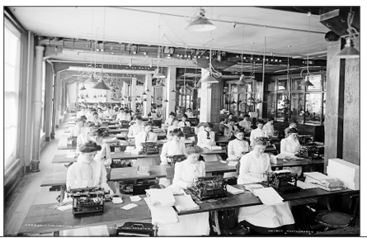
HAPPY – Primary Source
Source: The Female Typists, Library of Congress
HAPPY
H – Historical Context
A – Audience
P – Purpose
P – Point of View
Y – Why is it important
Use “FACTS”

Slide 36
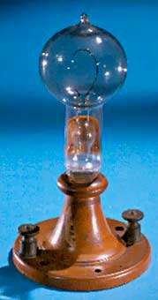
Electricity & Edison
New source of power
Allows for businesses to be open longer and improve workplace safety
Thomas Edison in his Menlo Park, NJ Lab

Slide 37
The Phonograph (1877)
The Epiphone or Dictaphone
Thomas Edison:
• innovator
• businessman
The Motion Picture Camera

Slide 38
Ford & Mass Production
Frederick W. Taylor
The Principles of Scientific Management (1911)
Scientific management: designing the mass production of a product to make it the most efficient way (Taylorism)

Slide 39
The AUTOMOBILE, Ford & Mass Production
Henry Ford
“Fordism” – make it affordable to the common man
Taylorism – efficiency in production
The Moving Assembly Line
1913 Ford Model T

Slide 40
Shifts in Labor Force
Evaluate how the trend depict will impact the United States during the period from 1866-1899?

Slide 41
Life of a Laborer
Wage Slave Life
12-16-hour days for little pay
Company Town: (Waltham System of the Market Revolution)
factory owned homes, company store, etc.
Worker wages paid back to the industrialist
Rent
Script: Company store credit
Endless CYCLE of DEBT
George Pullman – Pullman Strike 1894

Slide 42
19TH Century Unions
Knights of Labor
Terrance Powderly
Unskilled/Skilled laborers
American Federation of Labor (AFL)
Samuel Gompers
Skilled laborers
Industrial Workers of the World (IWW)
“wobblies”
Socialist & violent
Women delegates, Knights of Labor Convention
Goal: right to collective bargaining for better working conditions
Samuel Gompers

Slide 43
Tactics
Business Tactics to break unions
- Strikebreakers (“scabs” - immigrants) - lockout
- Blacklists - yellow-dog contracts
- private guards & state militia - court injunctions (interfering with (Pinkerton Detective Agency) interstate commerce)
Labor Tactics:
Strikes
Slow downs
Boycotts
Immigrants replace striking workers,
July 8, 1882

Slide 44
Factors that Weaken Labor Unions
Labor Unions were relatively ineffective during the Gilded Age
Government sided with Industrialists (Laissez faire beliefs)
Legal structure of the U.S.
Strikes interfere with Interstate Commerce Clause & the Mail
Court Interpretation of the U.S.
Sherman Anti-Trust Act: Labor Unions = Trust
Unions seen as radicalism/anarchists
Haymarket Square Riot
Socialism (Eugene V. Debs & Wobblies)

Slide 45
Strikes that defined Labor Unions
Gilded Age Strikes – Established how government and mass media perceived them
Great American Railroad Strike 1877
Haymarket Square Riot 1886
Homestead Strike 1892
Pullman Strike 1894
Tournament of today – a set-to between labor and monopoly, 1893

Slide 46
Period 6: (1866 – 1898) The transformation of the United States from an agricultural to an increasingly industrialized and urbanized society brought about significant economic, political, diplomatic, social, environmental, and cultural changes.
Essential Question: Evaluate how the development of industrial capitalism cause transformation in the United States bring about a modern age.
Students Can:
Explain how various factors contributed to the continuity and change of the “New South” from 1877-1899
Discern how innovation was a major contributing factor in the rise of industrialization
Evaluate how industrialism caused socioeconomic continuity and change
Agenda:
Do-Nothing Government?
Rise of Regulation
Debating the Role of Government
Homework:
Technological Innovation of the Industrial Revolution due 1/23 by class

Slide 47
View of Government in the Industrial Age
1866-1899: “Do Little Government”
Explain at least TWO factors that many believe the United State government should be known as “Do Little” during the period of 1866 – 1899.
Explain at least TWO factors that demonstrate that the government took an active role in the economy from 1866 -1899.

Slide 48
Government Policies Towards Business
Federal & state government pro business – PLUTOCRACY
Pro Business policies
Subsidies (railroads)
High tariffs
Stable currency (GOLD)
Little Regulation
Rational
Motivation for business is self interest
(Adam Smith)
Capitalism is best when government is small

Slide 49
Railroads & Government
Rise of the railroads during the Industrial Revolution
Transcontinental Railroad (Pacific Railways 1862)
Land grants & subsidies (loans)
Strike breaking:
U.S. government intercede in Great American Railroad & Pullman Strike (mail & interstate commerce)

Slide 50
Rise of Regulation
Regulation: government rule meant to protect consumers, laborers or competition
States governments pass legislation to regulate the price of grain elevators (Munn v. Illinois 1876 – upheld law)
States regulate railroad pricing: (Wabash v. Illinois 1886 – SCOTUS declared it unconstitutional)
Interstate Commerce Act (1887)
Requires “Reasonable and just rates” be charged
Publicized shipping rates and banned short haul & long-haul rates
Establishes the ICC (regulatory agency)
ICC lacks authority to actually enforce regulations

Slide 51
The ICC in Action
Family Skeletons Brought to Light by the ICC

Slide 52
Fearing Plutocracy
Middle Class fears corporate “TRUST” – increasing influence of the new rich
Sherman Anti-Trust Act 1890 - goal – prevent the artificial raising of prices by restriction of trade or supply.
U.S. v. E.C. Knight (1895)
government can regulate commerce
Can’t regulate manufacturers of goods
Labor Unions are covered under interstate commerce regulation
Labor unions = TRUSTS

Slide 53
Debating the Role of Government
Laissez Faire v. Regulation
Debate Prompt: Evaluate what is the proper role of the United States government in the Gilded Age from 1866 – 1899

