Slide 1
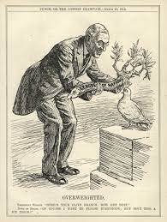
WWI – A War to End All Wars
Unit VII: 1914-1920

Slide 2
Objective 7.5: Explain causation and impact of the United States breaking its longstanding tradition of neutrality
Essential Question: How has America’s views been redefined by economic necessities, cultural notions, and national security during the turn of the 20th century?
Students can:
Explain the causes and consequences of U.S. involvement in WWI
Evaluate how the role of government was transformed by U.S. involvement in WWI
Describe the impact of international and internal migration patterns over time.
Agenda
The Precedent of Neutrality
Debating U.S. Interventionism
Imperialism Foreign Policy
Homework: Objective 17 Reading Questions

Slide 3
Take Up The Sword of Justice
“Whereas it is the duty and interest of the United States to observe conduct aforesaid towards powers those powers respectively; and to exhort and warn citizens of the United States carefully to avoid acts and proceedings whatsoever, which may in any manner to contravene the true spirit of neutrality, or to compromise peace of the United States . . .”
George Washington, “Proclamation of Neutrality” 1793
Why has the United States always stood for neutrality since Washington’s presidency?
What is the exception that the United States is always willing to make when dealing with European conflicts?

Slide 4
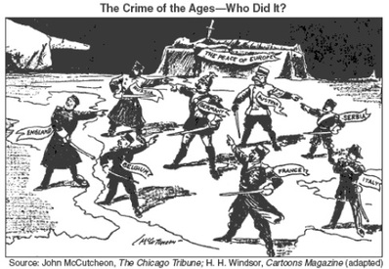
Driving the World to WAR!!!!!
Causation of WWI (1914-1918)
M: Militarism
A: Alliances
I: Industrialization & Imperialism
N: Nationalism
WWI Factions
Allied Powers: England, France, Russia, Italy & Japan (US 1917)
Central Powers: Germany, Austria-Hungary, & Ottoman Empire

Slide 5
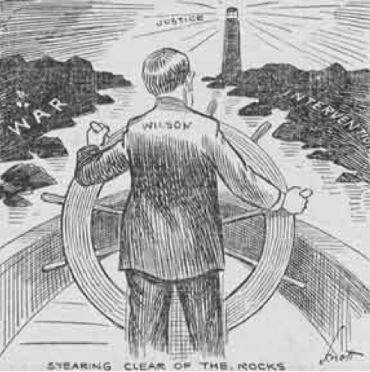
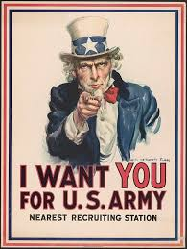
The Precedent of Neutrality
“Now, therefore, I, Woodrow Wilson, President of the United States of America, in order to preserve the neutrality of the United States and of its citizens and of persons within its territory and jurisdiction, and to enforce its laws and treaties, and in order that all persons, being warned of the general tenor of the laws and treaties of the United States in this behalf, and of the law of nations, may thus be prevented from any violation of the same, do hereby declare and proclaim that by certain provisions of the act . . .”
- Proclamation of Neutrality, 1914
Proclamation of Neutrality (1914) – U.S. willing to trade with Allied and Central Powers
Preparation for War
Council of National Defense (1916) (War mobilization effort)
Civilian Advisory Commissions formed in states

Slide 6
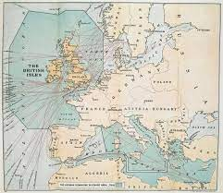
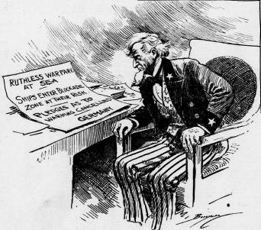
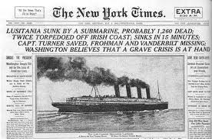
Driving America Towards War
Industrialize War (Machine Guns, Poison Gas, Submarines, Tanks)
War challenges to American neutrality:
German unrestricted submarine warfare
Sinking of the Lusitania (1915) – 128 Americans killed
Sussex Pledge (1916) – Germany end unrestricted warfare

Slide 7
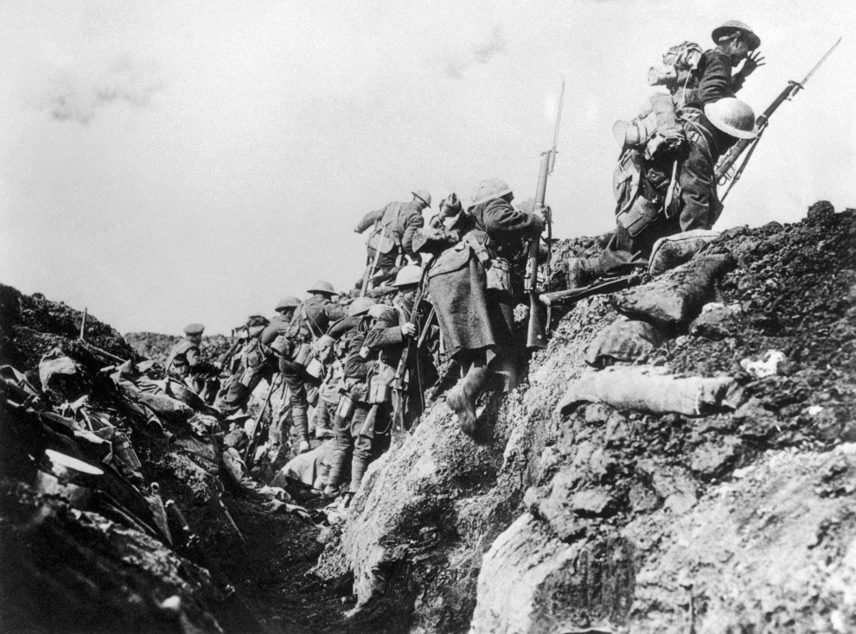
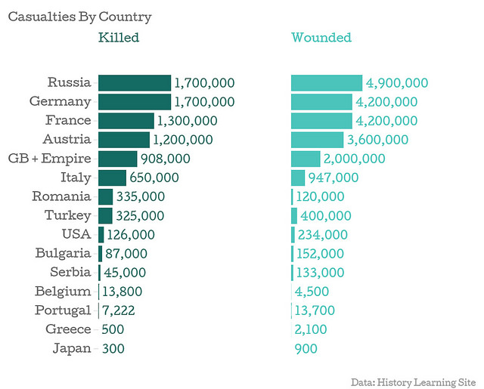
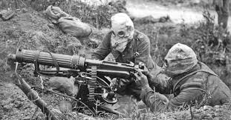
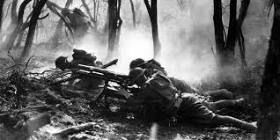
HORRORS WWI
WWI STALEMATE
Trench warfare

Slide 8
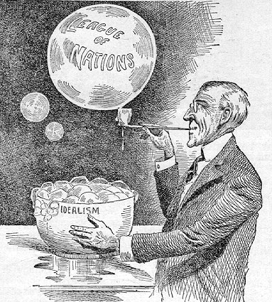
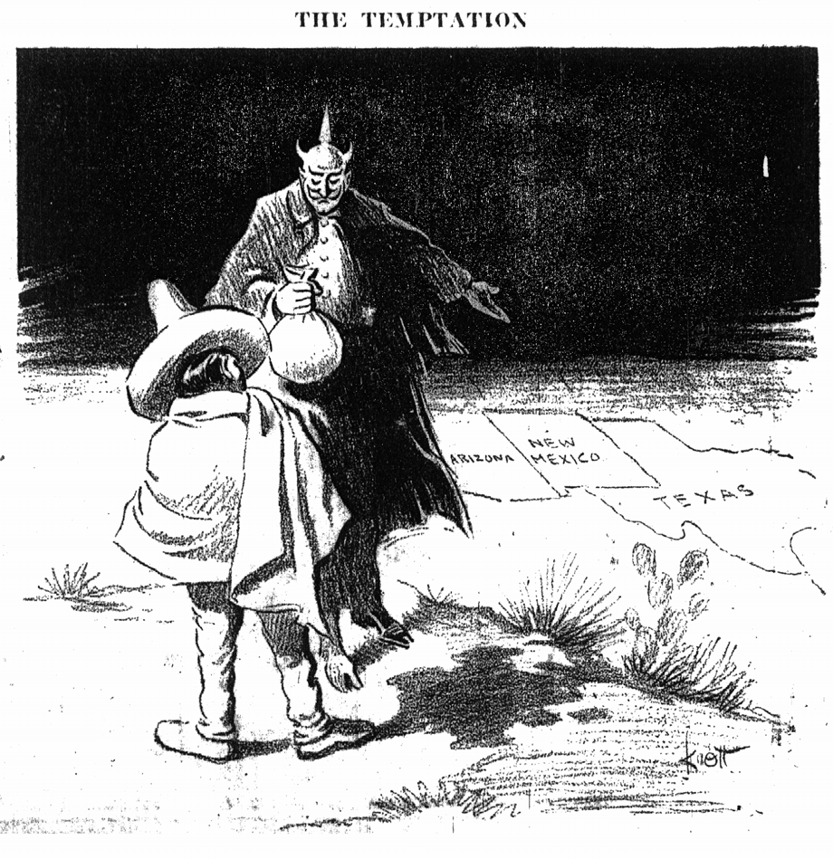
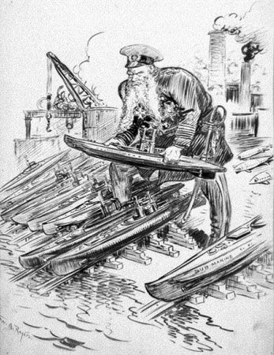
Breaking Washingtonian Precedent
Election of 1916: Wilson promises to maintain neutrality
Driving the U.S. to War
Zimmerman Telegram
Unrestricted Submarine warfare
U.S. Declaration of War 1917
Wilson pledge – “Fight a War to End All War”
14 Points of Peace
Prompt: Evaluate whether the United States should have taken part in WWI and accepted it role as a world power.

Slide 9
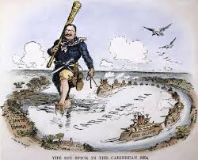
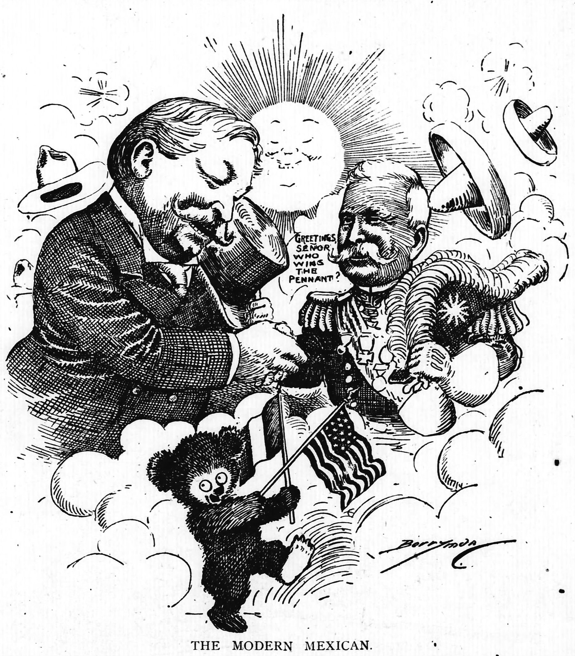
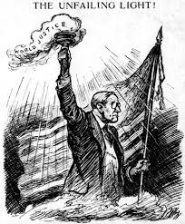
Comparing Imperialism Foreign Policy
Evaluate how the debate over U.S. interventionism impacted American foreign policy from 1901 to 1920.
Roosevelt’s Big Stick Diplomacy
Taft’s Dollar Diplomacy
Wilson’s Moral Diplomacy

Slide 10
Imperialism Impact
Evaluate how the debate over U.S. interventionism impacted American foreign policy from 1901 to 1920.
Explain how all three Presidents supported the Monroe doctrine.
Explain which imperialism policy did all three presidents rely on. (Use examples to support your answer)
What were the significant differences between Presidential imperialism policies?
How did Presidential imperialism policies support the wider debate about role of the United States on the world stage?

Slide 11
Objective 7.6: Explain how WWI mobilization impacted the role of government in lives of Americans and altered the lives of minorities and women.
Essential Question: How has America’s views been redefined by economic necessities, cultural notions, and national security during the turn of the 20th century?
Students can:
Explain the causes and consequences of U.S. involvement in WWI
Evaluate how the role of government was transformed by U.S. involvement in WWI
Describe the impact of international and internal migration patterns over time.
Agenda
Selling the War
WWI Mobilization
WWI Propaganda
Homework: Objective 17 Reading Questions

Slide 12
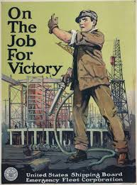
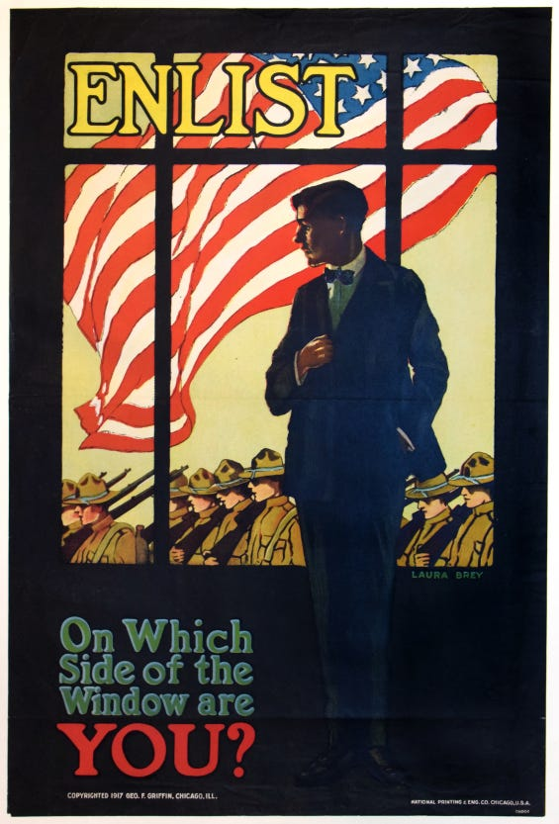
Selling the War
Explain how the role of government is transformed by U.S. entrance into WWI?
Selling the War

Slide 13
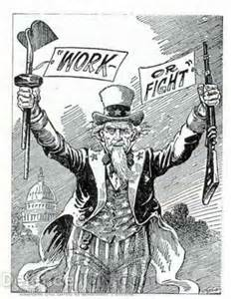
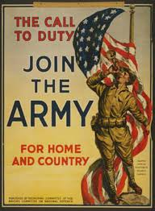
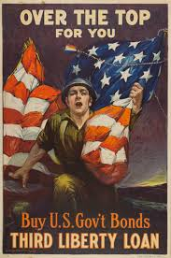
Selling the War Effort
President Wilson’s Decree “A War to End All Wars”
Selling the War Effort
Committee of Public Information (CPI): George Creel
Propaganda – promoting war mobilization
WWI Mobilization: Wilson’s Progressive beliefs
Government activism: government regulations (compliance required
Volunteerism: support the war effort (patriotic duty)

Slide 14
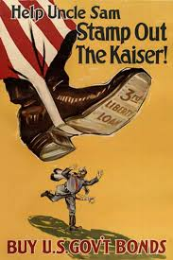
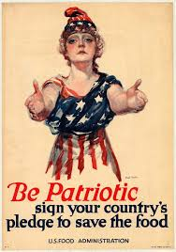
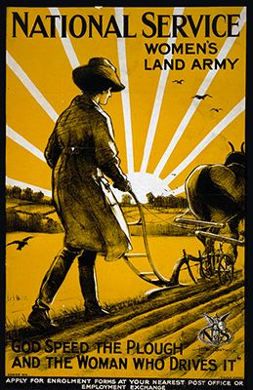
Innovation in War Effort
WWI mobilization innovations
War TIME 1ST
Selective Service Act: War time draft
Liberty Bonds: borrowing from civilians to finance the war effort
Rationing: limiting consumer goods for the war effort (food, gas, nylons)
Government intervention in economy
War Industries Board (Benard Burch)
Food Administration (Herbert Hoover)
Nation War Labor Board (William Taft)

Slide 15
WWI Government Activism
Developing WWI propaganda and explain how it supported war mobilization and whether it created great government activism in Americans’ lives.
The Fuel Administration under Harry Garfield was designed to promote fuel rationing and controlling fuel prices during WWI. It promoted volunteerism by encouraging rationing in the form of Heatless Mondays and assisted in the passage of day light savings time. But it gave government greater authority in the U.S. economy by being able to set prices and transportation costs for coal.

Slide 16
Objective 7.6: Explain how WWI mobilization impacted the role of government in lives of Americans and altered the lives of minorities and women.
Essential Question: How has America’s views been redefined by economic necessities, cultural notions, and national security during the turn of the 20th century?
Students can:
Explain the causes and consequences of U.S. involvement in WWI
Evaluate how the role of government was transformed by U.S. involvement in WWI
Describe the impact of international and internal migration patterns over time.
Agenda
The Call to War
WWI Cultural Effect
The role of government in America
Homework:
Unit VII Quiz – Monday 3/3 (Progressivism, Imperialism, &WWI)
Objective 17 Reading Questions due Wed. 3/5

Slide 17
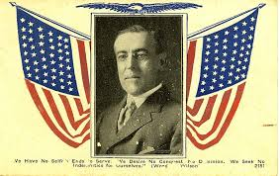
The Call to War
"We have no selfish ends to serve. We desire no conquest, no dominion. We seek no indemnities for ourselves, no material compensation for the sacrifices we shall freely make."
- President Woodrow Wilson
Describe a factor that led to the United States breaking its over 100-year tradition of maintaining neutrality.
Explain how President Woodrow Wilson built public support for WWI after the United States entered the war.

Slide 18
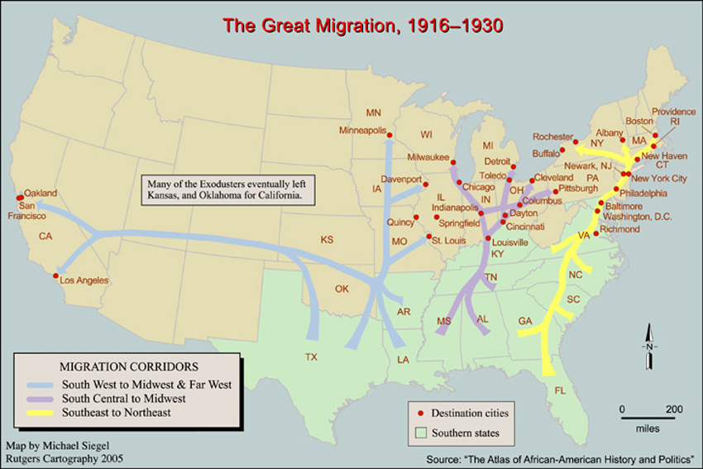
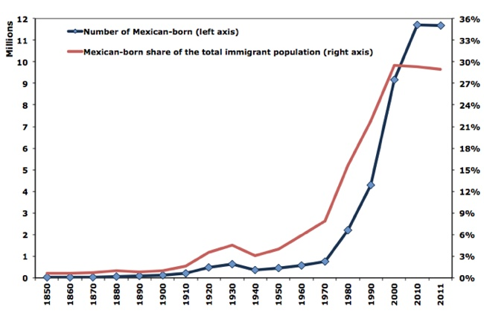
Migration Patterns
Mass population shift
Great Migration (African Americans); escaping Jim Crow
Latino immigration – Farm labor for war effort

Slide 19
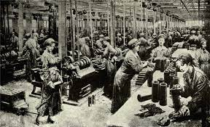
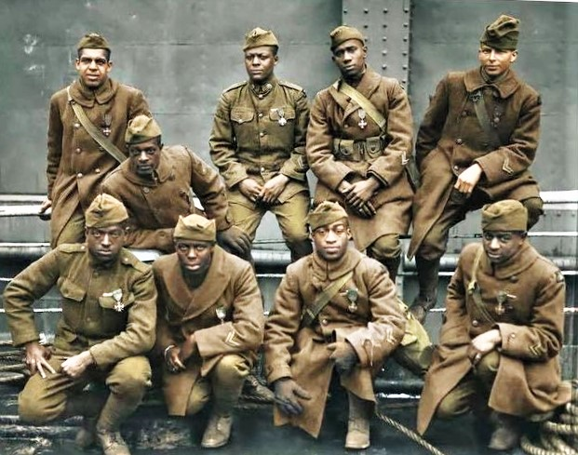
Opportunity
Women: factory workers 19th Amendment
African Americans (promote equality)
Great Migration – urbanization movement (Strike breakers)
Booker T Washington (Atlanta Compromise) Harlem Hell Fighters

Slide 20
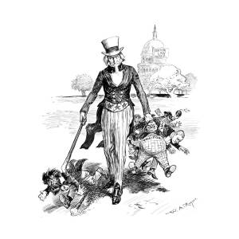
Security v. Freedom
War time challenges American civil liberties
Denial of Freedom:
Fear of socialism (Eugene V. Debs & Wobblies)
Espionage Act (1917) & Sedition Act (1918)
Schenck v. U.S. (1919) – “Clear & Present Danger”
Anti-German Sentiment: (Xenophobia)
Sauerkraut = Liberty Cabbage
18th Amendment: prohibition
Boycott German owned businesses

Slide 21
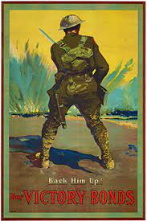
Loss of Laissez Faire
Prompt: Evaluate to what extent WWI expanded the progressive belief that the federal government should resolve problems in society and in the economy instead of supporting a laissez faire approach.
Write a one paragraph response to the prompt using historic evidence to support your claim.

Slide 22
Objective 7.5: Explain causation and impact of the United States breaking its longstanding tradition of neutrality
Essential Question: How has America’s views been redefined by economic necessities, cultural notions, and national security during the turn of the 20th century?
Students can:
Explain the causes and consequences of U.S. involvement in WWI
Evaluate how the role of government was transformed by U.S. involvement in WWI
Describe the impact of international and internal migration patterns over time.
Agenda
A war to end all wars
Setting the Role of America on World Stage
Debating U.S. Interventionism
Homework:
Unit VII Quiz – Monday 3/3 (Progressivism, Imperialism, &WWI)
Objective 17 Reading Questions due Wed. 3/5

Slide 23
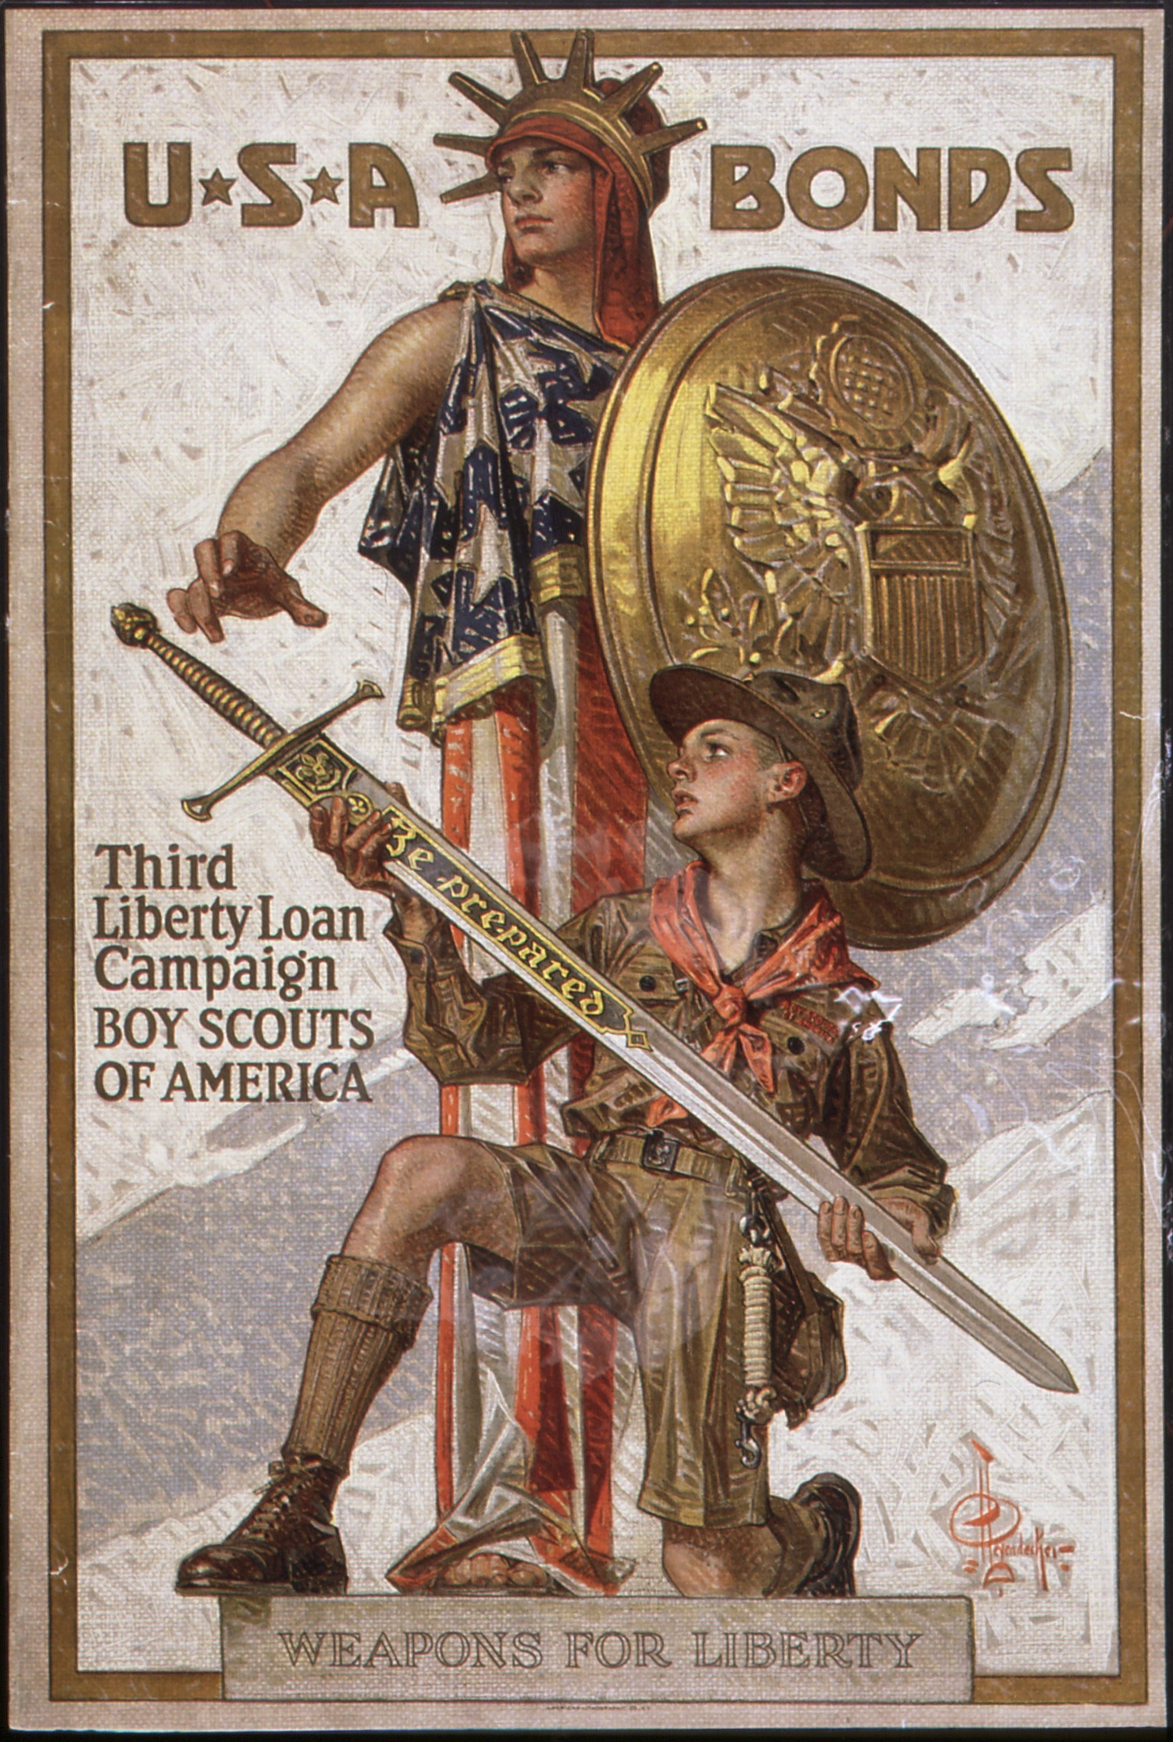
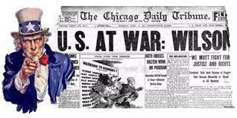
America on the World Stage
Shaping American foreign policy
U.S. Entrance in WWI
Evaluate whether the United States should have broken its longstanding tradition of neutrality and accepted it role as a world superpower.

Slide 24
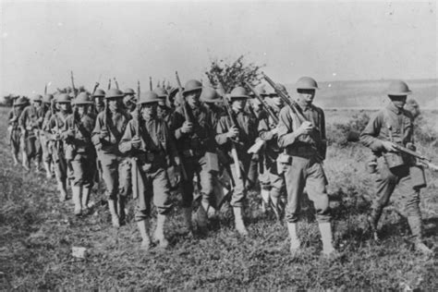
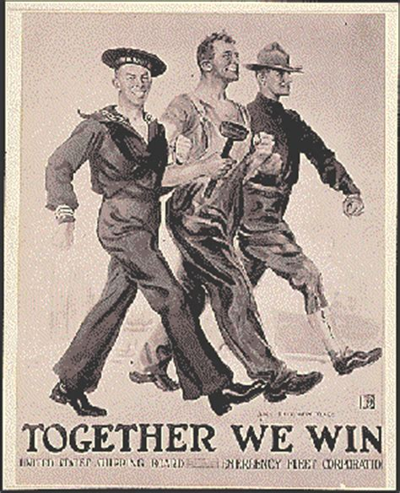
America at War
1917: Allies running out of new recruits
Selective Service Act 1917: the Draft
American Expeditionary Force (The Doughboys)
General John Perishing

Slide 25
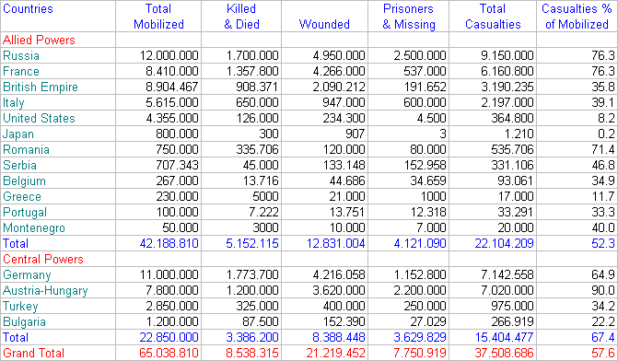
Industrial War Destruction

Slide 26
WWI Data

Slide 27
WWI Data

Slide 28
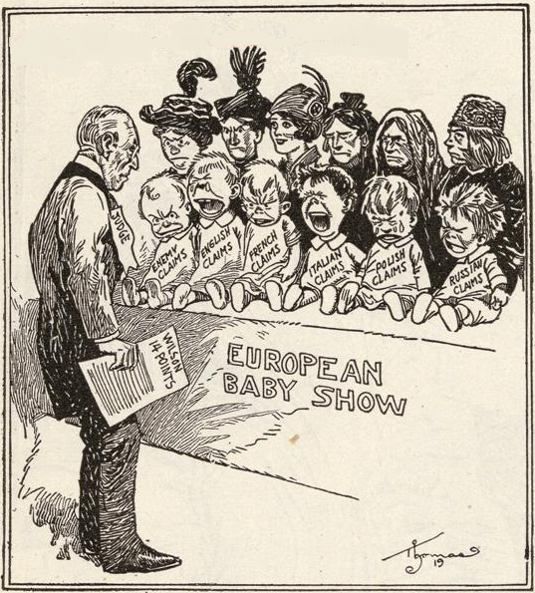
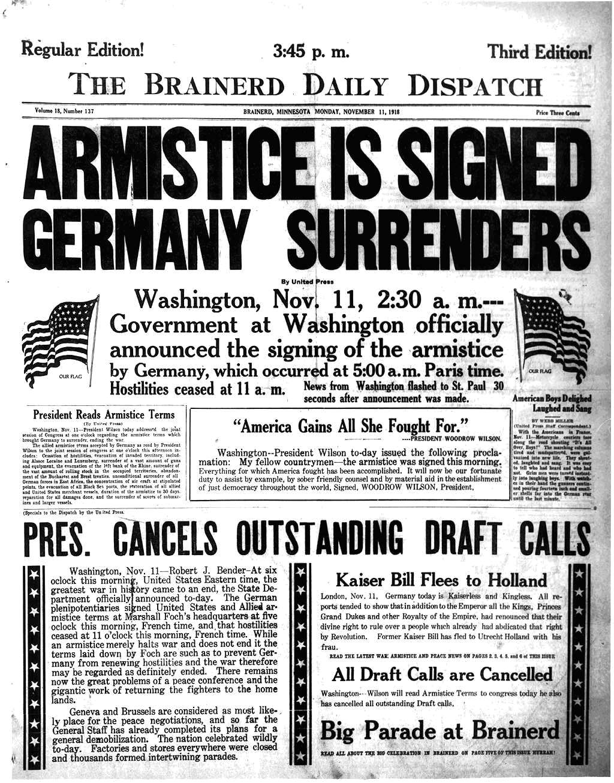
Armistice Day
Armistice, Nov. 11, 1918
US Forces provide needed fresh forces
Pres. Wilson’s a War to End All Wars – 14 Points of Peace

Slide 29
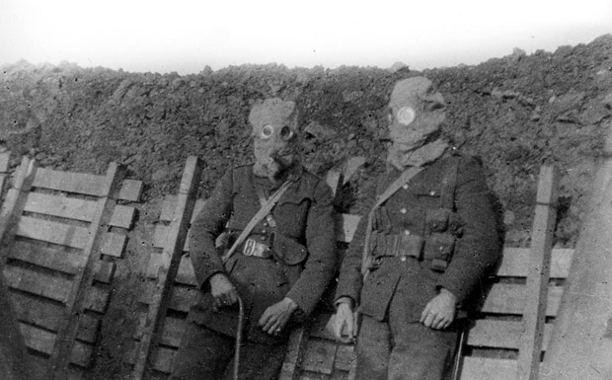
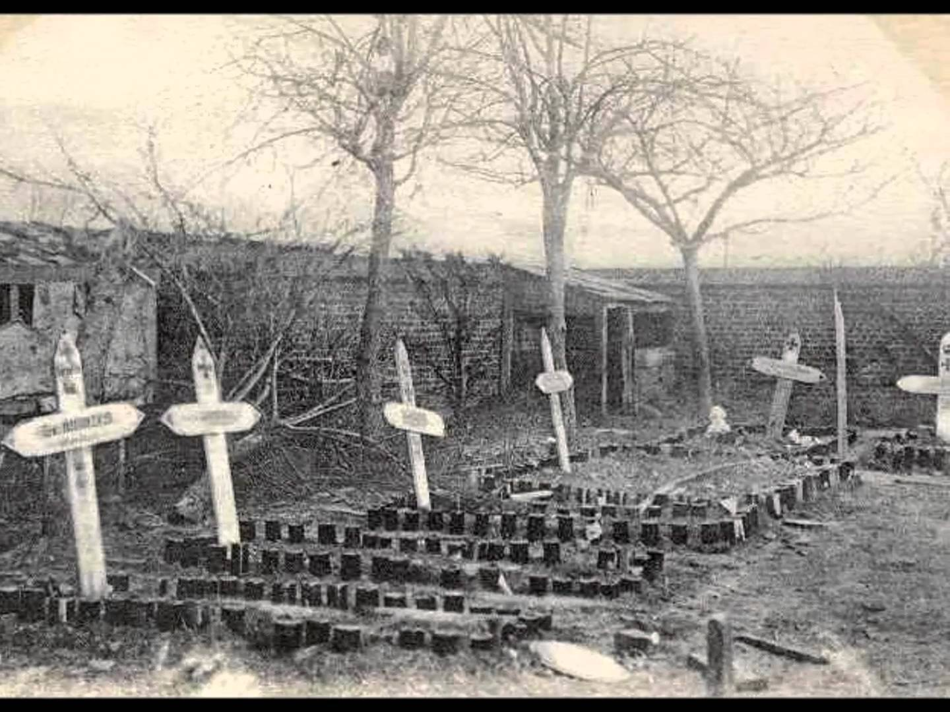
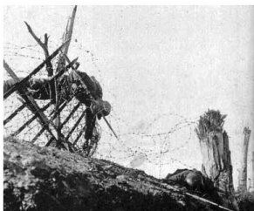
Remember the Falling
In the Green Fields of France
Evaluate how America’s experience in WWI influenced their perspective towards U.S. role on the world stage (internationalism)

Slide 30
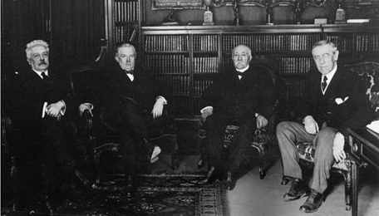
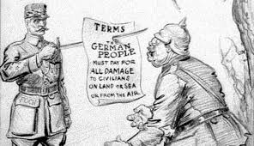
Peace at all COST
Versailles Peace Conference – Big FOUR: Wilson (US), Vittorio Orlando (Italy), David Lloyd George (Great Britain), and Georges Clemenceau (France)
Motivating Factors:
Wilson’s 14 Points of Peace (End all war)
Blame Germany for WWI (Europe)
Red Scare (Bolshevik Revolution)
Versailles Treaty 1918
League of Nations created (only part of Wilson’s 14 Points)
Germany pays war reparations (cause of WWII)

Slide 31
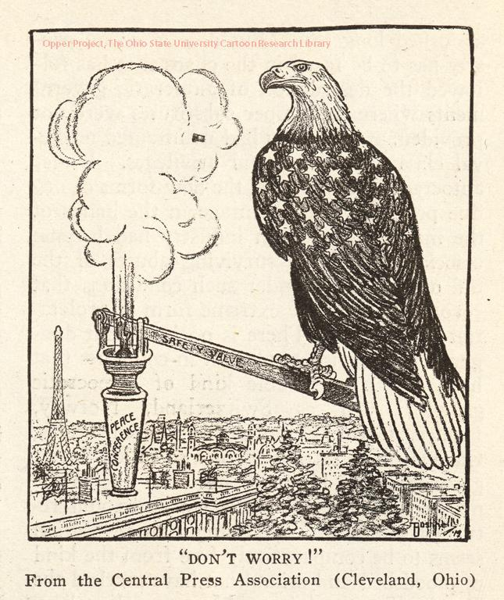
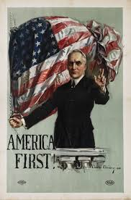
Return to Isolationism
Election of 1918: Republicans win control of Congress
Treaty of Versailles political division (Congress)
Irreconcilables – isolationism (stay out of European mess
Reservationists (Henry Cabot Lodge) – Remove Article X from Treaty of Versailles (Violates the U.S. Constitution – Declaration of War by Congress)
Election of 1920: (Referendum on the Treaty of Versailles) – U.S. rejects it role as a world superpower (ISOLATIONISM)
Warren G. Harding (R) – Normalcy

Slide 32
Return to Isolationism

