Slide 1
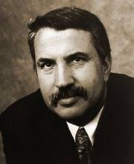
GLOBALIZATION Unit 8
“And then around 2000 came Globalization 3.0, in which the world from being small to tiny.”
- Thomas Friedman

Slide 2
CL.C&G.2.4: Compare the federal government of the United States to various types of government around the world in terms of balancing security and the protections of rights
CL.C&G.3.4: Compare citizenship in the American constitutional democracy to membership in other types of governments
CL.C&G.4.4: Assess how effective the American system of government has been in ensuring freedom, equality, and justice for all
Essential Question: How are governments created, structured, maintained, and changed?
Students can:
identify and describe various types of governments that have existed over time, across the world
compare citizenship in America to citizenship in other governments in terms of rights and responsibilities
Agenda:
Unit 6 Review
Unit 6 Test
Current Events Journals
Homework:
Current Events Journals

Slide 3
CL.C&G.2.4: Compare the federal government of the United States to various types of government around the world in terms of balancing security and the protections of rights
CL.C&G.3.4: Compare citizenship in the American constitutional democracy to membership in other types of governments
CL.C&G.4.4: Assess how effective the American system of government has been in ensuring freedom, equality, and justice for all
Essential Question: How are governments created, structured, maintained, and changed?
Students can:
identify and describe various types of governments that have existed over time, across the world
compare citizenship in America to citizenship in other governments in terms of rights and responsibilities
Agenda:
A Constitutional Republic
Forms of Government
Gummy Bear Governments
Homework:
No Homework
Current Events Journals due 5/20

Slide 4
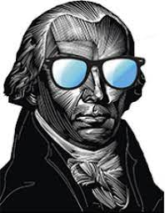
A Virtuous System
“Among the numerous advantages promised by a well constructed union, none deserves to be more accurately developed, than its tendency to break and control the violence of faction.”
- James Madison, Federalist 10, 1787
GENIUS!
The father of our Constitution, James Madison, designed a system of government that achieved three set goals. But it also encouraged values in all Americans that still resonate today.
What are the three goals of the Madisonisan Model of Government (U.S. Constitution)?
How does the U.S. Constitution instill in all Americans a set political culture based on five core values? (Use a core value to demonstrate how it works)

Slide 5
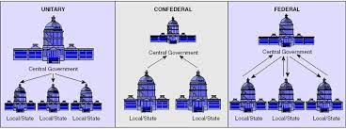
Government Systems
Government: a political system by which a country or community is administrated or administered regulated
Unitary System of Government
Confederation System of Government
Federal System of Government
Centralized power (national government)
(China & England)
Decentralized power – alliances of states (Articles of Confederation)
Division of power between state & national government (U.S. Constitution)

Slide 6
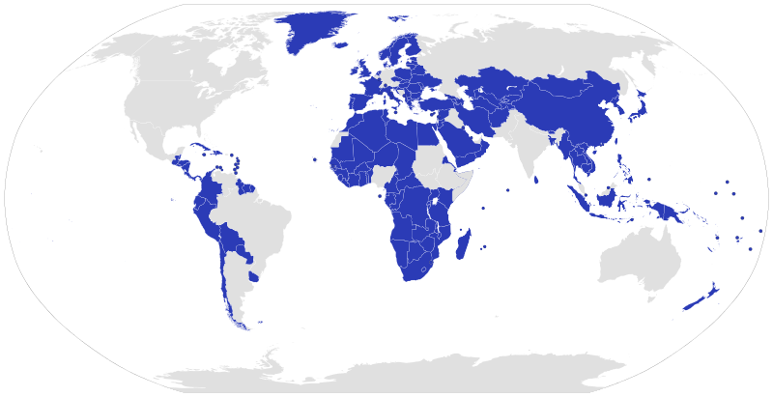
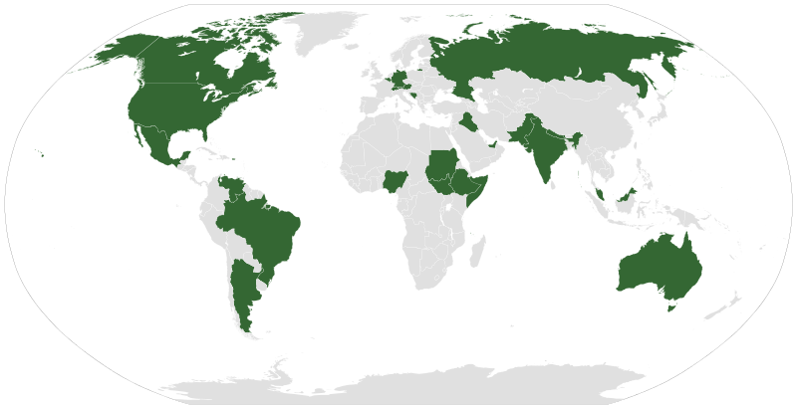
A World of Government
Governments of the World
Unitary Systems of Governments of the World
Federal System of Governments of the World

Slide 7
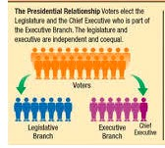
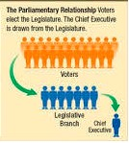
Executive v. Legislative Relationship
Two Types:
Presidential Government
Parliamentary Government
Executive and Legislative branches are separate (President & Congress)
Each branch elected separate
Two party system
Executive and legislative in the same branch (Prime Minister & Parliament)
Legislative branch elects prime minister
Multi-party system

Slide 8
Gummy Bear Government
All HAIL, the MIGHTY GUMMY BEARS!
Demonstrate how a form of government works
Gummy Bear Government:
As a group complete the reading and fill out the chart on your assigned government
Design an image of how the government works using the gummy bears (you may use other props)
Write the important information of the sheet of paper and setup your gummy bears
Take a picture of your design and information and email it Mr. Hultberg (hultbea@gcsnc.com) with the names of the group members on the subject line

Slide 9
Forms of Government
Arrange the forms of government along the political spectrum to demonstrate how power shifts from the many to one.
Power Spectrum
Democratic
Dictatorship
Socialism
Autocracy
Representative Democracy
Anarchy
Direct Democracy
Theocracy
Monarchy
Oligarchy

Slide 10
CL.C&G.2.4: Compare the federal government of the United States to various types of government around the world in terms of balancing security and the protections of rights
CL.C&G.3.4: Compare citizenship in the American constitutional democracy to membership in other types of governments
CL.C&G.4.4: Assess how effective the American system of government has been in ensuring freedom, equality, and justice for all
Essential Question: How are governments created, structured, maintained, and changed?
Students can:
identify and describe various types of governments that have existed over time, across the world
compare citizenship in America to citizenship in other governments in terms of rights and responsibilities
Agenda:
Governments from around the world
Gummy Bear Governments Analysis
Power vs. Freedom
Homework:
The Meaning of the Declaration of Independence

Slide 11
Governments around the World
Identify the for of government
___ 1. In Switzerland the people elected others to serve in legislative bodies, but also vote several times a year on proposed laws
___ 2. In South Africa, the political power remains with the white minority population and the black majority population are denied representation and say in government
___ 3. Saudi Arabia, the King appoints a council of Ministers to help him govern. Under the Saudi’s Constitution the Islamic holy book the Qur’an is recognized as the law of the land.
___ 4. In North Korea, one man leads and controls its government. He also controls the country’s political party which choose the people who runs for government and the people do elect, but really get no say in their government.
___ 5. In Denmark, the people elected a parliament legislative body. The Queen of Denmark leads the country, but only has limited role in government. The Prime Minister is the elected head of government.
___ 6. In Brazil, the people elect a president every four years, as well as elect the legislative body.

Slide 12
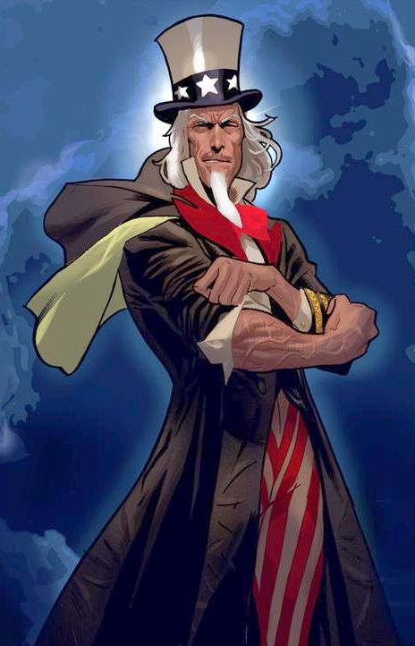
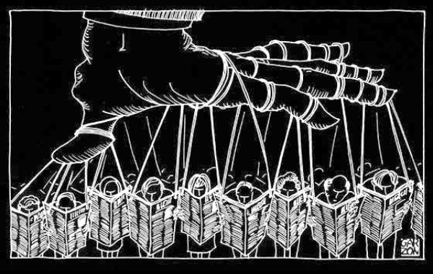
Characteristics of Government Authority
The shape of government authority
Chart characteristics of types of government authority
Definition
Advantage
Disadvantage

Slide 13
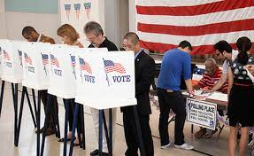
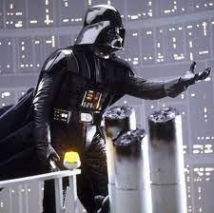
The True Face of Government
We have the power!
Understanding who has the power to govern
Democracy
Who has the power to govern?
How much liberty are citizens granted?
Why is liberty either restricted or expanded under a form of government?
Why does no form of government grant freedom?
How is government power restrained?
Anarchy
Monarchy
I have the power!
Theocracy
Autocracy
Oligarchy
Socialism

Slide 14
Form of Governments
Socialism
Autocracy
Representative Democracy
Anarchy
Direct Democracy
Theocracy
Monarchy
Oligarchy
Evaluate the best type of government the fits the description
Fairest to all the people it governs
Provides the greatest security to the people
Creates the most economic opportunity
Represents Thomas Hobbes view of government
Represents John Locke’s view of government
Denies the most liberty to the people
Allows for decisions to be made quickly
Is the most moral
Gives the greatest liberty to the people
Only benefits the few

Slide 15
Forms of Government
Arrange the forms of government along the political spectrum to demonstrate how power shifts from the many to one.
Power Spectrum
Democratic
Dictatorship
Socialism
Autocracy
Representative Democracy
Anarchy
Direct Democracy
Theocracy
Monarchy
Oligarchy

Slide 16
CL.C&G.2.4: Compare the federal government of the United States to various types of government around the world in terms of balancing security and the protections of rights
CL.C&G.3.4: Compare citizenship in the American constitutional democracy to membership in other types of governments
CL.C&G.4.4: Assess how effective the American system of government has been in ensuring freedom, equality, and justice for all
Essential Question: How are governments created, structured, maintained, and changed?
Students can:
identify and describe various types of governments that have existed over time, across the world
compare citizenship in America to citizenship in other governments in terms of rights and responsibilities
Agenda:
Citizenship Test
Declaration of American Citizens
Being an American
Homework:
Being an American

Slide 17
Jefferson’s Founding Idealism
We hold these truths to be self-evident, that all men are created equal, that they are endowed by their Creator with certain unalienable Rights, that among these are Life, Liberty and the pursuit of Happiness.–That to secure these rights, Governments are instituted among Men, deriving their just powers from the consent of the governed, –That whenever any Form of Government becomes destructive of these ends, it is the Right of the People to alter or to abolish it, and to institute new Government, laying its foundation on such principles and organizing its powers in such form, as to them shall seem most likely to effect their Safety and Happiness.
- Declaration of Independence
According to the Declaration of Independence what are guiding ideas of America as a nation?
How did these guiding ideas become incorporated in the U.S. Constitution and the republic that it forms?

Slide 18
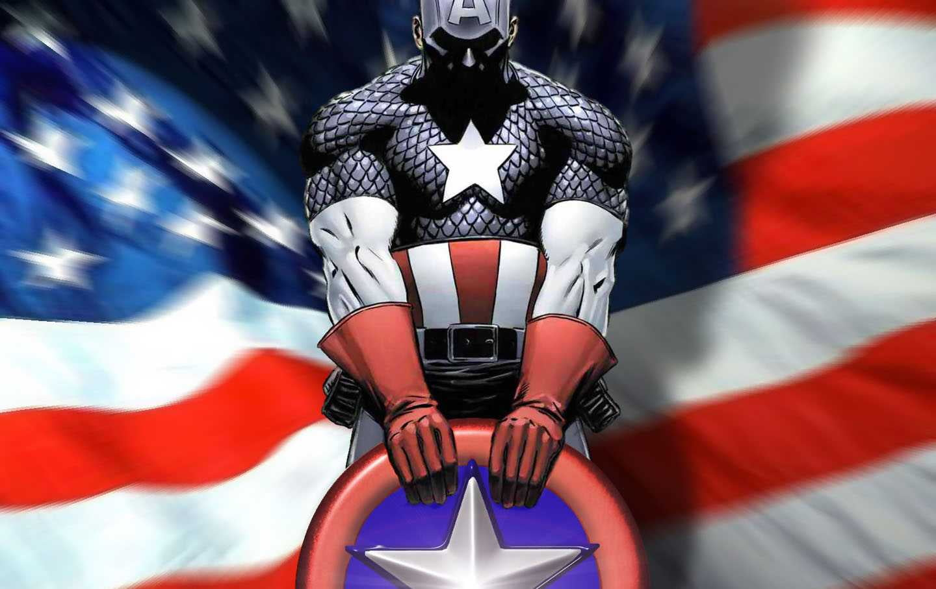
Being An American
“Educate and inform the whole mass of the people. They are the only sure reliance for the preservation of our liberty.”
- Thomas Jefferson
Illustrate and explain why democracy empowers and relies on the people to properly function.
Privileges
Duties
Responsibilities
Kryptonite (failures of the people)

Slide 19
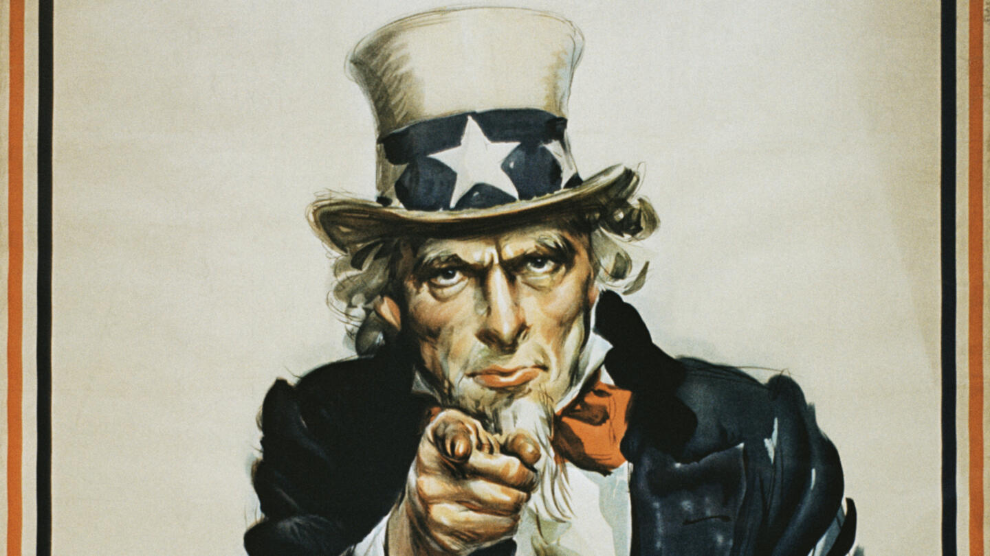
Citizenship
I want you to understand what it means to be a citizens in a democracy!
Identify as (P) privilege, (D) duty, or (R) responsibility
__ 1. Paying taxes
__ 2. Freedom of speech
__ 3. Serving on a jury
__ 4. Registering for the draft
__ 5. Voting in elections
__ 6. Obeying the law
__ 7. Owning a home
__ 8. Volunteering
__ 9. Serving in the military

Slide 20
CL.C&G.2.4: Compare the federal government of the United States to various types of government around the world in terms of balancing security and the protections of rights
CL.C&G.3.4: Compare citizenship in the American constitutional democracy to membership in other types of governments
CL.C&G.4.4: Assess how effective the American system of government has been in ensuring freedom, equality, and justice for all
Essential Question: How are governments created, structured, maintained, and changed?
Students can:
identify and describe various types of governments that have existed over time, across the world
compare citizenship in America to citizenship in other governments in terms of rights and responsibilities
Agenda:
Brave New World
Governmental Spectrum
Investigating another nation
Homework:
Global Citizen Comparison

Slide 21
A Brave New World
Living in a foreign land
You are moving to a new country to live and work. What do you need to know about the country before you relocate?

Slide 22
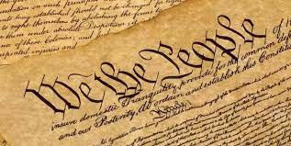
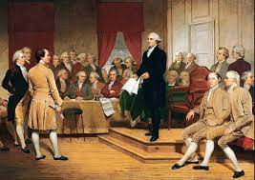
Democratic Governments
Democratic government – power to govern derives from the people
Protect & maintain liberties of citizens
Create access points for the voice of the people to be heard
Relies on suffrage to select government policies and elected officials
Uses a system of checks & balances and separation of powers to restrain government power

Slide 23
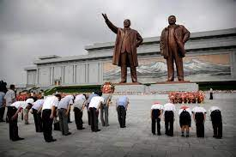
Authoritarian Governments
Authoritarianism – government in which the authority to rule is concentrated in a leader or few elites
Limit individual liberties
Non-competitive elections
Leaders use power arbitrarily
Dissidents jailed or punished
Nationalism – preserve the culture and power of the government (reverence towards leader)
North Koreans bowing before the statues of Kim Il Sung & Kim Jong Il

Slide 24
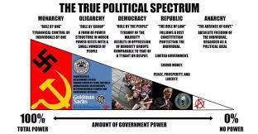
Governmental Analysis
Government of the people or a government of the few?
Factors:
Privileges of the people – “liberty”
Duties of the people – requirements
Responsibilities of the people – ask of them

Slide 25
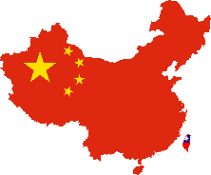
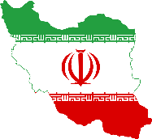
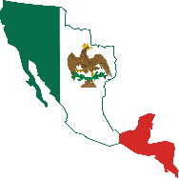
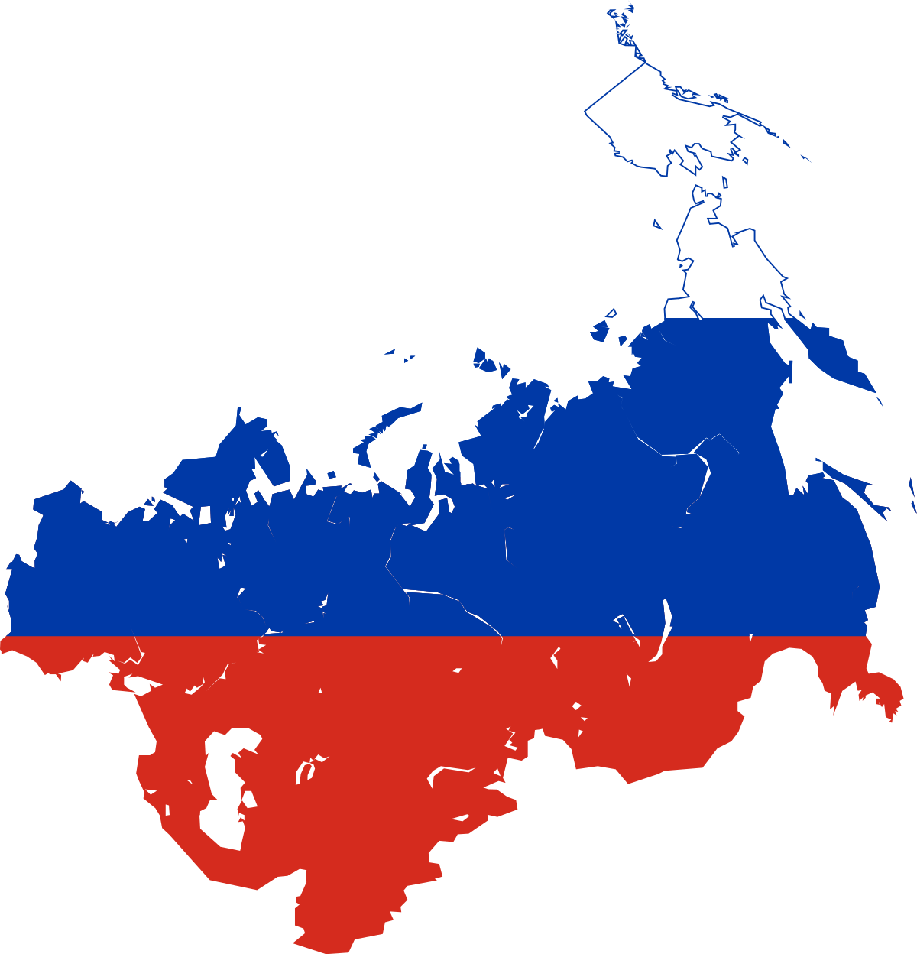
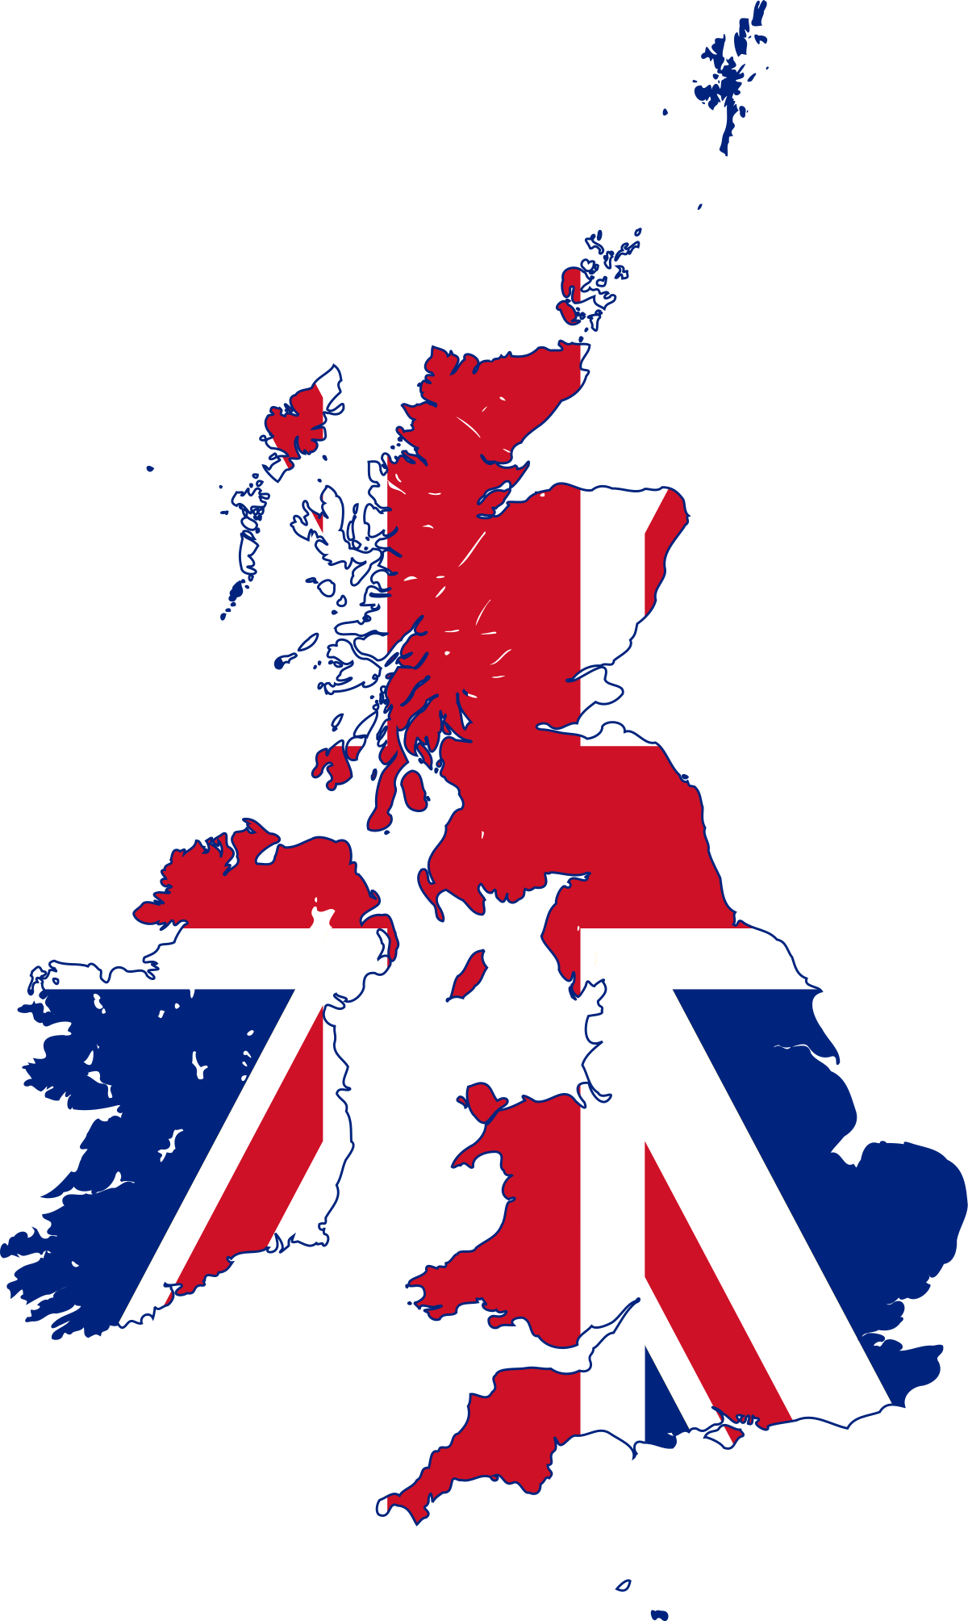
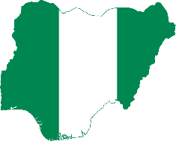
Comparison Nations
6 Nations
China
Iran
Mexico
Nigeria
Russia
United Kingdom

Slide 26
Traveling Aboard
Design a travel poster that represents your nation and the treatment of its citizens
Include information from your research to explain whether the nation upholds the ideas of civil liberties or is an autocracy that limits them

Slide 27
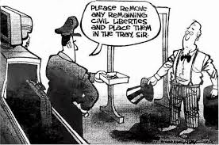
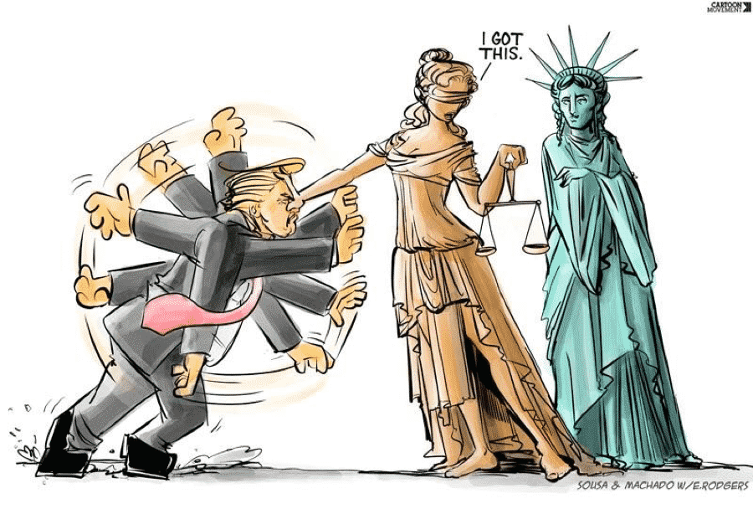
Diagnostic Nation
Government authority v. citizens’ rights
For your specific nation – what type of government governs the nation?
How does that nation grant or deny civil liberties?
Authoritarianism
Democracy

Slide 28
CL.C&G.2.4: Compare the federal government of the United States to various types of government around the world in terms of balancing security and the protections of rights
CL.C&G.3.4: Compare citizenship in the American constitutional democracy to membership in other types of governments
CL.C&G.4.4: Assess how effective the American system of government has been in ensuring freedom, equality, and justice for all
Essential Question: How are governments created, structured, maintained, and changed?
Students can:
identify and describe various types of governments that have existed over time, across the world
compare citizenship in America to citizenship in other governments in terms of rights and responsibilities
Agenda:
A Principled Government
Governmental Spectrum
Investigating another nation
Homework:
Travel Poster for a Nation

Slide 29
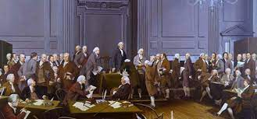
It’s a Principled Constitution
Founding Fathers’ views on government
Build a system of limited government
What about the liberties of the people?
A centralized government is tyrannical
Principles and Foundations of the U.S. Constitution
What two things did the founders of this country fear? How did they address these in the Constitution?
What does Mark Levin mean by "mob-ocracy?" How does this relate to majority rule?
How did the Articles of Confederation reflect the Framers’ concerns about centralization discussed by Levin?
How does our current system reflect the framers’ concerns about “mobocracy”?

Slide 30
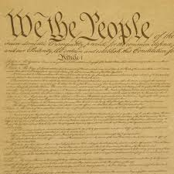
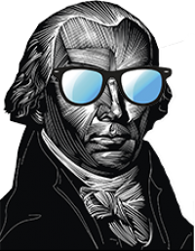
A Limited Government
Madisonian Model of Government – limiting power of government and majoritarian
Checks & Balances
Federalism
If men were angels, no government would be necessary.
Separation of Powers
Rule of Law
Popular sovereignty
Individual Liberties
Republicanism

Slide 31
Comparison Nations
6 Nations
China
Iran
Mexico
Nigeria
Russia
United Kingdom

Slide 32
Traveling Aboard
Design a travel poster that represents your nation and the treatment of its citizens
Include information from your research to explain whether the nation upholds the ideas of civil liberties or is an autocracy that limits them

Slide 33
Who has the POWER
The Founding Fathers designed the U.S. Constitution to restrain power. One of the main facets of limited government was the incorporation of the principle of separation of powers.
__ 1. Declare war
__ 2. judicial review
__ 3. Commander in chief
__ 4. Make treaties
__ 5. Impeach a federal official
__ 6. Veto
__ 7. Power of the purse
__ 8. Interpret the Constitution

Slide 34
CL.C&G.2.4: Compare the federal government of the United States to various types of government around the world in terms of balancing security and the protections of rights
CL.C&G.3.4: Compare citizenship in the American constitutional democracy to membership in other types of governments
CL.C&G.4.4: Assess how effective the American system of government has been in ensuring freedom, equality, and justice for all
Essential Question: How are governments created, structured, maintained, and changed?
Students can:
identify and describe various types of governments that have existed over time, across the world
compare citizenship in America to citizenship in other governments in terms of rights and responsibilities
Agenda:
Hallmarks of a Limited Government
International Scene
Global Citizen Comparison
Homework:
Current Issues in American Foreign Policy

Slide 35
Constitutional Restraints
James Madison wrote “The real measure of the powers meant to be granted to Congress by the Constitution is to be sought in the specifications...not...with a latitude that, under the name or means for carrying into execution a limited government, would transform it into a government without limits.” In stated this Madison demonstrates great understanding of how a proper government should operate in order to meet its objective goals. His experiences and studies of government assisted him in constructing the U.S. Constitution that has met the demands of future generations while still holding true to its founding ideas.
After reading the scenario, please respond to A, B, and C below.
James Madison stated “means for carrying into execution a limited government” to describe how the Constitutional Republic should work. Explain ONE idea incorporated into formation of the Constitution and how it supports the meaning of the quote.
Explain how the Articles of Confederation proved to the Founding Fathers that a decentralized government could NOT properly govern America.
Identify and explain ONE example of how the Constitution maintains a proper balance between liberty and security in American society.

Slide 36
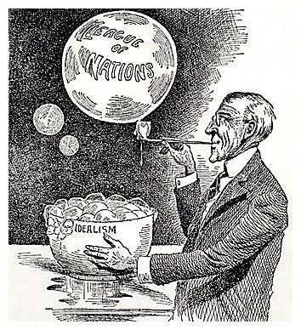
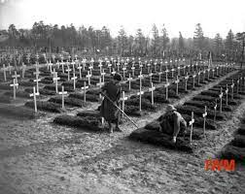
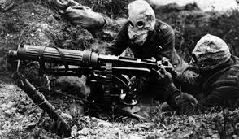
Rise of Cooperation????
Internationalism: a political idea that supports greater political and economical cooperation between nations
WWI – first industrialize war (death & destruction on a new scale)
Causation:
Militarism
Alliances (secretly formed)
Imperialism/Industrialism
Nationalism
President Wilson’s 14 Points of Peace
League of Nations – promote international cooperation
Resolve international issue through peaceful diplomacy
FAILED!!!!

Slide 37
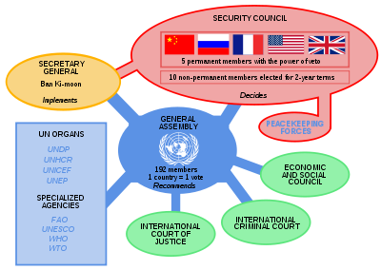
Cooperation Reborn
WWII – FDR revives Wilson’ plan for internationalism
Goals of the United Nations: promote peace, security, international law, economic development, and human rights
United Nations – formed 1944

Slide 38
Expanded Internationalism
Bretton Woods Conference 1944 – inability to trade and develop economic prosperity leads to war (causes of WWI & WWII)
Resolution:
World Bank: worked with developing countries to reduce poverty and increase share in prosperity
International Monetary Fund: (IMF) stabilize international monetary system and monitor world currencies

Slide 39
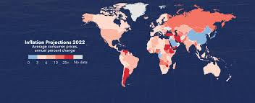
The Trend of Globalization
Globalization: the interdependence of nations around the globe caused by the growth of free trade
Effects:
Spread of technology
Access to resources & products
Cultural exchanges
Multi-national Corporations
Issue: economic issues in one part of the world impacts all of the world (Ex. War in Ukraine)
RISE OF INFLATION

Slide 40
Comparison Nations
6 Nations Comparison – Share how each nation governs its citizens through your travel posters
China
Iran
Mexico
Nigeria
Russia
United Kingdom

Slide 41
Democratic or Autocratic
Compare the 6 Nations and determine which have similar values to the United States in governing its citizens (Provide examples that support your conclusions)
DEMOCRATIC – LAND OF THE FREE
AUTOCRATIC – NO FREEDOM HERE
I want you to be FREE!
My way ONLY!

Slide 42
CL.C&G.2.4: Compare the federal government of the United States to various types of government around the world in terms of balancing security and the protections of rights
CL.C&G.3.4: Compare citizenship in the American constitutional democracy to membership in other types of governments
CL.C&G.4.4: Assess how effective the American system of government has been in ensuring freedom, equality, and justice for all
Essential Question: How are governments created, structured, maintained, and changed?
Students can:
identify and describe various types of governments that have existed over time, across the world
compare citizenship in America to citizenship in other governments in terms of rights and responsibilities
Agenda:
Comparison Governments
The Execution of Foreign Policy
Who is more powerful?
Homework:
Who is the most powerful?

Slide 43
Comparison Nations
6 Nations Comparison – Share how each nation governs its citizens through your travel posters
China
Iran
Mexico
Nigeria
Russia
United Kingdom

Slide 44
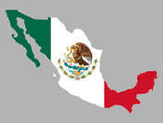
Mexican Citizenship
Mexico distinguishes between natural born citizen and naturalized citizens
Naturalized citizens cannot hold political office
Duties, Responsibilities and Privileges
Privilege
Vote in elections
Peacefully assemble and petition
Live and work
Freedom House Rating:
Partly free
Issue – government corruption and violence caused by drug cartels have lead to human rights abuses
Responsibility
Run for office (if natural born)
Enlist in the military
Duties
Obey the law
Pay taxes

Slide 45
Democratic or Autocratic
Compare the 6 Nations and determine which have similar values to the United States in governing its citizens (Provide examples that support your conclusions)
DEMOCRATIC – LAND OF THE FREE
AUTOCRATIC – NO FREEDOM HERE
I want you to be FREE!
My way ONLY!

Slide 46
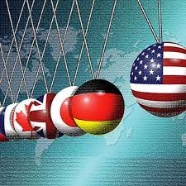
Pressing Foreign Policy Issues
Evaluating The United States role in the World
In your groups:
Discuss which foreign policy issues are the most pressing for the United States
How equipped is the United States in handling the issues?
Evaluate whether the United States should take a primary role in dealing with international problems.

Slide 47
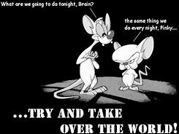
Foreign Relations
Foreign policy: the objectives that guide U.S. relationships with other nations
Protect & Promote National Security
Promote World Peace
Promote Democracy
Promote International Trade

Slide 48
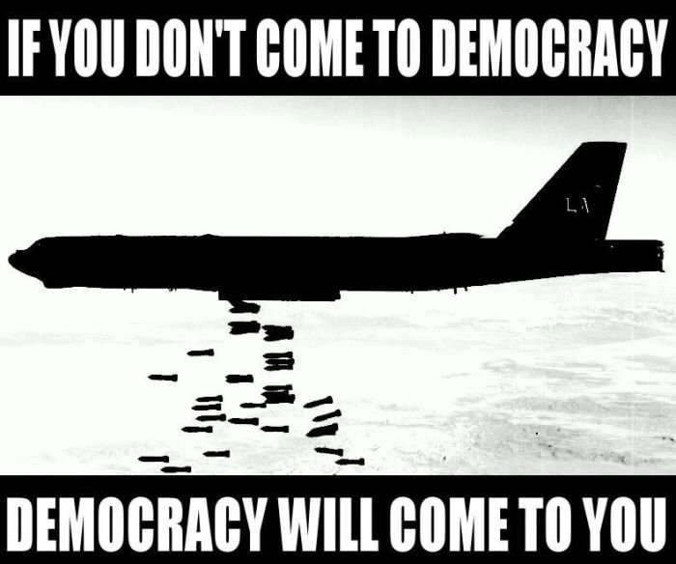
The TOOLS to Persuade
Tools & Tactics to support American foreign policy agenda
DIPLOMACY: Negotiate
Foreign aid: use gives money to assist them in dealing with a crisis
Ambassadors: represent the U.S. in foreign countries
Treaties: agreements between nations (with the consent of Senate)
Meeting & Receiving Diplomats
Executive Agreements: do not require Senate approval

Slide 49
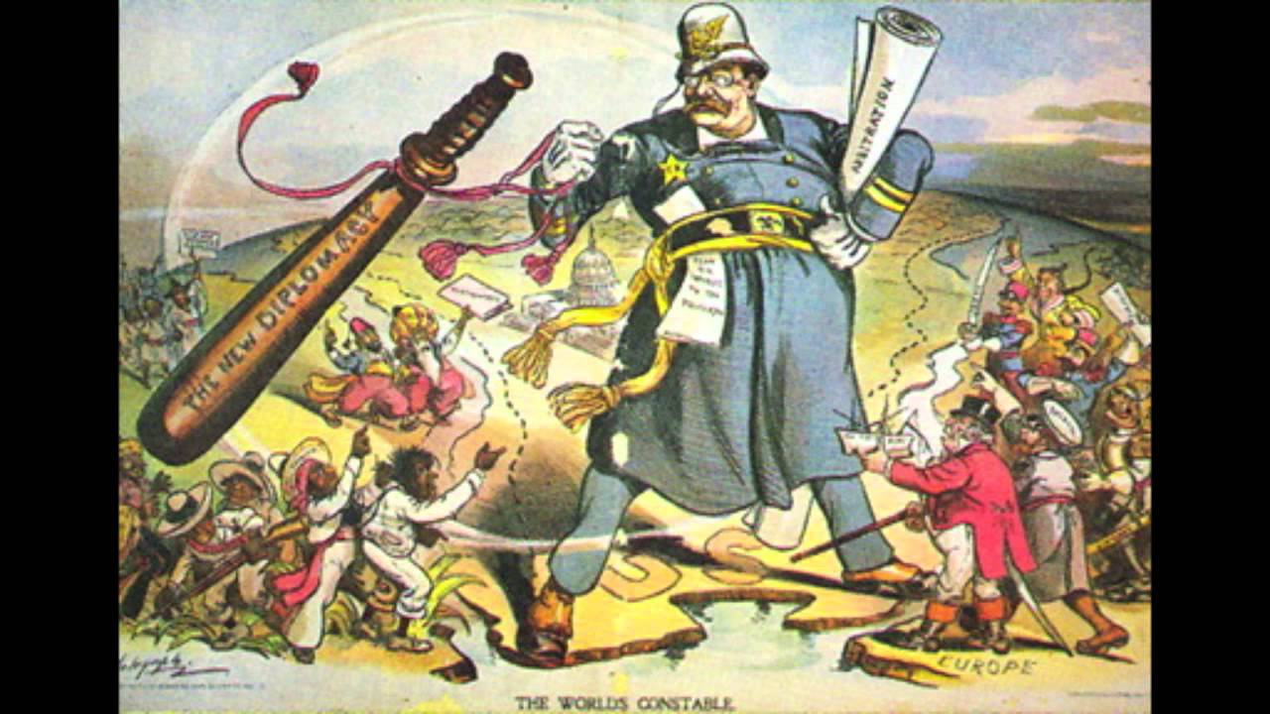
The TOOLS to Persuade
Foreign policy enforcement
Commander in Chief: use the military
War PowersResolution: commit troops to action for 60 days without a declaration of war
Tariffs – tax on imports
Embargo – refusal to trade with another country
Trade sanctions = blocking trades

Slide 50
CL.C&G.2.4: Compare the federal government of the United States to various types of government around the world in terms of balancing security and the protections of rights
CL.C&G.3.4: Compare citizenship in the American constitutional democracy to membership in other types of governments
CL.C&G.4.4: Assess how effective the American system of government has been in ensuring freedom, equality, and justice for all
Essential Question: How are governments created, structured, maintained, and changed?
Students can:
identify and describe various types of governments that have existed over time, across the world
compare citizenship in America to citizenship in other governments in terms of rights and responsibilities
Agenda:
Founding Perspective on Entanglements
A Limited Government?
Constitutional Debate on Foreign Policy
Homework:
Constitutional Debates in Foreign Policy
Current Events Journals due 5/20

Slide 51
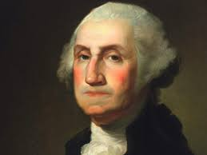
Washington’s Warnings
Europe has a set of primary interests which to us have none or a very remote relation. Hence she must be engaged in frequent controversies, the causes of which are essentially foreign to our concerns. Hence, therefore, it must be unwise in us to implicate ourselves by artificial ties in the ordinary vicissitudes of her politics or the ordinary combinations and collisions of her friendships or enmities.
Our detached and distant situation invites and enables us to pursue a different course. If we remain one people, under an efficient government, the period is not far off when we may defy material injury from external annoyance; when we may take such an attitude as will cause the neutrality we may at any time resolve upon to be scrupulously respected; when belligerent nations, under the impossibility of making acquisitions upon us, will not lightly hazard the giving us provocation; when we may choose peace or war, as our interest, guided by justice, shall counsel.
Why forego the advantages of so peculiar a situation?
Entanglements?
Evaluate how Washington views how the United States should proceed in dealing with relations with Europe?
Why do you think President Washington suggested this approach to foreign policy at the end of his presidency?

Slide 52
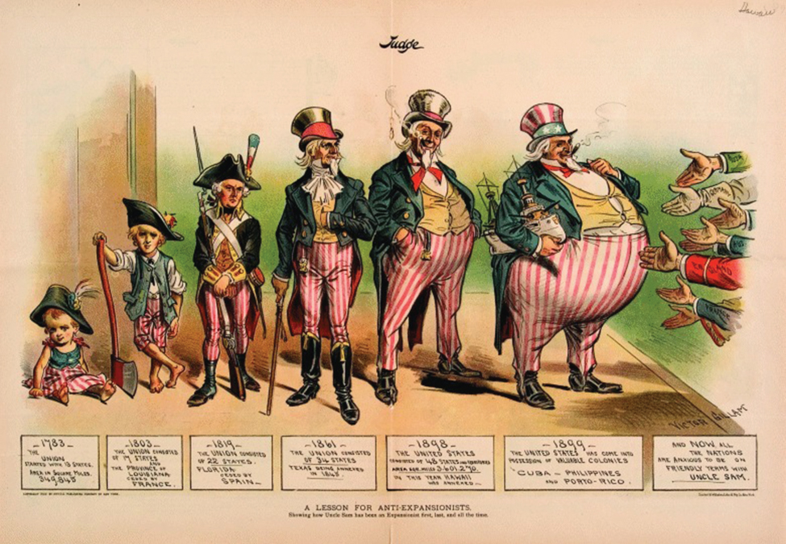
Uncle Sam’s Progressive Stages from Childhood
Analyze the political cartoon
Symbols: images in the cartoon that represent something else
Captions: Titles and written words
Activities: what is happening in the cartoon (helps to solve symbols & message)
Message: What is the cartoonist’s point of view and purpose?
Subject: What is the topic of the cartoon?

Slide 53
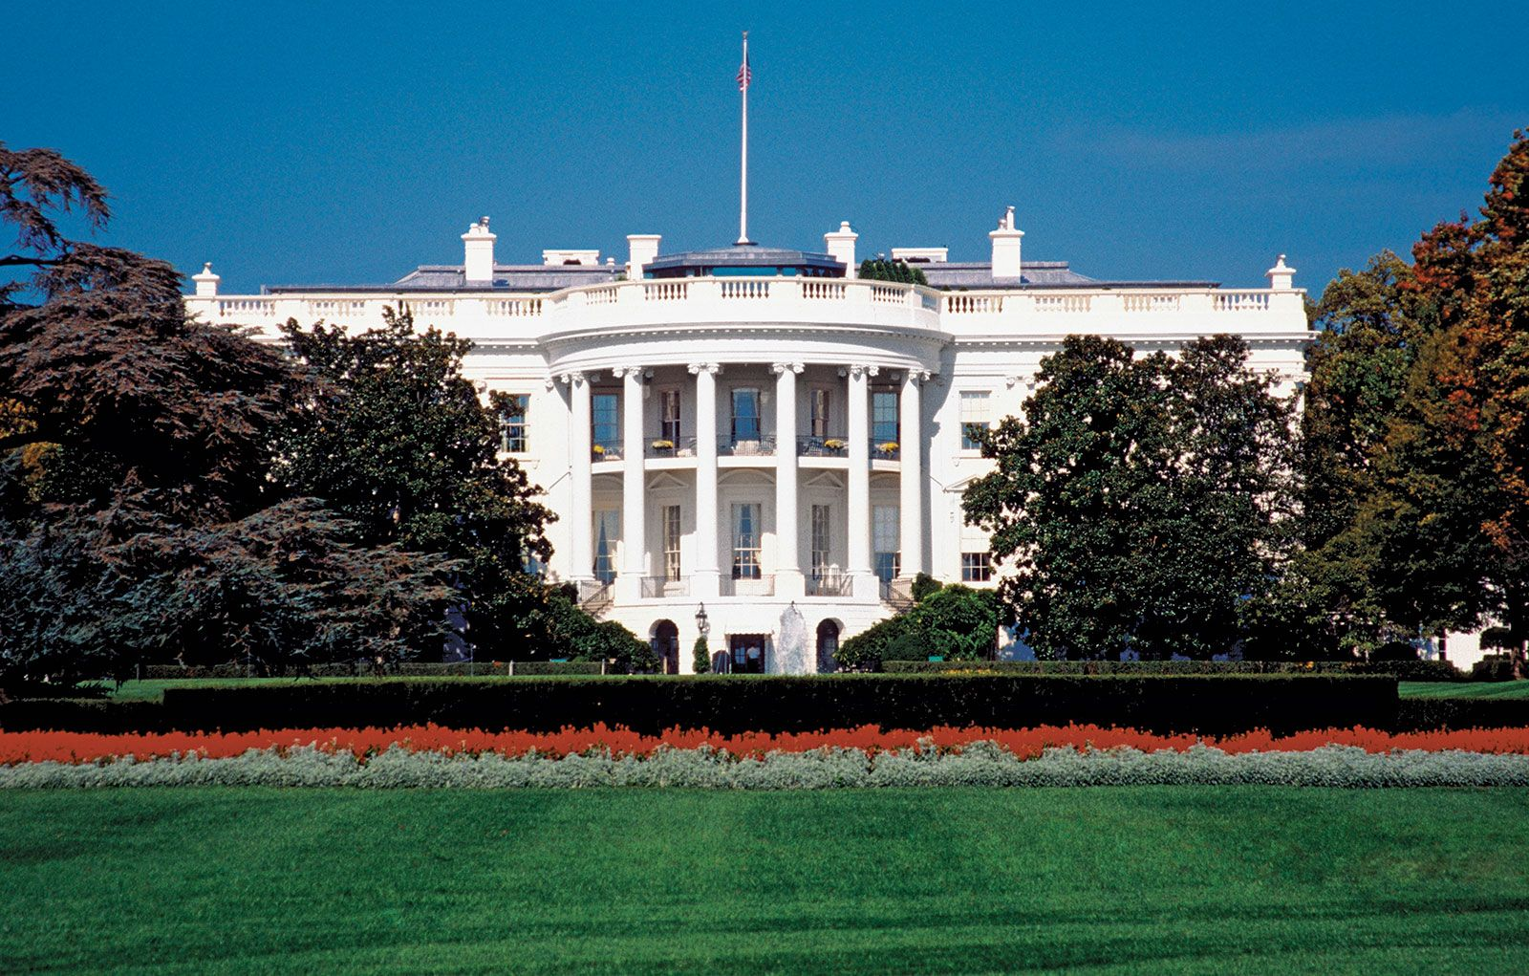
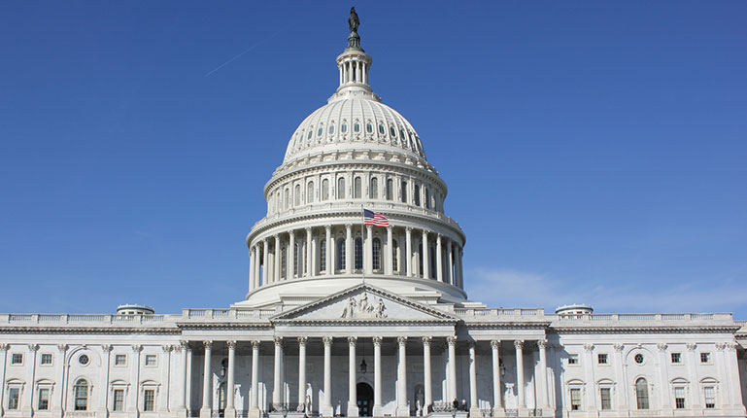
Who has the POWER????
Which branch, the executive or legislative, has greater power to conduct foreign policy?

Slide 54
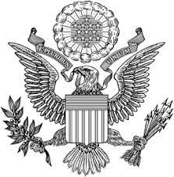
The Bureaucracy of Foreign Policy
Executive branch tasked with implementing foreign policy
It is impossible that the allied powers should extend their political system to any portion of either continent, without endangering our peace and happiness; nor can any one believe that our Southern Brethren, if left to themselves, would adopt it of their own accord. It is equally impossible, therefore, that we should behold such interposition, in any form, with indifference.
- The Monroe Doctrine, 1823
Department of State: foreign policy advisor
Department of Defense: U.S. Military
National Security Council: principle forum on foreign policy
CIA: Intelligence gathering
International Trade Administration: Strengthens U.S. ability to compete in a global economy

Slide 55
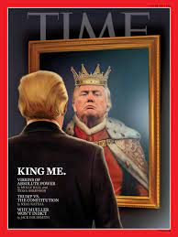
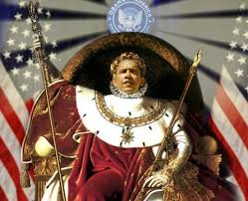
President Power in the Realm of Foreign Policy
Imperial Presidency – The ability of the president to over power checks & balances meant to limit the power of the executive
Factors of an IMPERIAL PRESIDENCY
Commander in Chief of the Military
Chief Diplomat
Crisis Manager
War Powers Resolution
Executive Agreements
Executive Orders
Executive privilege
Bully Pulpit (Persuader in Chief)
How effective is the system of checks & balances in limiting the power of the executive branch in the implementation of foreign policy?

Slide 56
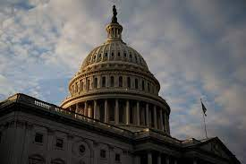
Congressional Limitations
Congressional restraints on executive power in foreign policy
But the great security against a gradual concentration of the several powers in the same department, consists in giving to those who administer each department, the necessary constitutional means . . . to resist encroachments of the others . . . It may be a reflection on human nature that such devices should be necessary to control the abuses of government. . . .
- James Madison, Federalist 51, 1788
No, Mr. President!
Power of the Purse
Lawmaking
Senate approval of treaties & appointments
Declare War
Oversight & Investigation

Slide 57
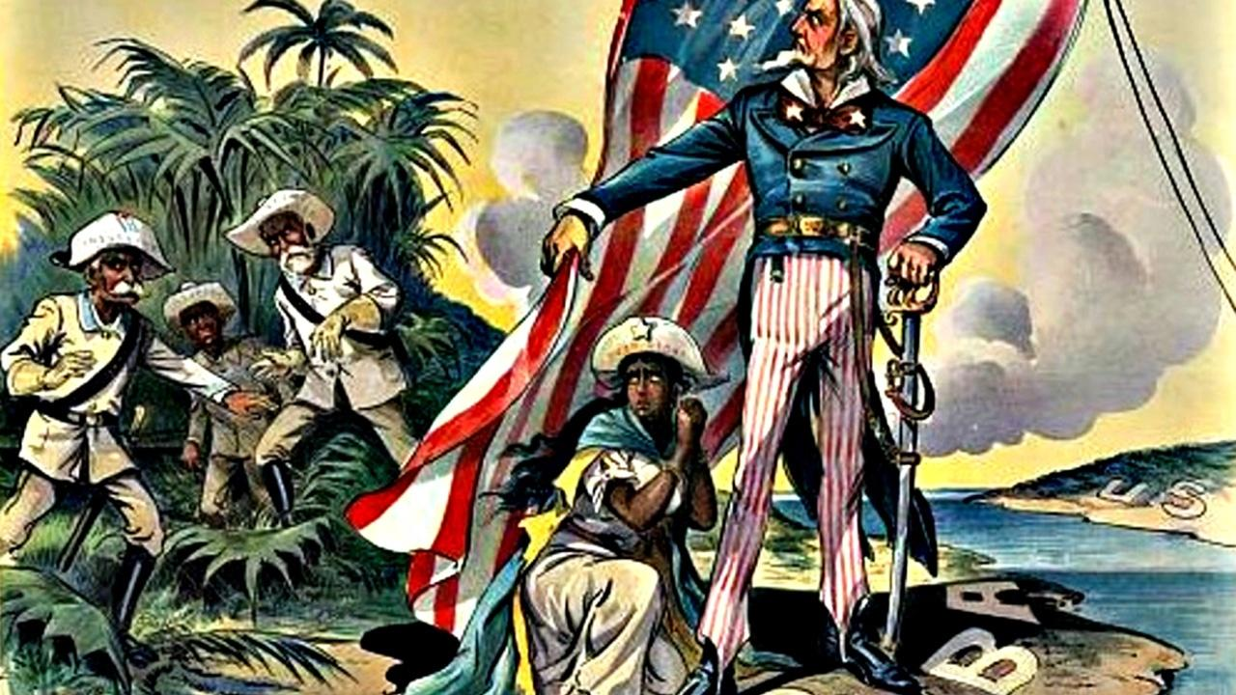
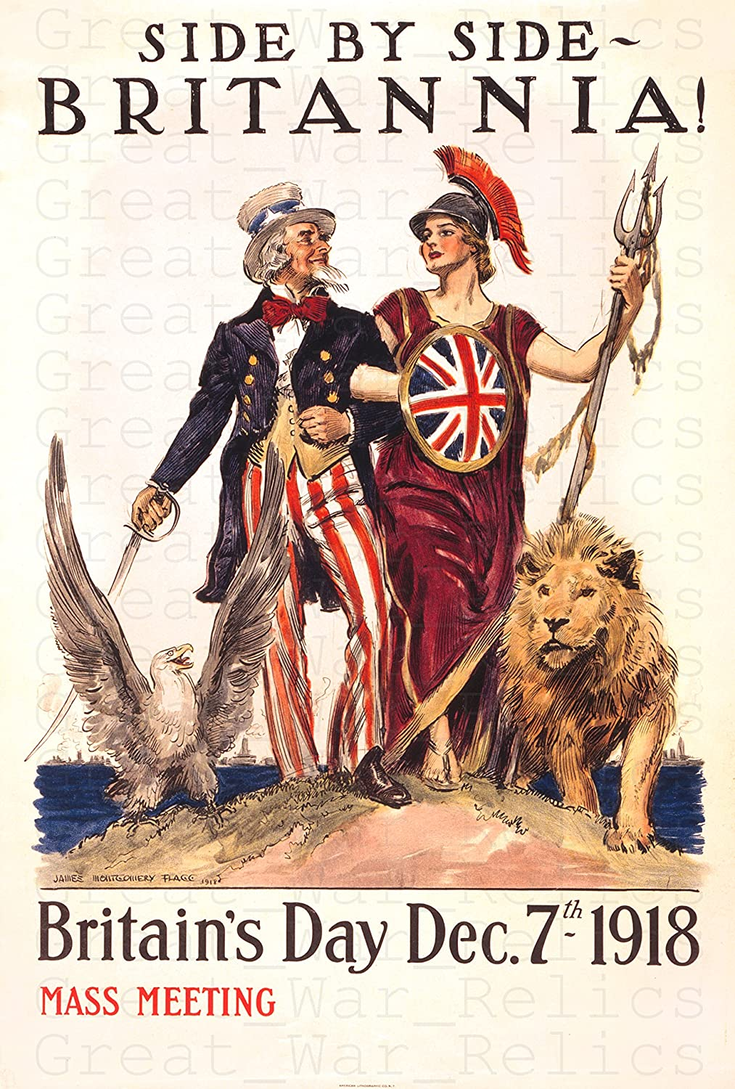
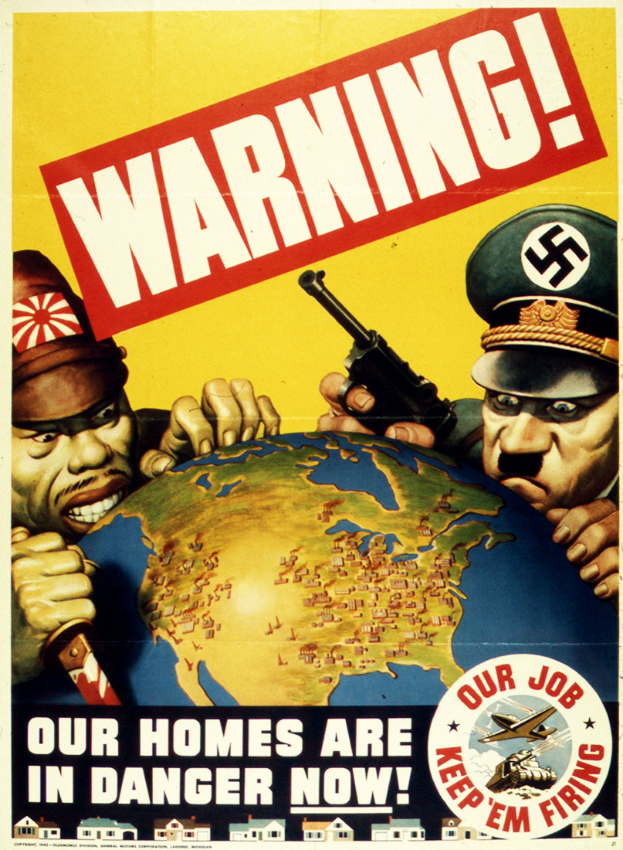
Constitutional Debate
Debating the United States Role in the World 1898-1945
Evaluate when the United States is justified for intervening into another country or foreign policy issue.
Spanish American War
World War I
World War II
Cold War

Slide 58
CL.C&G.2.4: Compare the federal government of the United States to various types of government around the world in terms of balancing security and the protections of rights
CL.C&G.3.4: Compare citizenship in the American constitutional democracy to membership in other types of governments
CL.C&G.4.4: Assess how effective the American system of government has been in ensuring freedom, equality, and justice for all
Essential Question: How are governments created, structured, maintained, and changed?
Students can:
identify and describe various types of governments that have existed over time, across the world
compare citizenship in America to citizenship in other governments in terms of rights and responsibilities
Agenda:
The Constitutional Power of Foreign Policy
Alliances – A League of Friendship
Constitutional Debate on Foreign Policy
Homework:
Current Events Journals due 5/20 (foreign policy journal)

Slide 59
Constitutional Principle
In order to lay a due foundation for that separate and distinct exercise of the different powers of government, which, to a certain extent, is admitted on all hands to be essential to the preservation of liberty, it is evident that each department should have a will of its own;² and consequently should be so constituted, that the members of each should have as little agency as possible in the appointment of the members of the others.
- James Madison, Federalist 51, 1788
Presidents are generally thought to have advantages over Congress in conducting foreign policy because of the formal and informal powers of the presidency.
Identify and explain TWO powers of the President in making foreign policy.
Identify and explain TWO powers of Congress in making foreign policy.
Choose one of the following informal powers of the President and explain why it gives the President an advantage over Congress in making foreign policy
Executive agreements
War Powers Resolution

Slide 60
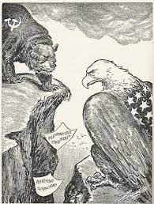
Rise of the Cold War
Post WWII established two superpower nations: United States (Democratic) & Soviet Union (Communist)
United States
USSR
VS.
Liberty
Popular sovereignty
Capitalism
Autocratic
Command economy
Sphere of Influence: a region division where a state has cultural, military, economic and political influence over
National security alliances

Slide 61
They Must Be MAD
The Atomic Age
1954 both United States & USSR have nuclear first strike capability
Mutually Assured Destruction (MAD) – national security policy that a start of a nuclear war would destroy the world – (Nuclear Deterrence)

Slide 62
Global Alliances
National Security Alliances
Free Trade Alliances
NATO – North Atlantic Treaty Organization
SEATO – South East Asia Treaty Organization
NAFTA – North American Free Trade Agreement
United States, Mexico, & Canada Agreement
CAFTA-DR Agreement
GATT – General Agreement on Tariffs & Trade

Slide 63
CL.C&G.2.4: Compare the federal government of the United States to various types of government around the world in terms of balancing security and the protections of rights
CL.C&G.3.4: Compare citizenship in the American constitutional democracy to membership in other types of governments
CL.C&G.4.4: Assess how effective the American system of government has been in ensuring freedom, equality, and justice for all
Essential Question: How are governments created, structured, maintained, and changed?
Students can:
identify and describe various types of governments that have existed over time, across the world
compare citizenship in America to citizenship in other governments in terms of rights and responsibilities
Agenda:
Foreign Policy Goals
Constitutional Debate on Foreign Policy
Legitimate use of foreign policy
Homework:
Know Your Rights
Current Events Journals due 5/20
Unit 8 Test May 13

Slide 64
Foreign Policy Goal
Promoting Democracy C. International Trade
National Security D. World Peace
__ 1. The United States signs a treaty agreement in which they agree to buy sugar from Brazil in exchange for American computers
__ 2. Members of the U.S. Supreme Court give lectures on Constitutional rights at a variety conferences in foreign countries
__ 3. The U.S. military forces Iraqi military out of Kuwait in Desert Storm Operations
__ 4. The United States establishes and joins the United Nations
__ 5. The U.S. president negotiates the United States, Mexico, and Canada Agreement
__ 6. The American military fights in the European theater during WWII to combat the spread of fascism
__ 7. The United States military assists Japan in establishing a Constitutional republic after WWII
__ 8. The American ambassador to Russia works on ways to end the war in Ukraine

Slide 65
Constitutional Debate
Debating the United States Role in the World 1898-1945
Evaluate when the United States is justified for intervening into another country or foreign policy issue.
Spanish American War
World War I
World War II
Cold War

Slide 66
A Legitimate Use of Authority
From 1898 to 1945 the United States utilized foreign policy and developed into a world super power.
Use a historic example and explain when the United States has used a legitimate Constitutional power in the implementation of foreign policy
Use a historic example and explain when the United States has used its Constitutional authority illegitimately

Slide 67
CL.C&G.2.4: Compare the federal government of the United States to various types of government around the world in terms of balancing security and the protections of rights
CL.C&G.3.4: Compare citizenship in the American constitutional democracy to membership in other types of governments
CL.C&G.4.4: Assess how effective the American system of government has been in ensuring freedom, equality, and justice for all
Essential Question: How are governments created, structured, maintained, and changed?
Students can:
identify and describe various types of governments that have existed over time, across the world
compare citizenship in America to citizenship in other governments in terms of rights and responsibilities
Agenda:
Human Rights Squares
Human Rights Comparison
What is a Human Right under Government
Homework:
Human Rights
Current Events Journals due 5/20
Unit 8 Test May 13

Slide 68
Defining Student Rights
In our system, state-operated schools may not be enclaves of totalitarianism. School officials do not possess absolute authority over their students. Students… are possessed of fundamental rights which the State must respect, just as they themselves must respect their obligations to the State. In our system, students may not be regarded as closed-circuit recipients of only that which the State chooses to communicate. They may not be confined to the expression of those sentiments that are officially approved. In the absence of a specific showing of constitutionally valid reasons to regulate their speech, students are entitled to freedom of expression of their views.
- Justice Abe Fortas, Tinker v. Des Moines, 1969
What are the responsibilities of a public educational environment towards their students?
Why could a school limit a right of a student or students?

Slide 69
Civil Rights v. Human Rights
Defining what is a right
Human Rights: the most fundamental rights (life, expression, education, etc.)
Civil Rights: rights granted based on citizenship (prevents discrimination as a bases for rights)
International view: civil rights are based in nation’s Constitution, but human rights are considered universal
Countries can deny civil rights
Countries cannot deny human rights

Slide 70
Universal Declaration of Rights
United Nations – “Universal Declaration of Human Rights” adopted 1948
Response to genocide/atrocities in WWII
Outlines 30 rights & freedoms (basis of international law)
Establishes a benchmark for treatment of all people
Issue: NOT Legally Binding to any Nation

Slide 71
What is a Human Right
Compare the U.S. Constitution’s Bill of Rights & Amendments to the Universal Declaration of Human Rights
Evaluate what should be considered a RIGHT?
What are the limits and responsibilities of government in guaranteeing human rights to their citizens?

Slide 72
CL.C&G.2.4: Compare the federal government of the United States to various types of government around the world in terms of balancing security and the protections of rights
CL.C&G.3.4: Compare citizenship in the American constitutional democracy to membership in other types of governments
CL.C&G.4.4: Assess how effective the American system of government has been in ensuring freedom, equality, and justice for all
Essential Question: How are governments created, structured, maintained, and changed?
Students can:
identify and describe various types of governments that have existed over time, across the world
compare citizenship in America to citizenship in other governments in terms of rights and responsibilities
Agenda:
Human Rights Squares
Trade Advantage
Calculating Comparative and Absolute Advantage
Homework:
Calculating Comparative and Absolute Advantage
Current Events Journals due 5/20
Unit 8 Test May 13

Slide 73
Human Right
What is the difference between human rights and civil rights?
Decipher is considered a human right, a civil right, or both
__ 1. Freedom of speech
__ 2. Right to adequate food
__ 3. No cruel and unusual punishment
__ 4. Presumed innocent until proven guilty
__ 5. Right to adequate shelter
__ 6. Right to asylum in another country to escape persecution
__ 7. Right to peacefully assembly
__ 8. Equal access to public services
__ 9. Equality under the law

Slide 74
What’s in a Label
Where is it all made?
Check labels on clothes, backpacks, and lunch boxes
What are some of the nations where products you possess are manufactured?
2. Why are the majority of these products manufactured in foreign countries instead of the U.S.?
Remember, no one nation knows how to make a pencil!
3. Why do nations like the United States trade with other nations?
The Pencil Lesson

Slide 75
Make a Trade
SCARCITY Trade provide resources & commodities nations lack
How does trade impact countries?
Globalization: increase interconnectedness between nations
Growth of Multi-national Corporations
Cultural Exchange: ideas from different cultures transfer
Environmentalism debate
Interconnectedness means all nations are impacted by changes in the global economy

Slide 76
Multi-nationalism
Big Business

Slide 77
You Got STATUS
Developed Nations
Developing Nations Communist
Under Developing Nations

Slide 78
To Be Absolute
When to trade:
Absolute Advantage: the ability to produce a greater amount of goods or services with the same amount of resources as a competitor.

Slide 79
Wanna Trade
Absolute Advantage practice
Brazil’s absolute advantage _____________________
U.S. absolute advantage _______________________

Slide 80
Let’s Play the Advantage
When to trade:
Comparative Advantage: the ability to produce goods and services at lower opportunity cost than a trade partner

Slide 81
Wanna Trade
Comparative Advantage practice
INPUT CHART
United States should produce ______
Chile should produce _______

Slide 82
CL.C&G.2.4: Compare the federal government of the United States to various types of government around the world in terms of balancing security and the protections of rights
CL.C&G.3.4: Compare citizenship in the American constitutional democracy to membership in other types of governments
CL.C&G.4.4: Assess how effective the American system of government has been in ensuring freedom, equality, and justice for all
Essential Question: How are governments created, structured, maintained, and changed?
Students can:
identify and describe various types of governments that have existed over time, across the world
compare citizenship in America to citizenship in other governments in terms of rights and responsibilities
Agenda:
Advantage in Trade
Protectionism v. Free Trade
A Trade Policy for the U.S.
Homework:
Protection v. Free Trade
Current Events Journals due 5/20
Unit 8 Test May 13

Slide 83
Calculating a Comparative Advantage
Nation | Car | Phones | Opportunity Cost
United States | 80 | 20
China | 60 | 100
United States OC for making 1 car =_____
China OC for making 1 car =_____
What should United States produce?
United States OC for making 1 phone =_____
China OC for making 1 phone =_____
What should China produce?
How does calculating the comparative advantage for producing goods further support why nations should trade?

Slide 84
Trade Lingo
Exports: products the U.S. sells to foreign countries
Imports : products the U.S. buys from foreign countries
Trade imbalance (Trade deficit): U.S. imports more than exports
What would the United States need to do gain a favorable balance of trade?

Slide 85
Barriers to trade
Protectionist view point: limit competition for products domestically, allowing local businesses to succeed by creating higher prices for imported goods.
Tariffs: tax on imports causes prices to increase
Quotas: Limit the number of imports
Product standard: set a special requirements for a product entering the country

Slide 86
Trade Weapons
Access to resources and finish goods are important to build an economy
Embargoes and Trade Sanctions prevent access to important products
Ex. Prevent Iran from obtaining nuclear weapons

Slide 87
Free Trade – Let it Flow
Free trade prospective: remove all barriers to trade and all resources and finish goods cross borders freely
NAFTA: North American Free Trade Agreement
CAFTA: Central American Free Trade Agreement
EU: European Union
GATT: General Agreement on Trade & Tariffs

Slide 88
Environmentalism
Issue: Climate change – (Global Warming)
Rise of carbon emission from global trade
Kyoto Protocol: a commitment by industrialize nations
to reduce greenhouse emissions
Goal: reduce global emissions by 5%
Debate:
International regulations causes greater cost to consumers
Does not apply to non-industrialized nations
President Trump withdrawing U.S. from the Kyoto Protocol
President Biden Reauthorizing U.S. involvement in Kyoto Protocol

Slide 89
Debating Free trade vs. protectionism
FREE TRADE
PROTECTIONISM

Slide 90
CL.C&G.2.4: Compare the federal government of the United States to various types of government around the world in terms of balancing security and the protections of rights
CL.C&G.3.4: Compare citizenship in the American constitutional democracy to membership in other types of governments
CL.C&G.4.4: Assess how effective the American system of government has been in ensuring freedom, equality, and justice for all
Essential Question: How are governments created, structured, maintained, and changed?
Students can:
identify and describe various types of governments that have existed over time, across the world
compare citizenship in America to citizenship in other governments in terms of rights and responsibilities
Agenda:
Push & Pull of Immigration
Waves of Immigration Impact
Immigration Debate
Homework:
Immigration Debate due Monday 5/16
Current Events Journals due 5/20
Unit 8 Test May 13

Slide 91
The Push and Pull of Immigration
Identify two push and two pull factors of immigration to the United States
Pull Factors – bring immigrants to the United States
Push Factors – push immigrants out of their home countries
Freedom
Opportunity
Abundancy of resources
Democracy
Education
Equality
Persecution
Lack of Opportunity
War
Famine
Inequality
Political Corruption
Natural Disasters

Slide 92
3 Waves of Immigration
Established the core values of liberty and opportunity
First Wave (1620-1776)
English dissenters seeking religious freedom
Europeans seeking opportunity
Second Wave (1820-1890)
Europeans from Northern & Western Europe & Asian
Industrial Revolution
Third Wave (1890-1914)
Europeans from Eastern & Southern Europe
Factory jobs

Slide 93
Anti-Immigration
Nativism – anti-immigration attitude
1st Anti-immigration legislation: Chinese Exclusion Act 1882
10 year ban on Chinese labor
Factors of Nativism
Job competition and wage suppression
Crime & alcoholism
Catholic – question loyalty to the United States

Slide 94
4th Wave of Immigration
Current immigration (1965-present)
4th Wave Trends
Mostly Latin American & Asian
Seeking opportunity and freedom
Current issues:
National security (9/11)
COVID
Job competition
Quality and quantity of resources

Slide 95
Modern Political Debate
Immigration, COVID, Loan Forbearance
Open the border because COVID threat has diminished
Close the border because COVID
Extend college loan forbearance because COVID effect on the economy
Get rid of mask mandates because they infringe on liberty
Pandemic Politics is Hypocritical

Slide 96
Immigration Debate
Evaluate U.S. immigration policy and determine what should be our nation’s policy in regards towards handling this issue.
Pro-Immigration
Anti-immigration

Slide 97
CL.C&G.2.4: Compare the federal government of the United States to various types of government around the world in terms of balancing security and the protections of rights
CL.C&G.3.4: Compare citizenship in the American constitutional democracy to membership in other types of governments
CL.C&G.4.4: Assess how effective the American system of government has been in ensuring freedom, equality, and justice for all
Essential Question: How are governments created, structured, maintained, and changed?
Students can:
identify and describe various types of governments that have existed over time, across the world
compare citizenship in America to citizenship in other governments in terms of rights and responsibilities
Agenda:
Kahoot Review
Globalization Study Guide
Challenge Questions
Homework:
Study for Unit 8 Exam
Immigration Debate due Monday 5/16
Current Events Journals due 5/20
Unit 8 Test May 13

Slide 98
Challenge Question
How could a national economy achieve a favorable balance of trade?
by increasing its money supply to surpass a trade deficit
by meeting its trade quotas with its industrial output
by importing goods equal in value to its exports
by exporting more than it imports

Slide 99
Challenge Question
Why has the U.S. government responded slowly to climate change issues, such as global warming?
The Supreme Court has ruled such actions to be outside the jurisdiction of the government.
There are no federal agencies with the authority to enforce climate-related regulations.
The problem of climate change is too complicated to be impacted by legislation.
There is substantial political opposition to climate change initiatives

Slide 100
Challenge Question
Which action is a civic responsibility?
voting in national elections
obeying laws
registering for the draft
Serving on juries

Slide 101
Challenge Question
How would U.S. consumers most likely react to a large increase in the excise tax on luxury cars imported from Japan?
U.S. consumers would continue to buy Japanese luxury cars.
U.S. consumers would buy more domestic or European luxury cars.
U.S. consumers who usually purchase Japanese luxury cars would demand greater fuel efficiency in those cars.
U.S. consumers who usually purchase Japanese luxury cars would buy non-luxury Japanese cars instead.

Slide 102
CL.C&G.2.4: Compare the federal government of the United States to various types of government around the world in terms of balancing security and the protections of rights
CL.C&G.3.4: Compare citizenship in the American constitutional democracy to membership in other types of governments
CL.C&G.4.4: Assess how effective the American system of government has been in ensuring freedom, equality, and justice for all
Essential Question: How are governments created, structured, maintained, and changed?
Students can:
identify and describe various types of governments that have existed over time, across the world
compare citizenship in America to citizenship in other governments in terms of rights and responsibilities
Agenda:
Unit 8 Review
Unit 8 Test
Immigration Debate
Homework:
Immigration Debate due Monday 5/16
Current Events Journals due 5/20

