Slide 1
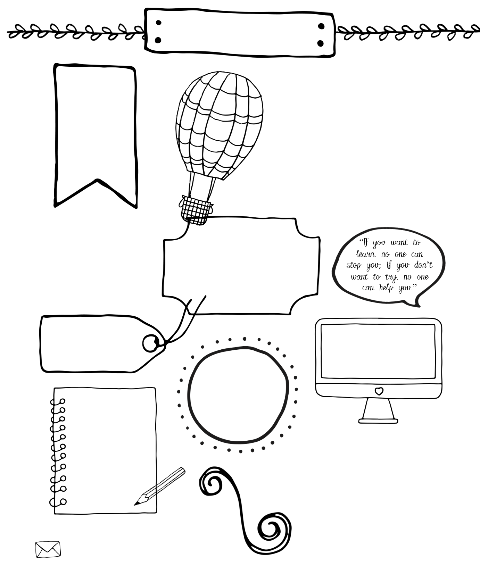
US History
Ms. Vest (Room 317)
Missing Work & Absent Work Policies
Homework is due when class begins.
To receive credit for late work student must complete Missing Work Form and submit the day the assignment was initially due. Late work results in a 20-point deduction each day it is late.
If you are absent it is your responsibility to check Absent Bin for your missed assignments and schedule time to make up tests. Per school policy you have three days to make up assignments missed due to absence.
Bring to every class:
Notebook
Pens or pencils
A POSITIVE Attitude
Join PowerSchool
If you aren’t already using it, please go to the Grimsley website and become familiar with PowerSchool. You can access your grades.
If you find you are missing an assignment. Check the No Name folder.
Classroom Expectations
1. BE KIND
2. Show Respect
3. Come prepared to learn.
4. Actively participate
5. Follow directions when given
We will create a classroom culture of mutual respect. This is my number one policy. We will all be respectful and tolerant to each other in this class
Teacher Contact
seibolj@gcsnc.com
Remind:
Join by texting @jvestUS1
To 81010
Grading
Tests/Projects
60%
Classwork/Quizzes/
Participation 40%
Things to Know
Cell Phones are to be kept out of sight unless instructed by me for use in the lesson, on silent. No charging phones in the classroom.
Test Day: Tuesday
Tutoring: Thursday Afterschool
Tardies
Being late to class is not acceptable. Disciplinary action will be taken on the second offense. Quizzes missed because of an unexcused tardy may not be made up.

Slide 2
Course Description and Essential Knowledge
The World History & Geography I course is a chronologically-organized study of world history and geography from prehistoric times through modern time. Students will study about western and non-western civilizations throughout this period of time.
Students will take an NCFE (North Carolina Final Exam) at the conclusion of this course that will count as 20% of their final grade per GCS policy.
Expectations:
Arrive to class on time and come to Class prepared. Students should bring a notebook/binder and pen/pencil to class every day. Tardy Policy: Students should be on time to class and ready to learn. After the first tardy the student will receive a warning. After the first warning student will be required to stay after school with teacher. A third time student will be sent to after school detention monitored through the school. Let it be noted that per school policy any student arriving to class 5 minutes late is skipping
Student work accountability. Students are responsible for completing ALL assignments. Students can request an extension for some assignments but extensions are not granted for routine assignments. Work that is excessively late detracts from student learning. I believe that responsibility for learning is an essential outcome of the course as well, and as such, all late work handed in after the associated unit test, though always accepted, will be subject to reduction of credit. All late work is due one week prior to the end of each quarter for consideration in the quarter grade.
Be organized. ALL assignments, notes, and handouts should be kept in your notebook/binder. If you are absent, you should get any missed assignments. You are responsible for all materials covered in class, including videos, presentations, and supplementary readings.
Do your own work (No plagiarism or cheating). Students are expected to complete their own work. Any student who gives or receives unauthorized help (including materials) on quizzes, tests, or other assignments is cheating. Plagiarism - using text from another source, including Internet web sites, without permission or citation - is also considered inappropriate. Such behavior will result in a student receiving no credit for the assignment, and the student will be referred by the teacher to the Honor council. For more information refer to Honor Council Handout.
A classroom is based on RESPECT.
You are expected to politely listen to your classmates' opinions and ideas, think about what they have said, and contribute yourself. Throughout the year students will be introduced to different cultures, lifestyles, and religions, students must be respectful, not judgmental. Statements of bigotry, intolerance, and racism will be punished with detention, and parents will be contacted.
Respect property that is not your own. Unless something is yours, do not touch it without permission. This refers to anything belonging to your classmates, the furniture in the room, and the teacher's belongings
Conduct yourself appropriately in class. No eating or drinking (including candy and gum) is allowed in the classroom. Treat others as you wish to be treated.
Bathroom Policy: Students must remain in the classroom during the first and last ten minutes of the class period per Grimsley School Policy. Use of the restroom will be conducted on an as needed basis, but at the teacher’s discretion if it becomes excessive.

