Slide 1
Using Your PSAT/NMSQT® Scores to Increase College Readiness

Slide 2
Using Your PSAT/NMSQT® Scores to Increase College Readiness

Slide 3
Get to Know the PSAT/NMSQT®
The PSAT/NMSQT is highly relevant to your future success because it focuses on the skills and knowledge at the heart of your education. It measures:
What you learn in high school
What you need to succeed in college
The PSAT/NMSQT measures reading, writing and language, and math skills developed over many years.
The PSAT/NMSQT does not ask for facts from literature, history, or science, or for recall of math formulas, because it measures your reasoning and critical thinking skills.
You don’t have to discover secret tricks or cram the night before.
There is no penalty for guessing.
The test length is 2 hours, 45 minutes.
Notes:
This slide provides students with information about the PSAT/NMSQT. The PSAT/NMSQT is focused on the skills and knowledge they are working on in their high school classes. Students don’t need to learn additional facts or formulas in order to be successful. They don’t have to worry about “gaming” the test — their scores will be based only on the questions they answer correctly (there is no penalty for wrong answers). Ask students if this information matches their perception of the PSAT/NMSQT. If students have already taken the assessment, ask them if they agree with the statements on the slide, or if they would like to comment on their assessment experience with the PSAT/NMSQT.

Slide 4
What Are the Benefits of Taking the PSAT/NMSQT®?
Prepare for the SAT®
Get free, personalized Official SAT Practice on Khan Academy®
Start getting ready for college with college and career planning tools
Enter the National Merit® Scholarship Program
See which AP® courses for which you might be ready
Get admission and financial aid information from colleges
Notes:
Ask students if they are planning to take the SAT. Inform them that the SAT is aligned to the PSAT/NMSQT. The PSAT/NMSQT is a preview of the content on the SAT and will help them practice for the SAT. PSAT/NMSQT scores, and all scores in the SAT Suite of Assessments, are accessible from the student’s online College Board account.
The PSAT/NMSQT offers several benefits:
When students link their College Board account with their Khan Academy® account, Khan Academy will use the PSAT/NMSQT scores to design a practice plan and practice questions tailored to each student’s strengths and areas for improvement. This program is completely free, and practice test questions on Khan Academy are created with College Board approval, so this is the best SAT practice available.
The student’s online score report links to valuable tools for college and career planning. Students can use BigFuture™ and Roadmap To Careers to investigate their academic interests and college and career options (more about BigFuture and Roadmap To Careers at the end of this lesson, slides 33-34).
When students take the PSAT/NMSQT® , they’re automatically screened for the National Merit® Scholarship Program, an academic competition for recognition and scholarships. For more information, visit NMSC’s website or see the Official Student Guide to the PSAT/NMSQT or the Guide to the National Merit® Scholarship Program (for educators). The National Merit Scholarship Corporation (NMSC) is a co-sponsor of the PSAT/NMSQT. In addition, The College Board is partnering with several other organizations who provide millions of dollars in scholarships to qualified low-income and minority students. Students who opt in to Student Search Service can be identified by these organizations.
PSAT/NMSQT scores are indicators of ability to succeed in Advanced Placement® courses. Students can find the AP® courses in which they are likely to succeed in the online reporting system (more information about the online reporting portal begins on slide 8).
If students opt in to Student Search Service® , they will receive information about admission and financial aid from colleges that participate in the program. (More information on Student Search Service is available on slide 35.)

Slide 5
Understanding My Paper Score Report
Notes:
This section provides a review of the paper score report that students receive from the school.
If students have already reviewed the online report, some of the following information may be repetitious. Please see slide 3 for guidance.

Slide 6
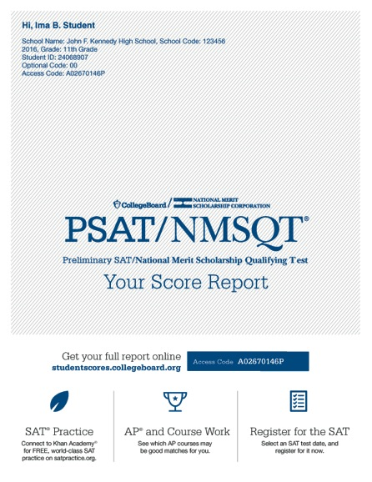
What Are My Scores?
Scores for the assessments in the SAT® Suite are vertically equated.
Notes:
Ask students to find “Your Total Score” in the center of the score report. In the sample on the slide, the total score is 960. Total scores are based on a scale of 320 to 1520 on the PSAT/NMSQT. Inform students that this is the score they would likely receive on the SAT had they taken the SAT on the same day they took the PSAT/NMSQT because all of the scores for the assessments in the SAT Suite are vertically equated. The SAT total score ranges from 400 to 1600. Ask students to consider whether they would be satisfied with this SAT score if they were using it to apply for college.
On either side of “Your Total Score,” students will find their section scores. “Your Evidence-Based Reading and Writing Score” is on the left (430 on the slide), and is the scaled score they earned from the Reading Test and the Writing and Language Test combined. “Your Math Score,” to the right of the total score (530 on the slide), is the scaled score they earned from taking the Math Test. Both of these section scores are on a scale of 160 to 760 on PSAT/NMSQT, and are added together to get the total score. On the SAT, the range for these section scores is 200–800.
Below the Evidence-Based Reading and Writing Score, and below the Math Score, students will see where their scores fell on a graph between 160 and 760.
The colors on this graph represent the grade-level benchmark. Students who meet the grade-level benchmark are on track to meet the college readiness benchmark on the SAT. For their section scores, if the score falls in the red area of the graphic, they “need to strengthen their skills,” meaning they are more than one year below the grade-level benchmark. If the score falls in the yellow part of the graphic, they are “approaching benchmark,” or below the grade-level benchmark by one year or less. If the score falls in the green area of the graphic, they are on track for college readiness and have met or exceeded the benchmark.

Slide 7
What Are My Scores? (cont.)
Test scores, cross-test scores, and subscores give students insightful information about their strengths and areas for improvement.
Notes:
Test scores, cross-test scores, and subscores give students insightful information about their strengths and areas for improvement.
Test scores range from 8 to 38. By reviewing their test scores, students can discover if they performed better on the Reading Test or the Writing and Language Test, which together produce the Evidence-Based Reading and Writing section score. For example, in the sample report on the slide, the student earned a 26.5 and is in the yellow on the Math Test, indicating his score is less below the average score of students who met the grade-level benchmark.
The range for subscores is 1–15. Three subscores are generated from the Math section (Heart of Algebra, Problem Solving and Data Analysis, and Passport to Advanced Math); four subscores are generated from the Evidence-Based Reading and Writing Section. Of those four subscores, two are generated from the Writing and Language Test only: Expression of Ideas and Standard English Conventions. Command of Evidence and Words in Context are derived from questions on both the Reading Test and the Writing and Language Test. In the sample on the slide, the student is near the green on Passport to Advanced Math, but in the center yellow on Problem Solving and Data Analysis and Heart of Algebra, demonstrating his or her relative areas of strength and weakness, and clarifying the areas in Math in which he or she can work to improve.
Cross-test scores are derived from questions related to science or history/social studies on the Reading Test, the Writing and Language Test, and the Math Test. The range for cross-test scores is between 8 and 38 on PSAT/NMSQT.

Slide 8
What Are My Score Percentiles?
Percentiles and benchmarks are provided for 10th and 11th grades on the PSAT/NMSQT®.
Notes:
Immediately below each of the three scores, students are presented with their Nationally Representative Sample Percentile. This number is the percentile ranking for a student if ALL U.S. students, in their same grade, took the test. (It is a norm-referenced group of all U.S. students in their grade, regardless of whether they typically take the PSAT/NMSQT, derived via a weighted research study sample.) From the example on the slide, the student can read that, at the score of 960, he or she performed better than 51 percent of students nationally. Help students find and understand their Nationally Representative Sample Percentile for both section scores and the total score.
Percentiles and benchmarks are provided for 10th and 11th grades on the PSAT/NMSQT. If a student is younger or older, then he or she is compared to the nearest grade level. For example a ninth-grader will be compared to 10th-grade benchmarks.

Slide 9
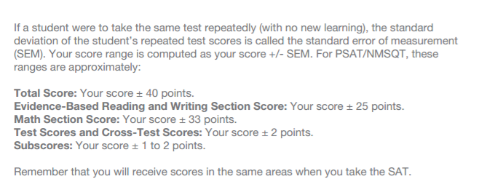
What Are My Score Ranges?
PSAT/NMSQT® scores should be interpreted as ranges rather than singular points.
Notes:
When students take tests more than once, scores may differ on each testing occasion. PSAT/NMSQT scores should be interpreted as ranges rather than singular points, since a student’s score might vary slightly if he or she had taken different versions of the test under identical conditions. For the example, on the slide, the total score of 960 should be interpreted as 960 ± 40 points, or a range of 920 to 1000.

Slide 10
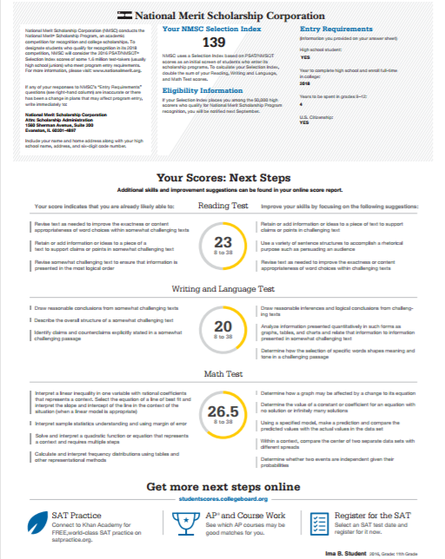
What Is the National Merit® Scholarship Program?
Notes:
The National Merit Scholarship Program is an academic competition for recognition and scholarships that began in 1955. Of the 1.5 million students who take the PSAT/NMSQT, some 50,000 with the highest PSAT/NMSQT Selection Index scores qualify for recognition in the National Merit Scholarship Program. In September, these high scorers are notified through their schools that they have qualified as either a Commended Student or a Semifinalist.
Selection Index scores are calculated by doubling the sum of the Reading, the Writing and Language, and the Math Test scores. Students can find this score in the middle of the top of page 3 of the paper score report. If there is an asterisk after the number, the student is not eligible for the competition during this test administration.
For more information, visit NMSC’s website or see the Official Student Guide to the PSAT/NMSQT or the Guide to the National Merit® Scholarship Program (for educators).

Slide 11
What Are My Areas of Strength? What Skills Do I Need to Build?
Your Scores: Next Steps
Notes:
The PSAT/NMSQT score report is intended to support students as they analyze their strengths and areas for growth on the road to college readiness. The “Skills Insight” portion of their report gives each student information about what they likely know and can do according to their test results, based on students who scored similarly. It also provides suggestions for areas that need work so that they can develop their knowledge and skills. Only a subset of their skills and suggestions are on the paper report; the full list is online.
“Your Scores: Next Steps” gives students more information about the knowledge and skills they have demonstrated, and the knowledge and skills on which they should focus for growth.
Ask students to write down the areas in which they can improve their skills (from the right side of the score), and then think about and commit to ways to work on those skills. Their plans might include practicing on Khan Academy or asking for help from a teacher. It might be assignments that teachers provide in their classes. It is helpful for the students to develop plans for skill development as they review their scores with their teachers.

Slide 12
What Are My Next Steps?
Continue to take challenging courses in high school
Link scores with Khan Academy®
Set up a practice plan and stick to it
Register for the SAT®
Utilize other resources to research and prepare for college
Notes:
Upcoming slides will explain Official SAT Practice with Khan Academy, SAT Registration, BigFuture, Roadmap to Careers, and Student Search Service.

Slide 13
Official SAT® Practice with Khan Academy®— It’s FREE!
Go to satpractice.org and create a free account.
Get personalized recommendations. Link your Khan Academy account to your College Board account to import past SAT Suite results, or take diagnostic quizzes to get personalized recommendations.
Create a study plan. Select a test date and set up a practice schedule.
Notes:
Official SAT Practice on Khan Academy is offered to students at no cost. Students have access to thousands of official SAT test questions (written and reviewed by the College Board) and six full-length SAT tests. Students can access Official SAT Practice on a computer, or by using the Daily SAT Practice app or Khan Academy app on their mobile device. Khan Academy creates personalized learning plans for each student based on his or her test performance and practice on Khan Academy. It also provides videos that will tutor students in the areas in which they need help.

Slide 14
How Can I Practice with Khan Academy®?
Thousands of practice questions and videos covering every SAT® concept
Six official, full-length SAT practice tests with more to come
Personalized recommendations based on each student’s strengths and weaknesses
Tailored practice schedule mapping out each students’ path to test day
SAT tips and strategies, sharing information about each part of the test
Watch a video introducing Official SAT Practice on Khan Academy
Notes:
This slide links to a video that demonstrates the features of Official SAT Practice on Khan Academy. Students in a computer lab setting can set up their accounts immediately. They have to enter their name, email address, and birth date, and will immediately receive a link to set up a username and password. They can also use their Gmail or Facebook login information to get started immediately. They can then log in to the account and begin practicing.

Slide 15
What Steps Will I Follow to Link My College Board Account to Khan Academy®?
Step 1
Log in or create a Khan Academy account.
Step 2
When prompted, agree to link your Khan Academy and College Board accounts. You will then be directed to collegeboard.org.
Step 3
Sign in or create a College Board account.
Step 4
When prompted, hit “Send” to authorize the account linking.
Step 5
Start practicing on Official SAT® Practice on Khan Academy!
Notes:
In order to receive personalized practice plans based on their PSAT/NMSQT results, students will have to link their Khan Academy accounts and their College Board accounts. To begin the linking process, students must log in to their Khan Academy accounts. Students will be prompted to link their Khan Academy and College Board accounts when they log in. When students agree to link the accounts, they will be directed to collegeboard.org. When they reach collegeboard.org, they will need to sign in to their College Board account.

Slide 16
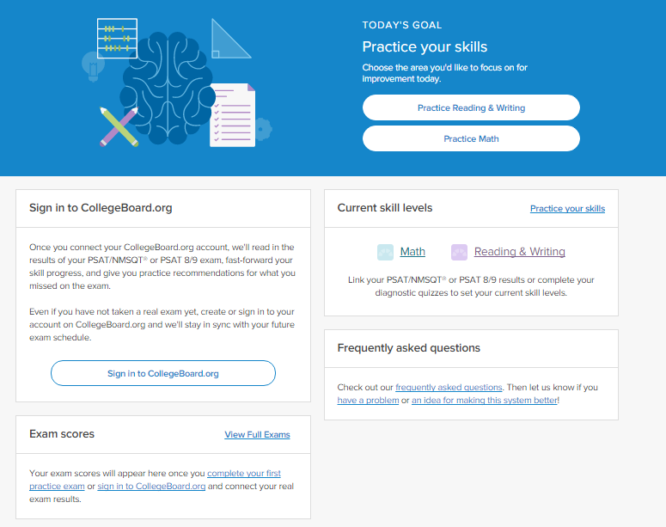
How Can I Link My College Board and Khan Academy® Accounts?
After successfully logging in to your College Board account, you will be asked to authorize the account linking.
After clicking “Send,” you will be redirected to SAT® Practice on the Khan Academy site.
You can remove the link at any time by clicking on “Revoke,” which is found in your College Board account settings.
Notes:
After successfully logging in to the College Board account, they will be asked to authorize the linking of the accounts. This allows Khan Academy to access student score data related to the SAT Suite of Assessments. Students will see a screen clarifying what they are agreeing to link. If they choose to click “Send,” they will be directed back to Official SAT Practice on Khan Academy. Students can choose to remove the link by clicking on “Revoke” in the College Board account settings.

Slide 17
How Do I Register for the SAT®?
SAT Registration link from Popular Tools menu
sat.org/register
Notes:
Students who took the PSAT/NMSQT have seen a test that is similar in content and format with the SAT. They have already started practicing for the SAT by taking the PSAT/NMSQT!
Students can navigate to the SAT registration site by clicking on the Popular Tools menu within the online score report and selecting SAT Registration. This will open a new window for sat.org/register. They will need photos of themselves to upload for verification. The complete registration checklist is available at https://collegereadiness.collegeboard.org/sat/register/online-registration-help.
Fee waivers are available for students who demonstrate financial need. Direct students to their counselors to get further information about fee waivers.

Slide 18
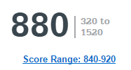
What Additional Resources Will Help Me Prepare for My Future?
BigFuture™
College Action Plan
College Search
Scholarships
Financial Aid
Roadmap to Careers
Student Search Service®
Notes:
Students have multiple resources available to help them plan and prepare for college. The Popular Tools menu includes links to other College Board tools within BigFuture and Roadmap To Careers™ .
The College Board developed BigFuture in collaboration with parents, students, and educators to make the college planning process easier and less overwhelming. At bigfuture.org, students can:
› Use intelligent search-and-match tools and informative videos to find colleges that are a good fit.
› Learn how families have paid for college.
› Create a personalized plan for college so students know what to do and when to do it.
Roadmap To Careers provides a career exploration tool that can help students learn more about their interests and how this may correspond to a future career.
Student Search Service (slide 35) connects colleges with potential students. (It isn’t currently available in Popular Tools.)

Slide 19
BigFuture™— Search Colleges, Scholarships, and Careers
Search for colleges.
Watch videos from real students.
Hear from education professionals.
Learn about different colleges.
Get help paying for college.
Build a personalized plan for getting into college.
Notes:
BigFuture is the website that helps students plan for college. It is a free, comprehensive website that guides students as they prepare for, find, and enroll in college. At bigfuture.org, students can:
Start with a focus on themselves: their interests, what and where they want to study, how much financial assistance they think they’ll need, and other important considerations.
Search for colleges and easily compare them based on factors ranging from majors to size and location.
Watch videos from real students who explain what they did to get into college and what their college experiences have been like.
Hear from education professionals who provide the inside story on preparing for and getting into college.
Learn about the different kinds of colleges and how to find one that is the right fit for them.
Find valuable help in paying for college by discovering what goes into college costs and how to find financing.
Build a personalized plan for realizing their goals and getting into a college that meets their needs.

Slide 20
Road Map to Careers
Roadtrip Nation and College Board are partnering to help students connect with careers.
Choose your core interests.
Watch videos of leaders who share your interests.
Learn about majors and careers that align to your interests.
See examples of leaders who followed a similar path.
Notes:
Roadmap to Careers can then blend all of those together to create a personalized journey for students through people, careers, and majors that align with their interests. It starts by looking at Leaders who match their interests. They might be famous people, or the glass blower down the street who loves her job. Students watch videos of these Leaders talking about their path, and they can see what education and path the Leaders followed. Students learn about majors that align to their interests, get tangible recommendations for ways to be ready for this major (through coursework and otherwise), and see examples of Leaders who have followed a similar path. Finally, students can learn more directly about careers that align with their interests so that they know why it’s worth putting in the effort in their high school classes and worth going to college.

Slide 21
Thank You.

