Slide 1

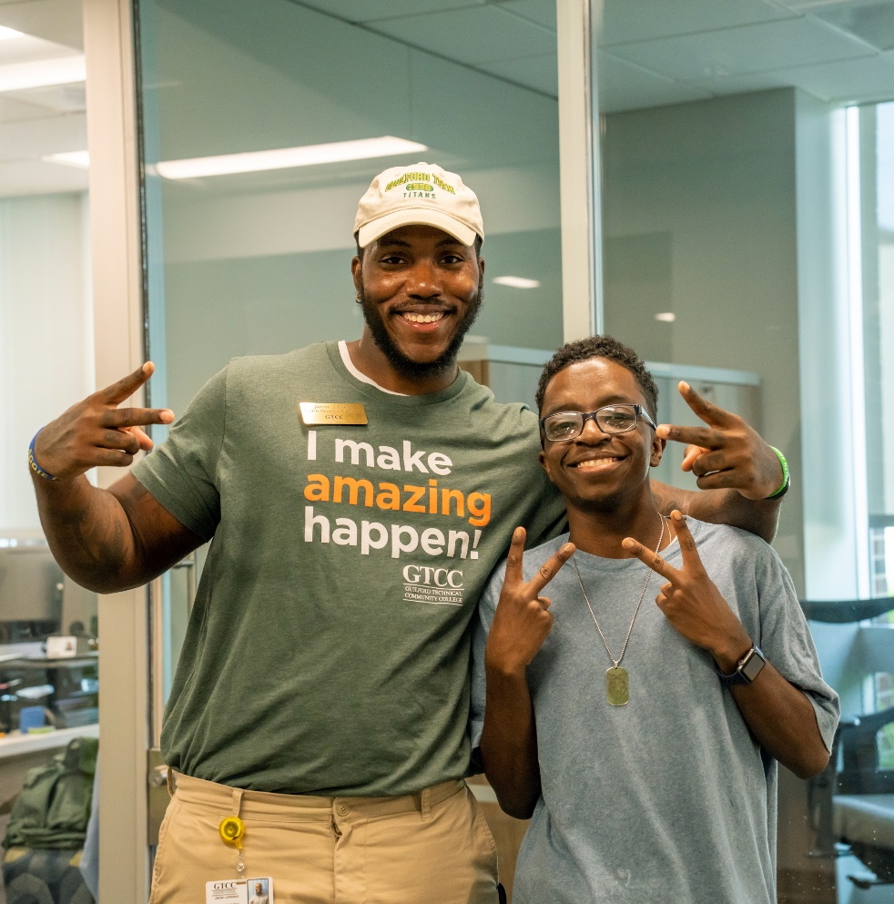
Career & College Promise
Explore the Possibilities!
www.gtcc.edu/ccp

Slide 2
GOAL – Career and College Promise
The goal of Career and College Promise is to increase the number of completed associate’s and bachelor’s degrees for North Carolina’s residents by providing early access to college while a student is in high school. Early access to college allows students to “try on” college while in the more familiar environment of high school. Students practice their new time management skills, study skills, and experience the academic rigors of college with the added support offered by faculty and staff. College courses taken early in high school that apply to students’ associate and bachelor’s degrees also save students time and money as they pursue higher education.
Perspective | Career and College Promise: A premier college access program with room for growth
Sarah A. Deal
12/2/20

Slide 3

Career and College Promise Requirements
11th & 12th grade only
Unweighted GPA 2.8 or higher OR passing test scores
Students must pick from an approved College Transfer or Career/Technical Pathway

Slide 4

Dual Enrollment
CCP provides an opportunity for eligible high school students to earn college credits towards a college degree, diploma, or certificate. Dual credit for high school graduation requirements is a bonus but should not be what drives course selection. Courses in the CCP Transfer Pathways should be selected based on the published bachelor’s degree plan for the major at the university the student intends to transfer to after high school.

Slide 5
CCP Student Expectations and Standards
CCP students are held to the same academic and discipline standards as traditional college students.
Must maintain a GTCC cumulative GPA of 2.0 or higher.
Falling below a cumulative GPA of 2.0, failing a course, and/or withdrawing from a course can result in probation and subsequent suspension from college classes.
Students are responsible for books and fees
Refunds – must withdraw before the 1st day of class
Attendance – no difference in excused & unexcused
Expect academic rigor! Be self-directed!
Grades earned as CCP students go on your official college transcript

Slide 6
CCP Pathways
Career and College Promise provides dual enrollment opportunities for eligible North Carolina high school students to accelerate completion of college certificates, diplomas, and associate’s degrees that lead to college transfer or provide entry-level job skills.
College Transfer Pathway
Career Technical Education Pathway
A CCP student can choose between a…

Slide 7
College Transfer Pathway
Baccalaureate degree plan
Comprehensive Articulation Agreement Transfer Course List
Universal Gen Ed Transfer Courses are guaranteed to transfer to all UNC System schools
Classes – restricted to courses in pathway
Additional classes – allowed after a pathway is complete

Slide 8
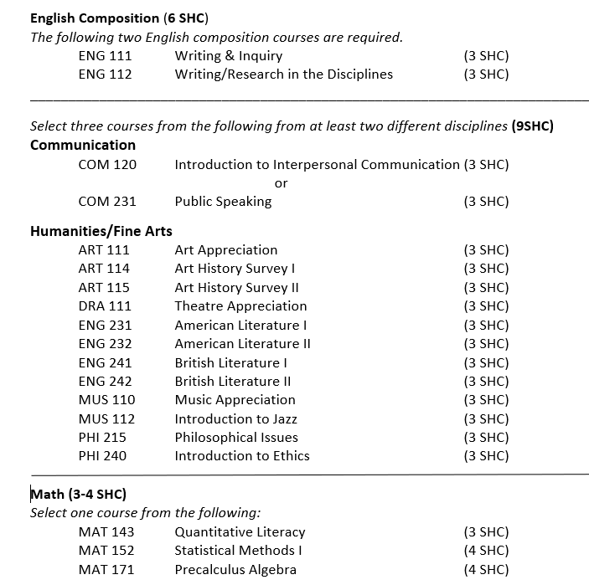
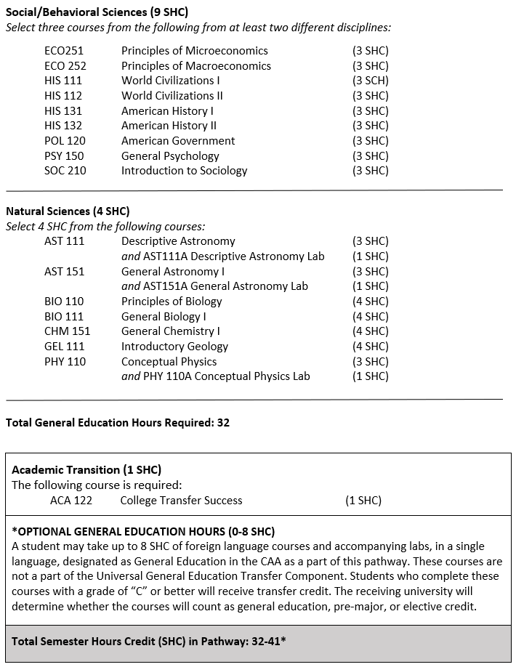
College Transfer Pathway Leading to the Associate in Arts
General Education (31-32 Credits)
The general education requirement includes study in courses selected from the Universal General Education Transfer Component (UGETC) of the Comprehensive Articulation Agreement.

Slide 9
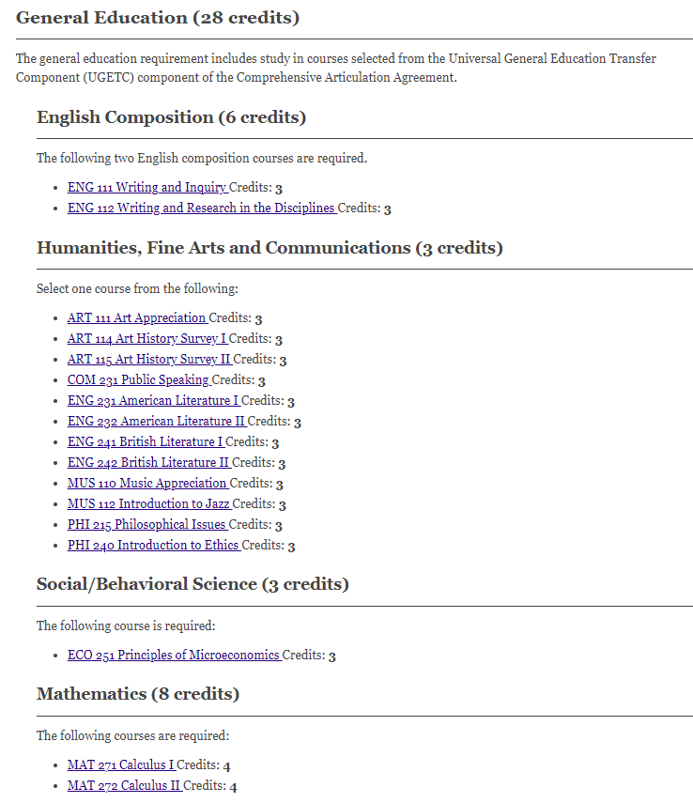
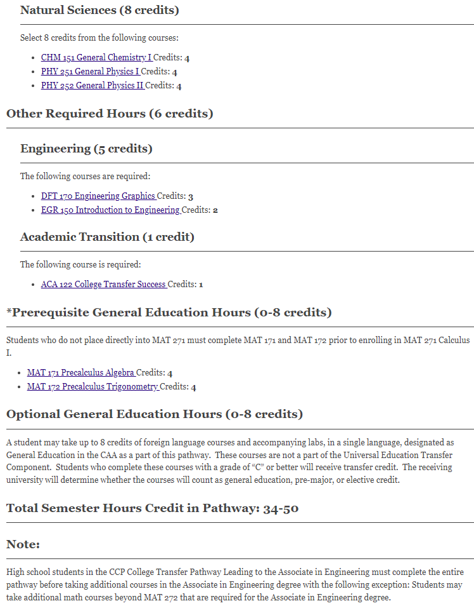
College Transfer Pathway Leading to the Associate in Engineering (General Education 28 Credits)
The general education requirement includes study in courses selected from the Universal General Education Transfer Component (UGETC) component of the Comprehensive Articulation Agreement.
High school students in the CCP College Transfer Pathway Leading to the Associate in Engineering must complete the entire pathway before taking additional courses in the Associate in Engineering degree with the following exception: Students may take additional math courses beyond MAT 272 that are required for the Associate in Engineering degree.

Slide 10
Career Technical Education Pathway
Students are prepared for highly skilled, high salary, and/or in-demand careers
Students receive hands-on training
Students learn job specific skills related to their specific pathway

Slide 11
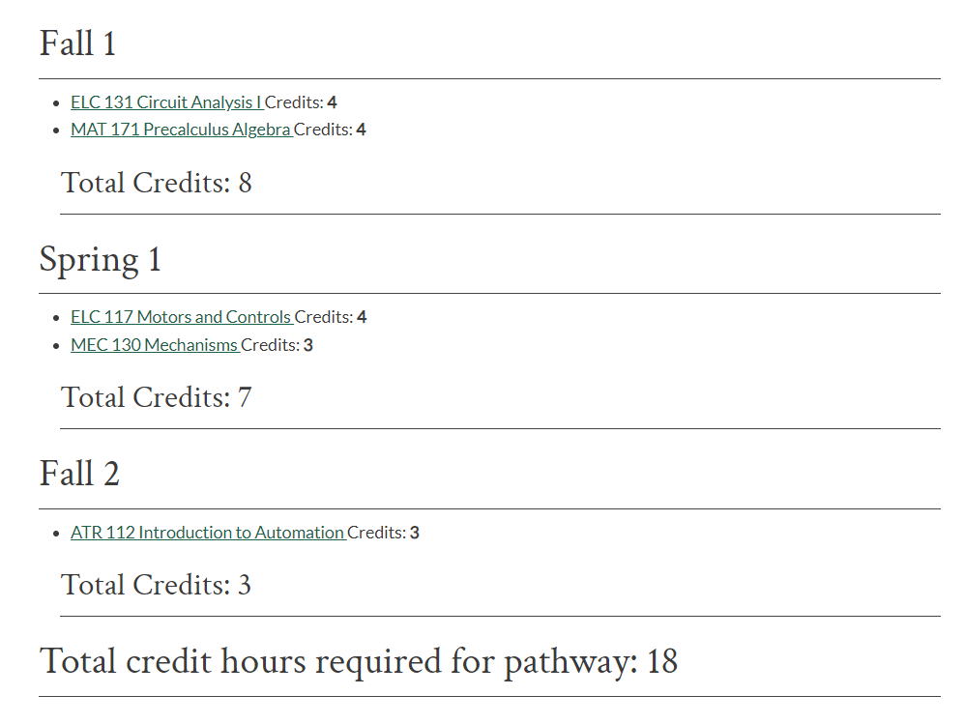
Mechatronics Engineering Technology - CCP Pathway
Upon completion of this curriculum, graduates should be able to individually or with a team safely install, inspect, repair and maintain industrial process and support equipment. Students will also be encouraged to pursue skill development as lifelong learners. Completion of this pathway consists of 5 of the 23 courses required in the Mechatronics Engineering Technology AAS degree.
Program outcomes:
  Display a working knowledge of mechanical systems; hydraulic/pneumatic systems; and electrical and motors and control systems.
  Perform preventative maintenance and troubleshoot a variety of industrial systems;
  Work safely according to industry standards
  Provides foundation to Mechatronics Engineering Technology AAS degree

Slide 12
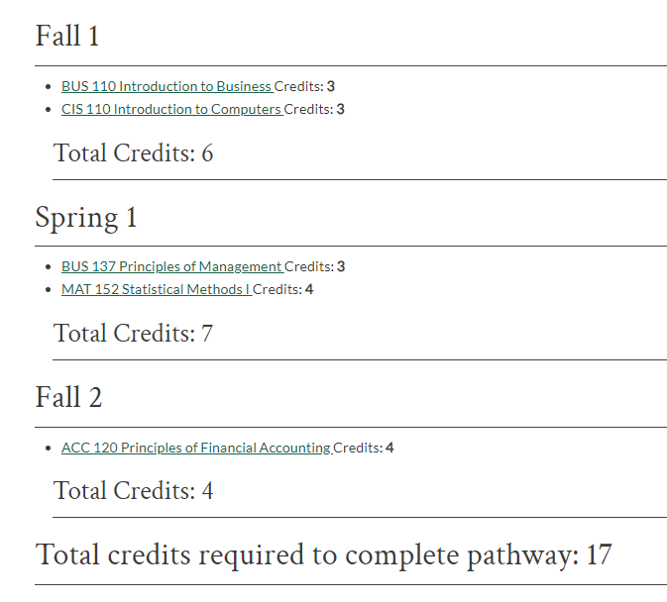
Business Administration - CCP Pathway
This certificate program provides graduates with a basic foundation in business administration. Credit earned in this program may be transferred toward an Associate in Applied Science Degree in Business Administration or an Associate in Applied Science Degree in Business Administration - Human Resource Management.
Upon successful completion of the Business Administration Core Certificate, the graduate should be able to:
  Prepare financial statements correctly
  Explain the role of management and its interrelationship with other functional areas in order to achieve organizational goals
  Identify legal and ethical issues that arise in business decisions and the laws that apply
  Apply marketing principles in organizational decision making
  Work as a contributing member of a team

Slide 13
DisAbility Access Services
Disability Access Services facilitates access to programs and services at GTCC through the provision of accommodations and services. All requests for accommodations/services must be supported by official documentation that includes a diagnosis of a disabling condition.
Contact das@gtcc.edu with questions.

Slide 14
Amazing in 8
Why 8-week Classes?
GTCC plans to convert most courses to 8-week sessions in the fall of 2025.
Eight-week classes will be a great opportunity for you because they let you focus on fewer subjects at a time, making it easier to keep up and do your best. You can finish your classes faster, which means you’re closer to reaching your goals. If life gets busy, you don’t have to wait long to start a new class since there are more chances to jump back in. Plus, finishing classes quickly will give you a big boost of confidence and keep you excited about learning!
The fall and spring semesters will include an 8-week Session 1 and an 8-week Session 2.

Slide 15
What are the Benefits of 8-week Classes?
More Focus. Eight-week classes are meant to be more efficient. That helps cut down on distractions, and you can concentrate better. Your peers taking these classes say they like how they can stay focused on their subjects.
Fewer Classes at a Time. You focus on 2-3 courses at a time, rather than 4-5 in a 16-week format.
Complete Faster. If you want, you may be able to complete more courses each semester. Cross more classes off your to-do list to get to your graduation goal.
Manage Your Time Better. Fewer classes each sessions give you more time for work and family, even when taking a full-time load.
Better Results. Many colleges and universities report students like you stay the course in school and graduate at a higher rate. So, you're not wasting time or money.

Slide 16
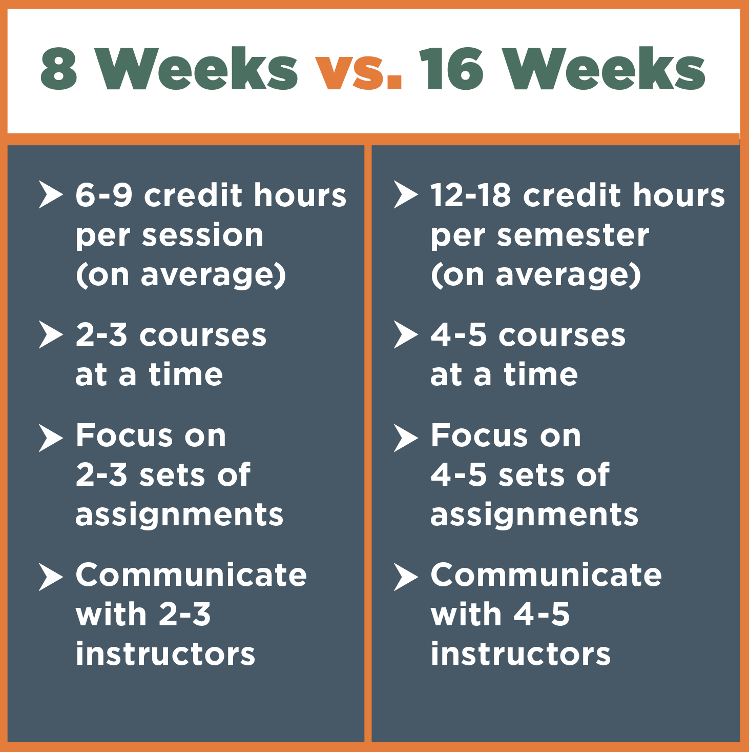
How do the Formats Compare?

Slide 17
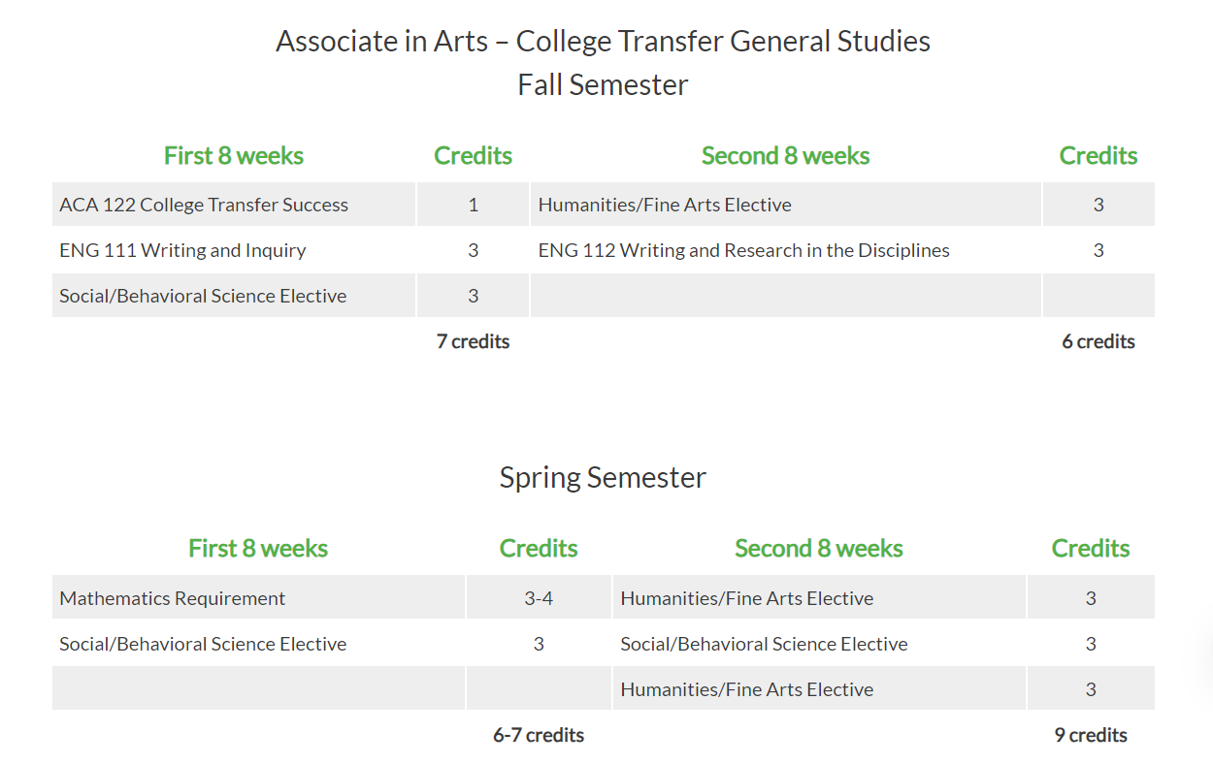
Example Schedule

Slide 18

Why is GTCC moving to 8-week courses?
  National research shows that the 8-week format improves learning and success.
  You will have to manage fewer courses at a time which could help you concentrate better and remember the information longer.
Do 8-week courses mean I can finish my degree faster?
  The 8-week format may allow you to complete your degree faster, especially if you are currently enrolled part time.
  To get the most benefit, you should take about half the number of credits (between six and nine credits) in each 8-week session compared to a 16-week semester (12-18 credits).
  There will be a limit of 11 total credits per 8-week session.
  You should work closely with your advisor to build a course schedule that supports your goals.

Slide 19
Will all classes be offered in 8-week sessions?
  Most courses will be offered in 8-week sessions, but a few will remain in a 16-week format because of high contact hours.
Would my course load increase?
  No! Your overall course load will not increase. Instead of taking four or five courses over 16 weeks, you'll take two or three courses in each 8-week session. The total number of credit hours per semester remains the same.
  This makes it easier for you to manage your time and focus on fewer classes.
How many classes do I have to take to graduate with an associate’s degree in two years?
  A college transfer student needs to average 15 credits (about five classes) per fall and spring semesters to graduate in two years, or 12 credits in fall and spring and six credits during the summer.
  Some applied science programs may require more than 15 credits per semester and/or summer classes to meet graduation requirements in two years.

Slide 20
How will the registration process work?
  You should continue to meet with your advisor to plan your classes.
  Students taking any courses in the first 8-week session must register for all their semester courses before the semester starts via ccp@gtcc.edu. They can also register for both 8-week sessions, giving them a full semester schedule.
  For students only taking courses in the second 8-week session, registration must be completed before the second session begins.
Will I need to register once or multiple times per semester under the 8-week model?
  You will only need to register once per semester. If you are taking courses in the first 8-week session and need to adjust your second 8-week session courses, you will be able to do so.
When do I pay fees/digital books?
  Charges are placed on your account when you register for your course(s). Payment for tuition and fees is due at the end of each registration period.
  Please visit the Cashier Office page for payment dates and deadlines.

Slide 21
CCP Application Process
The Application Packet includes:
  GTCC Application for Admission – Apply online using the CFNC CCP application. (Please include your social security number.)
  High School Transcript – Please request this through cfnc.org if you attend a public high school.
Additional Forms
  Verification of Student Eligibility Form – Please make sure that you have all signatures required and that you have included the pathway.
  Copy of Homeschool Registration Form – if applicable.
  High School Transcript – Please include this if you attend a private school or homeschool.
IMPORTANT NOTE:
Scan the additional forms and email them as attachments using the attach button to ccpadmissions@gtcc.edu. Do not copy and paste the forms into the body of the email.

Slide 22

Transcript
Send to GTCC
  Public School Students use CFNC
  All others email transcript to ccpadmissions@gtcc.edu
Required each semester
MUST list unweighted cumulative GPA
MUST list courses by grade level
MUST be signed and dated

Slide 23
Registration
Please disregard any emails or phone calls you get from GTCC regarding registration and orientation. They do not apply to high school students. Your information will come directly from the CCP office.
You must include the information requested or your registration will be delayed.
Please note:
You cannot register online.
All registration will be done through email.
The registration request must come from your GTCC email.
Registration requests from parents will not be accepted.
Do not send duplicate requests.
You can only register for classes in your pathway.
Allow 2 business days.
Confirmation – access your schedule in Self-Service.
Take the Online Success Seminar
Request for an advisement with your Student Success Coach/Advisor
Send your request for registration by email to CCP@gtcc.edu
  Include:
  Your name
  GTCC ID number (to get your ID # Log into Self-Service and go to User Profile)
  College Class with section number (Example: ENG 111-FJT01)

Slide 24
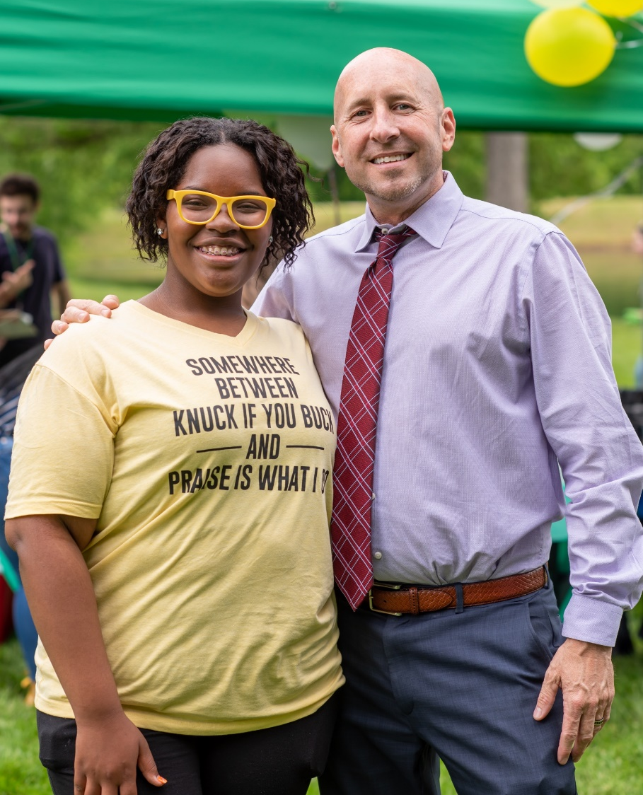
Orientation
Orientation is mandatory for all CCP students.
Instructions for completing orientation will be sent prior to the beginning of the semester.
Orientation includes information needed to get your student ID and books.
You will also receive tips on how to be successful in your college classes.

Slide 25

Fees and Books
Tuition is always waived for CCP students.
Fees must be paid by the due date or classes may be dropped.
Students are responsible for books unless arrangements have been made with your school.

Slide 26

Summer/Fall
2025
Important Dates
Priority Application Deadline
Summer and Fall
March 15th

Slide 27

Thank you!
Please email us at ccp@gtcc.edu if you have additional questions!
You can also visit www.gtcc.edu/ccp to view the pathways and find the forms that I mentioned earlier in this presentation.

