Slide 1
Welcome to the Academy at Lincoln!
Elementary Open House

Slide 2
Meet your teachers

Slide 3
Ms. Morgan Diiorio – ELA & 4th Grade SS
Hello! I’m Ms. Diiorio. I am thrilled to be your teacher this year! We are going to have a fantastic year filled with lots of learning and fun adventures. I graduated from NC State in May 2021 with a STEM Focused Elementary Education Degree. I have lived here in Greensboro since I was 4 years old and am happy to call it my home! My fiancé, Mante, and I have been together for 5 years and love spending time with our two cats. Some of my favorite things to do when I'm not teaching and spending time with my cats are reading, crafting, walking, and spending time with my family. I am so excited to have you in my class and can't wait to get to know you very soon!!

Slide 4
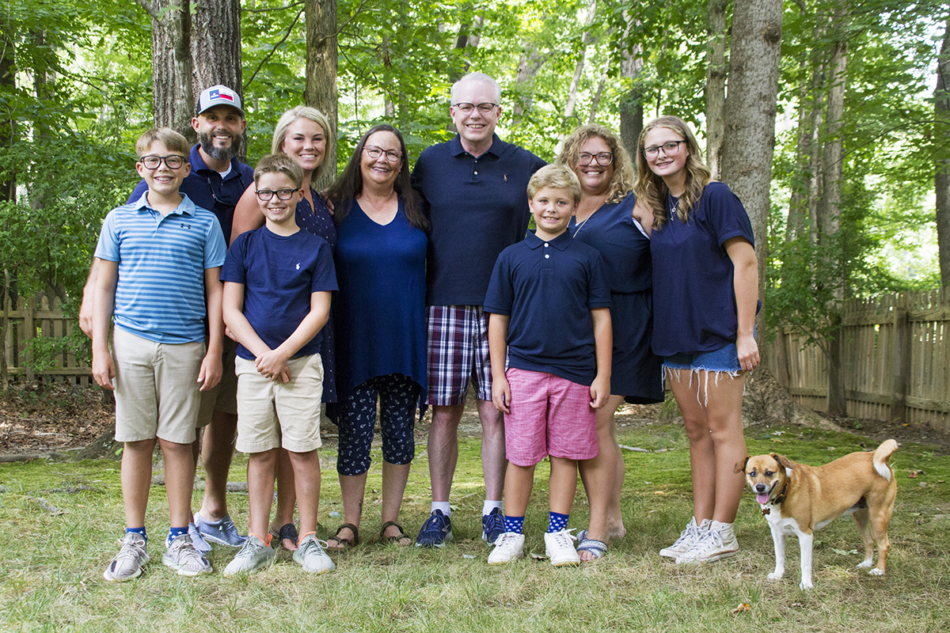
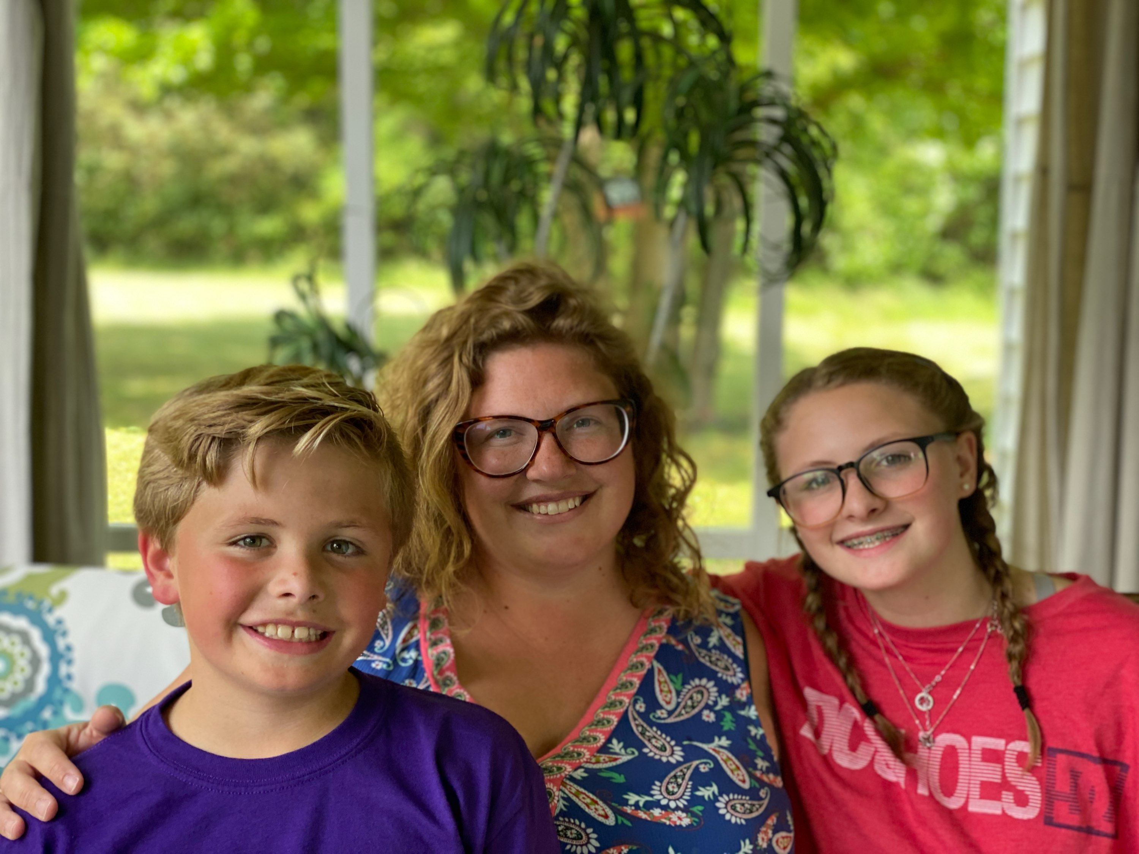
Ms. Ashley Geise – Math & 5th Grade SS
Hi! I’m Ms. Ashley Geise, and I am so excited to be your teacher! This is my 13th year teaching, and my fourth year at The Academy at Lincoln. My favorite subject in the entire world is math, and social studies is a close second! When I’m not teaching, my children Lillian (13) and Hayes (9) keep me very busy. We love playing outside, spending our summers by the pool, and watching, playing, and attending many sporting events. I pride myself on being a lifelong learner, and my motto is “learn something new every day.” I can’t wait to learn from each other this year! I am so happy to be back here at school with you! I have so many amazing things planned for this school year!

Slide 5
Ms. Katie Norwood Science & 5th Grade SS
Hi! I’m Ms. Katie Norwood! I'm very excited to be working with our students both new as well as returning from last year again this year teaching science and 1 class of social studies!! This is my 3rd year teaching VS at Lincoln, but my 14th year in education! I am originally from Virginia, and attended the University of Virginia, where I received a BA in History and an MT in Elementary Education with add-ons for Middle Grades Social Studies and Gifted Education. I live in High Point with my better half Cullen and our dogs Rocco and Dixie. When I’m not teaching, you can find us walking our dogs, gardening, and raising poultry! We have 6 backyard chickens and, just this past summer, we hatched our first quail chicks! Life definitely keeps me busy for sure!! I can’t wait for this school year – we have so many fun things planned for you!!

Slide 6
A typical day at lincoln

Slide 7
A typical day at Lincoln…
School begins at 9:20 and elementary students will dismiss at 4:10
You may begin dropping off at 9am in the car circle
Masks are mandatory in the building.
Social distancing of at least three feet will be maintained when possible.
Students will receive Universal breakfast and lunch
Students will go through the cafeteria line and bring items back to class
Families are encouraged to still complete a free and reduced lunch application
Students will not use lockers, they will take bookbags from class to class. When possible, err on the side of a smaller bookbag, as space is limited in classrooms and we don’t want tripping hazards.

Slide 8
A typical day at Lincoln….
2021-2022
Elementary Supply List

Slide 9
Daily Schedule
Homeroom | 9:00-9:20
Core 1 | 9:20-10:30
Core 2 | 10:33-12:12
Lunch | 10:50-11:17
Core 3 | 12:15-1:25
Core 4 | 1:28-1:47
Encore | 1:50-2:35
Back to Core 4 | 2:38-3:29
Homeroom | 3:30-3:35
Recess | 3:35-4:05
Dismissal | 4:10

Slide 10
Dismissal Procedures
Dismissal Procedures – Car rider line
Please arrive by 4:00
Display your sign in your dashboard
Proceed to the circle, in either the inside or outside lane
If you arrive BEFORE 4:10, you may bypass the line and proceed to the circle. Follow the signs that are posted.
If you arrive AFTER 4:10, you must remain in the line, as there will be two way traffic.
Students will be dismissed at 4:10

Slide 11
Health & Safety
We do not plan to do questionnaires and contact tracing, at this time, due to masking
We do anticipate students that may have to be out for extended periods of time
We will utilize Canvas to communicate with students when they are absent.
Notes will be posted, as well as assignments that will be graded.
It will be the student’s responsibility to check Canvas and complete and submit the work that is posted for the days missed, according to the make-up policy.

Slide 12
Encore/enrichment

Slide 13
Encores Offered
PE | Ms. Frederick/Ms. Haggerty
Art | Ms. Casto/Ms. Arante
Music | Ms. Zaruba/Mr. Parnell
Drama | Ms. Whitley/Ms. Damman
Exploratory Language | Mr. Proano

Slide 14
Ms. Arante - Art
Ms. Arante grew up in Forest City, NC and graduated from Rutherford-Spindale High School. She then moved to Greensboro and graduated from UNC Greensboro with a BFA with a concentration in Painting and Arts Education. Ms. Arante has been a GCS teacher since 2012 and a teacher at The Academy at Lincoln since 2018.
Ms. Arante enjoys copious amounts of coffee and hot tea, spending time outdoors and watching spooky movies. She is a mom to two cats and too many chickens, and is currently trying to keep a green thumb.
Contact Info email: arantem@gcsnc.com Google Voice:336-484-1694

Slide 15
Ms. Casto - Art
I am thrilled to be teaching art to Grades 4 and 5 during the 2021-2022 school year. This is my fifth year teaching with Guilford County Schools, and my second year at Lincoln. Pablo Picasso said, "Every child is an artist. The problem is how to remain an artist once he grows up." I keep this in mind as I work to build confidence and resilience in young artists.
I came to education from a career as an artist. I am originally from West Virginia, where I worked for a company that made printed paper products and imported gifts and toys. My art appeared on things that people purchased in stores or from catalogs. We licensed the rights to make products featuring characters from Walt Disney, Mattel, and Hasbro, and I had the awesome privilege of working with their studio artists on design concepts. I moved to North Carolina in 1994 and worked as a graphic designer and art director at Carson-Dellosa Publishing in Greensboro. Later, I worked as artist/designer at a gift wrap company in Reidsville. I love to draw and paint with watercolors, gouache, and acrylics, but I also like to create digital art.
My hobbies include reading, writing, gardening, and cooking. I have a BA in psychology/studio art and art history, and a Master's degree in Public Administration. I live in High Point with my two cats, William and Kate.

Slide 16
Ms. Damman – Dance/Drama
Katherine Damman is a third year teacher at Lincoln Academy where she teaches Dance to 4th-8th grade. She started dancing in Middle School and went on to study Dance Education at UNC Greensboro. She currently assists in coaching the UNCG Dance Team and teaches Barre classes outside of school. She enjoys being the head of the dance department at Lincoln and is dedicated to allowing students to experience dance at all levels.

Slide 17
Dance Syllabus
Please take a look at the syllabus for dance. Contact Ms. Damman if you have questions.

Slide 18
Ms. Frederick - PE
Hey friends, my name is Iesha M. Frederick! I am so excited to be the Elementary Physical Education teacher at Lincoln Academy! I came to Greensboro in 2009 for college but I am originally from Warsaw, North Carolina. This will be my 7th year with Guilford County Schools and my 2nd year as Physical Education teacher at Lincoln!
Education:
North Carolina Agricultural and Technical State University, 2013: B.S. Sports Science and Fitness Management; Business Administration Concentration
Drexel University, 2019: Master of Legal Studies; NCAA Compliance and Sports Law
Currently pursuing a Doctorate in Education, Educational Leadership and Management
Hobbies :Watching scary movies, coaching sports, attending sporting events, and traveling

Slide 19
Ms. Haggerty - PE
Hi! I'm Ms. Haggerty, and I am so excited to be your teacher this year. This is my third year teaching and my third year at the Academy at Lincoln. I am also the Girls’ Soccer Coach here at Lincoln. I graduated from Greensboro College with a Bachelor of Science in Health and Physical Education. When I'm not at school, I enjoy spending time outdoors, spending time with family, as well as watching movies.
Contact Info:
Email: haggera@gcsnc.com
Phone: (336) 939-6702

Slide 20
Mr. Parnell - Music
Mr. Parnell graduated from UNCG with a Bachelor's and Master's degree in Music Education. In his 13 and a half years of teaching, Mr. Parnell has taught elementary music, middle school band, chorus, and orchestra as well as High school Marching Band. He is looking forward to working with all his students at the Academy at Lincoln.

Slide 21
Mrs. Whitley - Drama
Mrs. Whitley is super excited to get to know all of you this year. She is a very proud wife and a mother of 2 wonderful children. In 2009, Mrs. Whitley graduated from The University of North Carolina at Greensboro with a BFA in Theatre Education. This year will be Mrs. Whitley’s 13th year as the theatre director at Lincoln. She was very excited and humbled to be named the 2020-2021 Lincoln Teacher of the Year and in 2016, she was the Guilford County Schools Arts Educator of the Year. As the director of theatre at Lincoln, Mrs. Whitley takes great pride in her program. She enjoys getting to know new people and helping students find a passion for theatre! This year Mrs. Whitley is excited to announce that we will have auditions for our fall show- Bestest Bedtime Stories as Told by our Grandpa. (He’s Silly). In the Spring we will audition Moana Jr. Sign ups for the fall show are located outside of the band room now. Any elementary student is welcome to audition. Please see Mrs. Whitley with any questions. (Her classroom is in mobile unit 2)

Slide 22
Ms. Zaruba – Music
Hi! I'm Ms. Zaruba, the Chorus and Piano and General Music teacher here at Lincoln. This is my second year at Lincoln and my tenth year teaching overall. I am a Greensboro native, and a Grimsley High School alum (Go Whirlies!) I graduated in 2012 from East Carolina University and am licensed to teach music in grades K-12. After spending the first years of my career in eastern NC, I am so happy to be back to teach in my hometown. When I'm not teaching, I love cooking, watching movies, and hanging out with my cat, Sybil.

Slide 23
VS Program

Slide 24
Welcome, Mr. Holland!
Will Holland serves as the AG Nurture Specialist at The Academy at Lincoln. His role is that of liaison between the parents of AG students and the school. Mr. Holland can be reached at hollanw@gcsnc.com

Slide 25
Ms. Scott – Curriculum Facilitator
Ms. Scott is the Curriculum Facilitator at The Academy at Lincoln. She is a great resource for any testing or curriculum questions that may arise. She can be reached at scottr2@gcsnc.com

Slide 26
What makes us different?
Vertical alignment from 4th-8th grade
William & Mary Curriculum
Competition → Collaboration
Procedural → Conceptual
Engaging Instructional Methods and Curriculum Models used
Market
Want to know more about the VS Program at The Academy at Lincoln? Refer to this website for more information:
https://sites.google.com/view/vsatlincoln/home

Slide 27
What makes us different?
Project-Based Learning
Many opportunities to participate in clubs.
Weekly SELFriday lessons
Growth Mindset
Engineering Design Cycle
Science Fair
Want to know more about the VS Program at The Academy at Lincoln? Refer to this website for more information:
https://sites.google.com/view/vsatlincoln/home

Slide 28
Communication
Every weekend, you can expect a newsletter from the elementary team.
Curriculum Updates
Important Events
A current email address is extremely important for us to have on file.
Please feel free to email us anytime!
geisea@gcsnc.com
diioria@gcsnc.com
norwook2@gcsnc.com
Grades updated each Friday on Powerschool.

