Slide 1
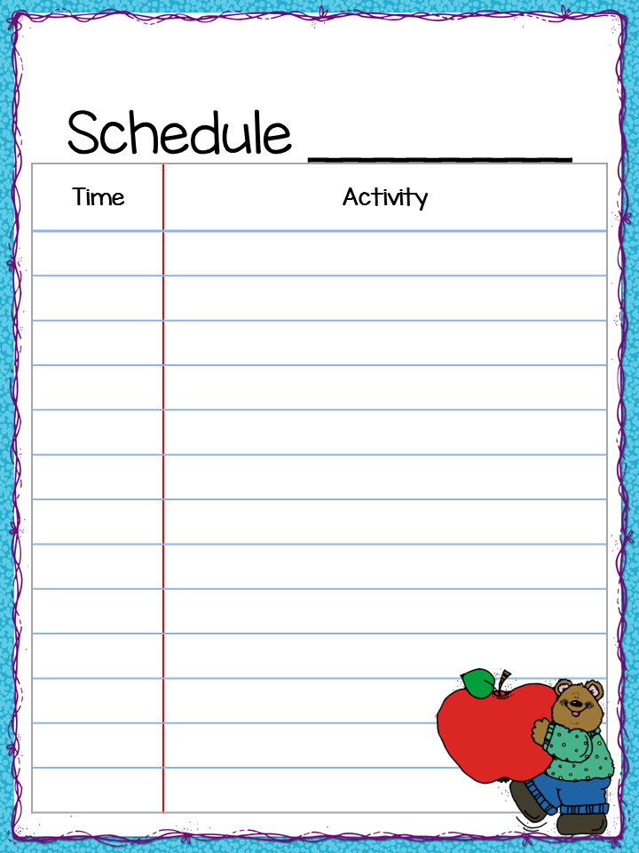
Ms. Williams
Monday & Friday
7:20-7:55 | Morning Enrichment
8:00-8:10 | Teacher Directed
8:10- 8:55 | Guided Reading - CKLA
9:00 -10:00 | Phonics - CKLA
10:00-10:20 | ELA - CKLA
10:20-11:05 | Specials
11:10-11:45 | ELA - CKLA
11:55-12:25 | Lunch
12:20-1:25 | Math
1:25-1:55 | Recess
1:55-2:25 | Science/Social Studies
J. Ross © 2014 Teacher by the Beach

Slide 2
Ms. Williams
Tuesday
7:20-7:55 | Morning Enrichment
8:00-8:10 | Teacher Directed
8:10- 8:55 | Guided Reading - CKLA
8:55-9:55 | Phonics - CKLA
9:55-10:55 | Specials
11:00-11:45 | ELA – CKLA
11:55-12:25 | Lunch
11:20-1:20 | Math
1:20-1:50 1:50-2:25 | Recess Science/Social Studies
J. Ross © 2014 Teacher by the Beach

Slide 3
Ms. Williams
Wednesday
7:20-7:55 | Morning Enrichment
8:00-8:10 | Teacher Directed
8:10- 8:55 | Guided Reading - CKLA
9:00 -10:00 | Phonics - CKLA
10:00-10:30 | ELA - CKLA
10:35-11:15 | Specials
11:20-11:45 | ELA- CKLA
11:55-12:20 | Lunch
12:20-1:20 | Math
1:20-1:50 | Recess
1:50-2:25 | Science/Social Studies
J. Ross © 2014 Teacher by the Beach

Slide 4
Ms. Williams
Thursday
7:20-7:55 | Morning Enrichment
8:00-8:10 | Teacher Directed
8:10- 8:55 | Guided Reading - CKLA
8:55-9:55 | Phonics - CKLA
9:55-10:35 | Specials
10:35-11:20 | ELA - CKLA
11:20-11:40 | RTI/Guided Reading
11:55-12:20 | Lunch
12:20-1:20 | Math
1:20-1:50 | Recess
1:50-2:25 | Science/Social Studies
J. Ross © 2014 Teacher by the Beach

