Slide 1
Theatre with Ms. Mishra
Semester 2

Slide 2
Classroom expectations
Arrive on time
Come to class ready to learn and work
Help keep our spaces and supplies in good repair
Treat your ensemble and director(s) with respect
Do not eat in the classroom unless given permission
Absolutely no gum

Slide 3
Attendance
Attendance will be taken at the beginning of every class, if you are not present it will be marked on the attendance document.
Students who are late are responsible for keeping up with class journals.
Students who are present on time every day in the week will go into a drawing for a prize at the end of the week.
Students who are late 2 or more days will receive a check in with your adults at home and may receive further consequences.

Slide 4
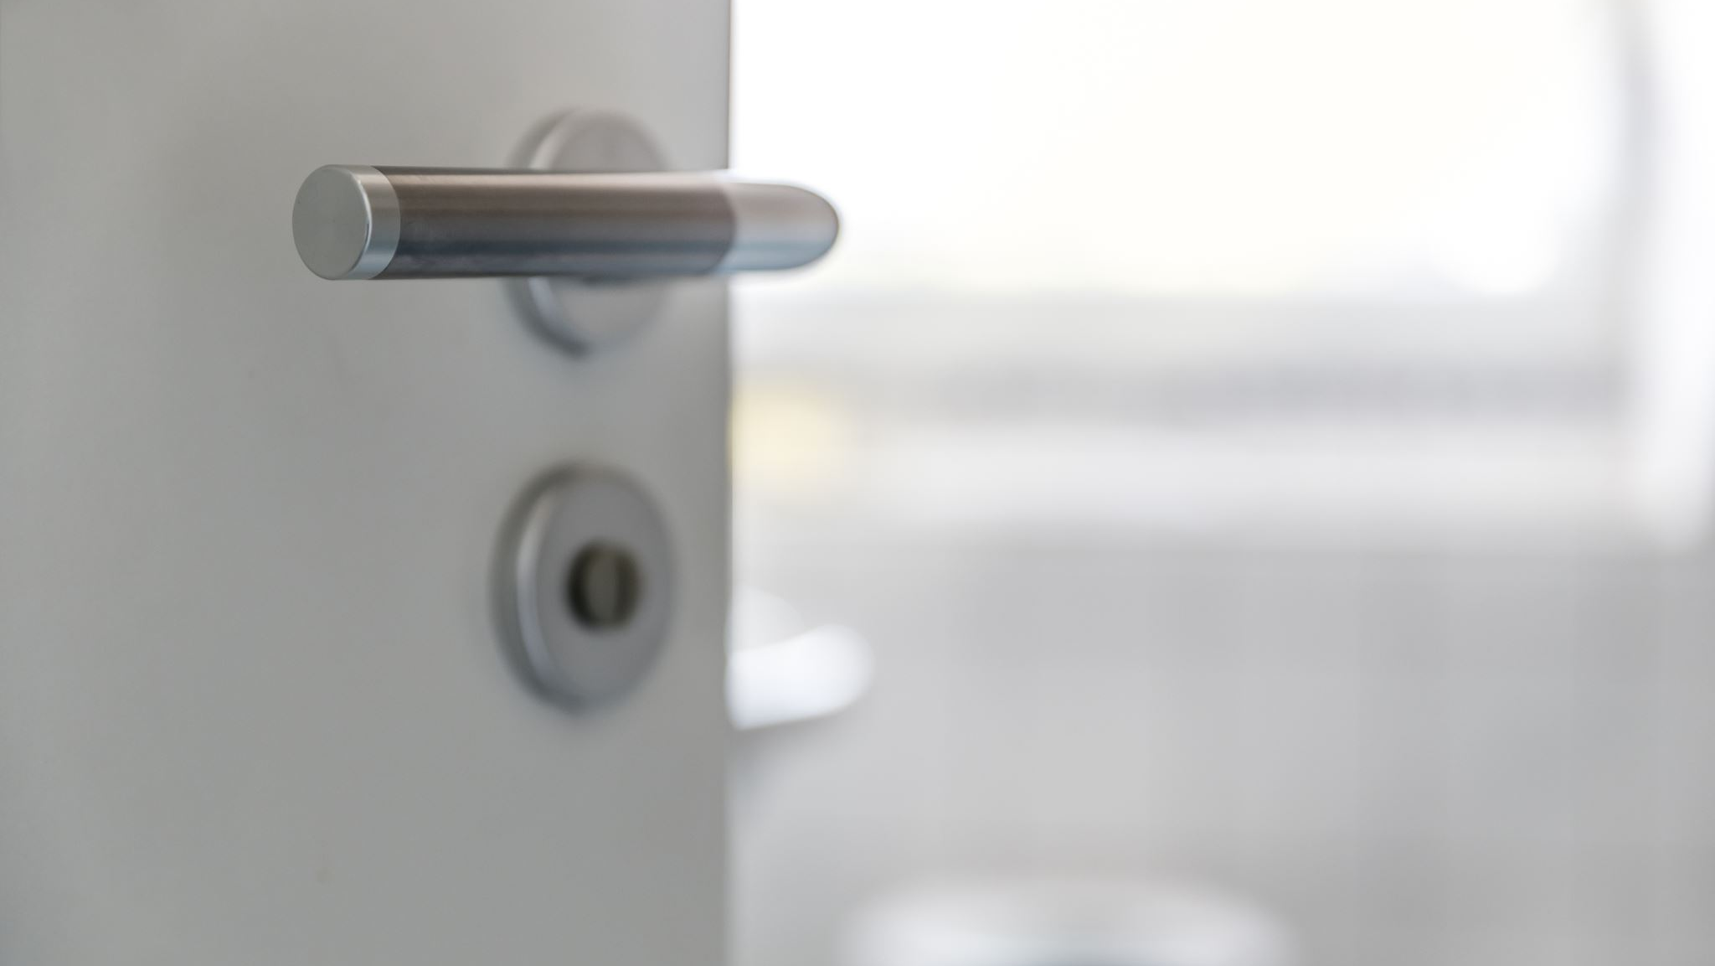
Bathroom
At the beginning of each quarter each student will receive a pass with 8 spaces to be used for bathroom/ water breaks.
Student names and class periods will be written on each pass and are the sole responsibility of the student to keep track of.
If you loose your pass, a new one will not be issued.
At the end of the quarter any unused spaces may be redeemed for prizes.
If you need to use the restroom, write your name on the whiteboard and I will check in when you may leave the classroom.

Slide 5
journals
Journals will be completed in the first 5 minutes of class everyday as students enter the classroom.
Journal prompts must be completed in complete sentences unless the prompt says otherwise.
Students are responsible for catching themselves up on any missed journals.
Only responses in your class journal will be accepted for grading: no looseleaf paper.
Journals will be graded once a week and are worth 5 points apiece (date:1pt; complete sentences:1pt; on time:1pt; fully answers the prompt:2pts).
Late journals will be accepted up to 2 weeks after the grade is posted.

Slide 6
Other grades
Class engagement: each week, you will earn a grade for engagement in class. Your preparedness, participation in class discussions, effort in group work, and appropriate use of class time will be factored into this grade.
Performance assignments: over the course of the semester you will have performances that take place in class. For these assignments, there will be progress benchmarks throughout the rehearsal process and your final performance will be assessed with a rubric.
Miscellaneous assignments: worksheets, design projects, etc.

Slide 7
Spotlit Students
This semester, I want to give our theatre classes the opportunity to be recognized for their skill, hard work, creativity leadership, etc..
Each week you will be invited to nominate your classmates for the spotlight.
Nominations are anonymous, but must include why you are nominating your classmate.
At the end of the week, I will go through the nominations and select a student for the spotlight.
Students will receive any nominations submitted for them.

Slide 8
today’s Activity
Let’s get to know each-other!
With your assigned partner, take turns taking on the role of news reporters/ red carpet correspondents and celebrities.
Reporters should ask the interview questions on their list, ‘celebrities’ should answer as their actual selves.
Tomorrow, we will introduce our partners to the class!

Slide 9
Homework
You won’t have a ton of homework for this class, but you will need to rehearse/practice, work on some projects, and complete classwork that you may be behind on on your own time.
For tomorrow: take home your class syllabus/contract and have your adults sign it and bring it back to class.
The class that gets all of their syllabi in first will earn a treat!

Slide 10
Ensemble Games
,When we have time remaining at the end of class, we may be able to play different ensemble games that we will learn over time.
Today we are going to start off with a classic theatre game: Zip, Zap, Zoop

